Slide 1
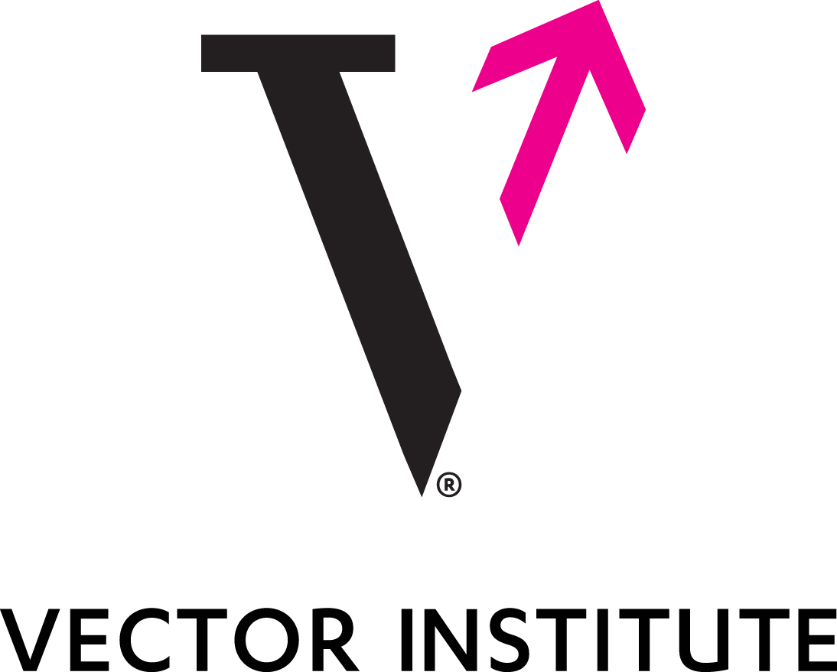
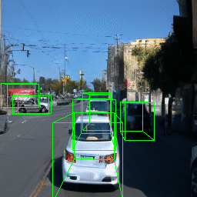
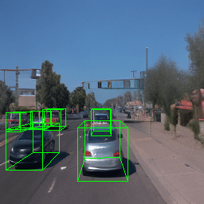
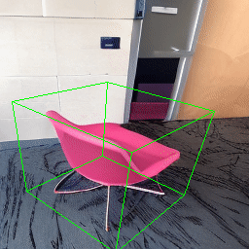
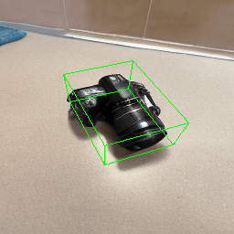
Neural Assets:
3D-Aware Multi-Object Scene
Synthesis with Image Diffusion Models
Ziyi Wu, Yulia Rubanova, Rishabh Kabra, Drew A. Hudson, Igor Gilitschenski, Yusuf Aytar, Sjoerd van Steenkiste, Kelsey R. Allen, Thomas Kipf
Project page: https://neural-assets.github.io/
NeurIPS 2024
Spotlight
Notes:
We present Neural Assets, this project is done when I was a Student Researcher at Google DeepMind. It has been accepted by NeurIPS 2024 as a Spotlight presentation

Slide 2
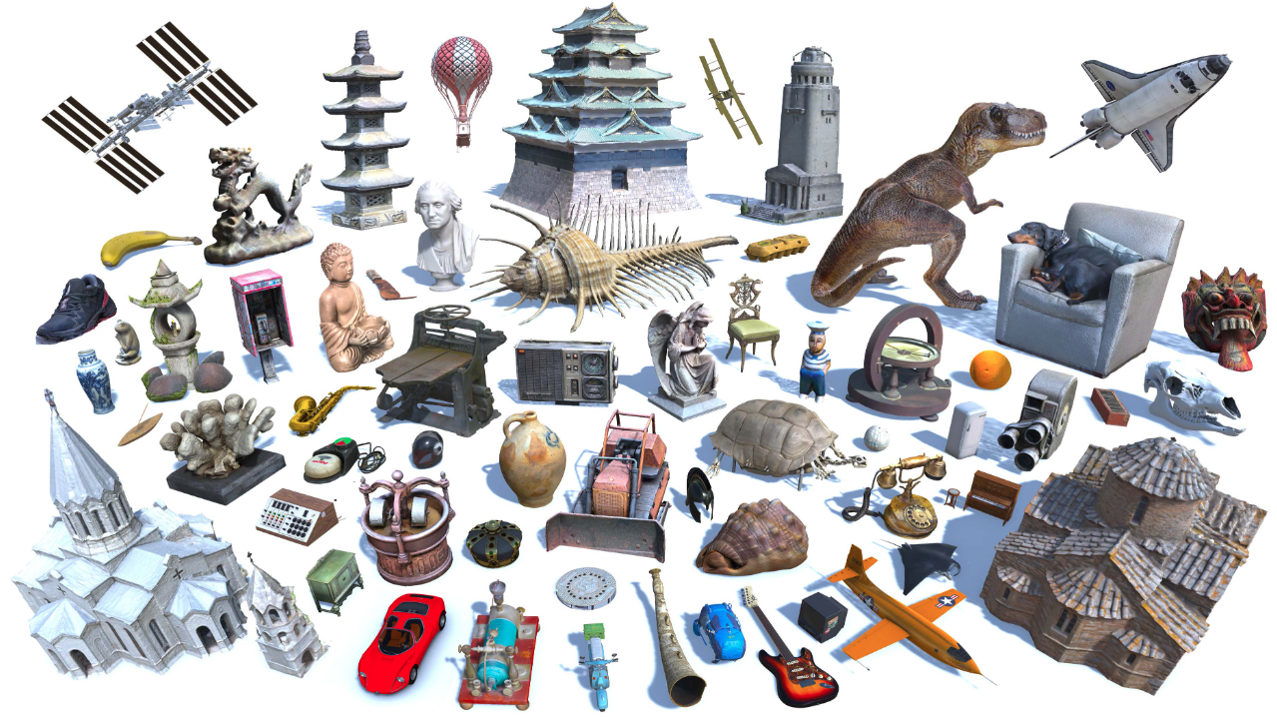
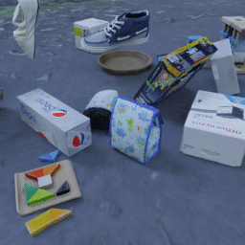
Motivation
Traditional computer graphics workflows usually involve
1) the creation of 3D assets
2) the animation of them
Can recent generative models do so?
Deitke, Matt, et al. "Objaverse-xl: A universe of 10m+ 3d objects." NeurIPS. 2024.
Greff, Klaus, et al. "Kubric: A scalable dataset generator." CVPR. 2022.
Zheng, Yang, et al. "PointOdyssey: A large-scale synthetic dataset for long-term point tracking." ICCV. 2023.
Notes:
Our motivation comes from traditional graphics workflow, which often involves two steps:
the creation of 3D assets like object meshes,
and the animation of them to achieve interesting scenes
In this paper, we ask the question: can we replicate such process in recent generative models?

Slide 3
Text-Guided Image Generation
Recent text-to-image diffusion models (DMs) are impressive
However, they lack precise spatial control of objects
https://deepmind.google/technologies/imagen-3/
Notes:
Recent advance in diffusion models enables us to generate almost anything describable using text. However, these models lack precise spatial control of objects
For example, if I want to move this ballon left for 10 pixels, it’s very hard to accurately describe it using text.
And what if we want to rotate this object a bit. The model is never trained on 3D rotation angles, so it’s impossible to do so

Slide 4
Prior Works: 2D Spatial Control in DMs
Condition pre-trained DMs on semantic layouts
2D boxes, masks, points, etc.
Li, Yuheng, et al. "GLIGEN: Open-set grounded text-to-image generation." CVPR. 2023.
Wang, Xudong, et al. "InstanceDiffusion: Instance-level Control for Image Generation." CVPR. 2024.
Notes:
There are many works trying to inject 2D spatial control to image generators via bounding boxes, object masks and so on

Slide 5
Prior Works: 2D Spatial Control in DMs
Limitations: cannot directly specify the 3D pose of objects
Existing DMs exhibit a pose-bias
Prompt: “a chair”
Bears are all forward-facing!
Wang, Xudong, et al. "InstanceDiffusion: Instance-level Control for Image Generation." CVPR. 2024.
Rombach, Robin, et al. "High-resolution image synthesis with latent diffusion models." CVPR. 2022.
Notes:
However, they can only specify a rough location of the object, while the 3D poses is undetermined. As a result, many generated objects are just forward-facing
As pointed out by a famous work Zero-123, this is because of the training data bias. For example, most of the chairs in training images are forward-facing, so if you prompt the model to generate a chair, it will generates mostly the front-view of the chair

Slide 6
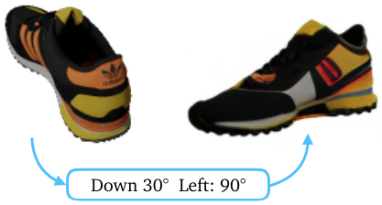
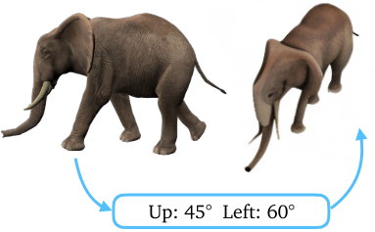
Prior Works: 3D-Aware Image DMs
Condition DMs on 3D poses:
3DiM & Zero-1-to-3
Limitations: single-object, no background
Input
Novel View
Input
Novel View
Watson, Daniel, et al. "Novel view synthesis with diffusion models." ICLR. 2023.
Liu, Ruoshi, et al. "Zero-1-to-3: Zero-shot one image to 3d object." ICCV. 2023.
Notes:
Inspired by this, the pioneering work 3DiM and Zero-123 propose to condition DMs directly on 3D poses, and can achieve 3D pose control such as rotating the object
However, these models are only designed for single object images without backgrounds. It’s not directly applicable to real-world images

Slide 7
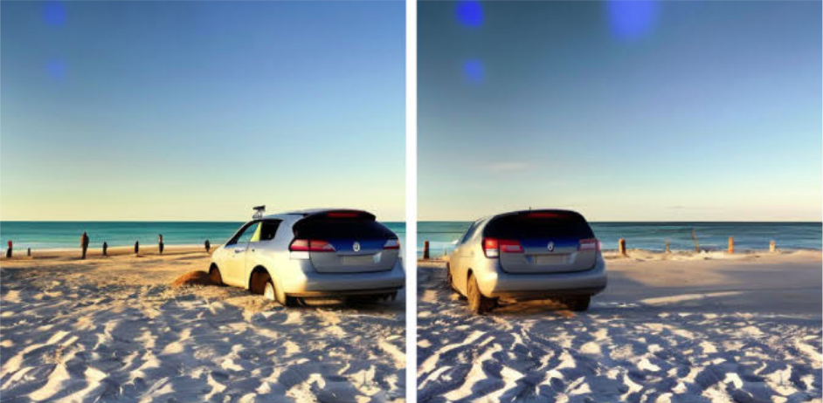
Prior Works: 3D-Aware Image DMs
Recent works on images with backgrounds
3DIT: trained on synthetic data, single-object
Diffusion Handles: single-object, only small rotation
3DIT
Diffusion Handles
Michel, Oscar, et al. "Object 3DIT: Language-guided 3d-aware image editing." NeurIPS. 2023.
Pandey, Karran, et al. "Diffusion Handles: Enabling 3D Edits for Diffusion Models by Lifting Activations to 3D." CVPR. 2024.
Notes:
Finally, some recent works start to look into images with backgrounds. I’ll cover two representative works here
3DIT uses Blender to simulate paired images before and after applying a 3D transformation, and fine-tunes Stable Diffusion to solve this as an image-to-image translation problem. However, it’s trained on synthetic data, so there is always a sim-to-real gap here. In addition, it can only control one object in one model forward pass
Diffusion Handles instead uses depth map and image wrapping to perform 3D-aware editing. Again, it can only control single object. Also the use of depth map prevents it from doing large rotation of objects

Slide 8
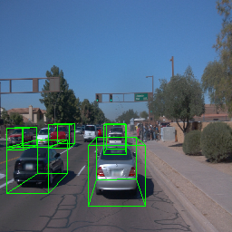
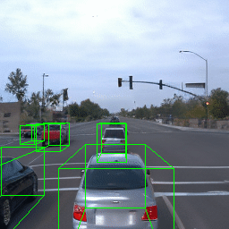
Prior Works: Subject-Driven Image Generation
Goal: learn a subject and synthesize it in new contexts
Limitations: >1 ref image, single subject, no spatial control
Ours: one reference image, multi-subject, 3D pose control
4 images, 1 subject
No control
1 image, 5 subjects
3D pose control
Ruiz, Nataniel, et al. "DreamBooth: Fine tuning text-to-image diffusion models for subject-driven generation." CVPR. 2023.
Notes:
Finally, our work is also related to the task of subject-driven image generation. The goal of this task is to learn a special token representing a subject from some reference images, and then synthesize it in new contexts
Yet, these methods typically require multiple reference images, can only learn a single subject, and most importantly, cannot control their spatial location in the generated image. As you can see, they are mostly just centered
In contrast, we only require 1 reference image, and can control the 3D pose of multiple subjects

Slide 9
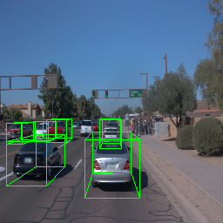
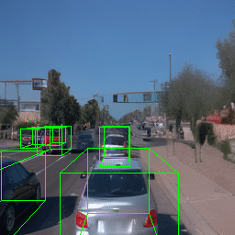
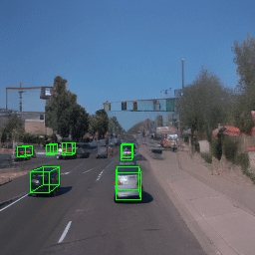
Problem Formulation
Given a source image with multiple objects, we want to
Learn a neural representation of each object
Manipulate them in a physically-plausible way
Neural Assets – multi-object 3D control from a single source image
Source Image
Translate
Rotate
Rescale
Sun, Pei, et al. "Scalability in perception for autonomous driving: Waymo open dataset." CVPR. 2020.
Notes:
Concretely, this work aims to learn a representation of each object in a source image,
that enables manipulating them in a physically-plausible way, such as translation and rotation
We present a novel Neural Assets representation to achieve all these goals

Slide 10
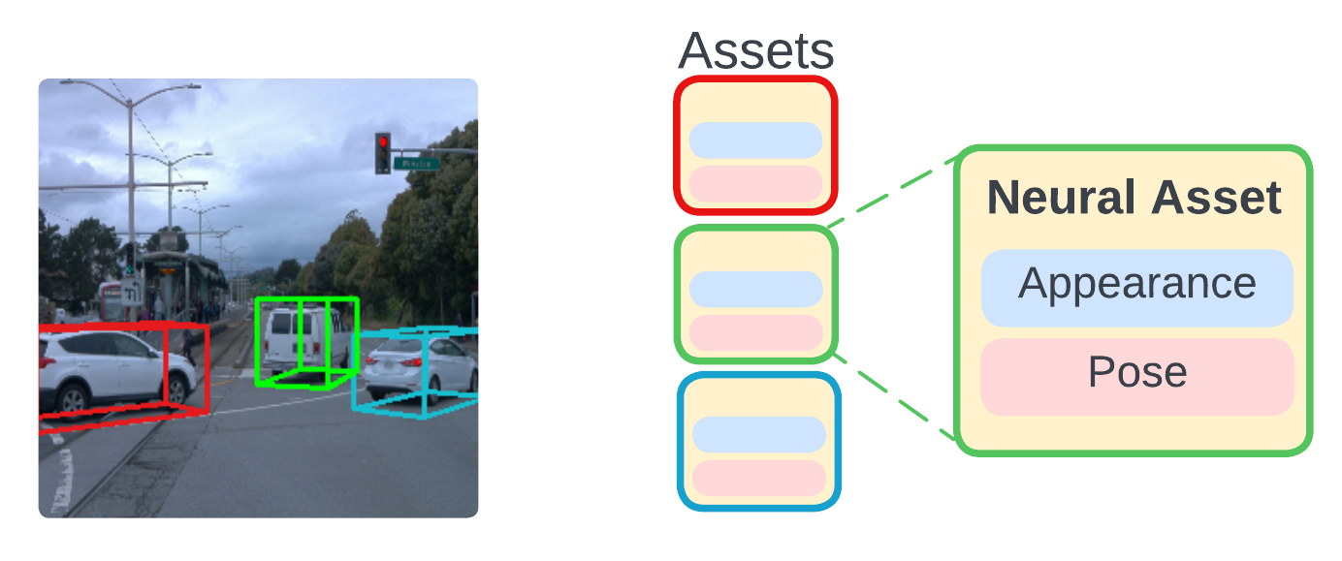
Method: Neural Assets
What can we learn from Computer Graphics workflows?
3D assets are reusable, with a fixed appearance (e.g. canonical 3D shape & texture)
Creators only change their pose (e.g. rigid transformation & scaling)
Neural Asset: per-object representation, factorized into disentangled appearance and pose tokens
Notes:
Recall the CG pipeline we talked about at the beginning. What can we learn from it?
First, once created, 3D assets are reusable across scenes since they have a fixed appearance. Then, people only need to adjust their 3D pose to animate them.
Therefore, our Neural Asset representation also consists of an appearance token, and a pose token

Slide 11
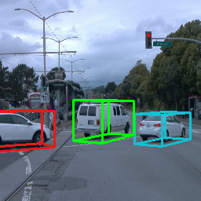
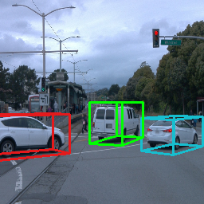
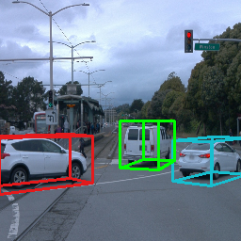
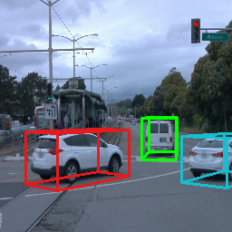
Method: Neural Assets
But, what data should we use?
Need: same object under different poses
Hard to obtain in real world…
Video as a scalable data source!
Notes:
But what training data can we use to learn such disentangled representation? In theory, we need paired images with the same set of objects but under different poses. But such data is very hard to obtain in real-world. This is why prior work like 3DIT decides to use synthetic data
Instead, we propose to use real-world videos as a scalable data source. As you can see from this example, the cars move over time thus their poses are changing, but their identity is the same

Slide 12
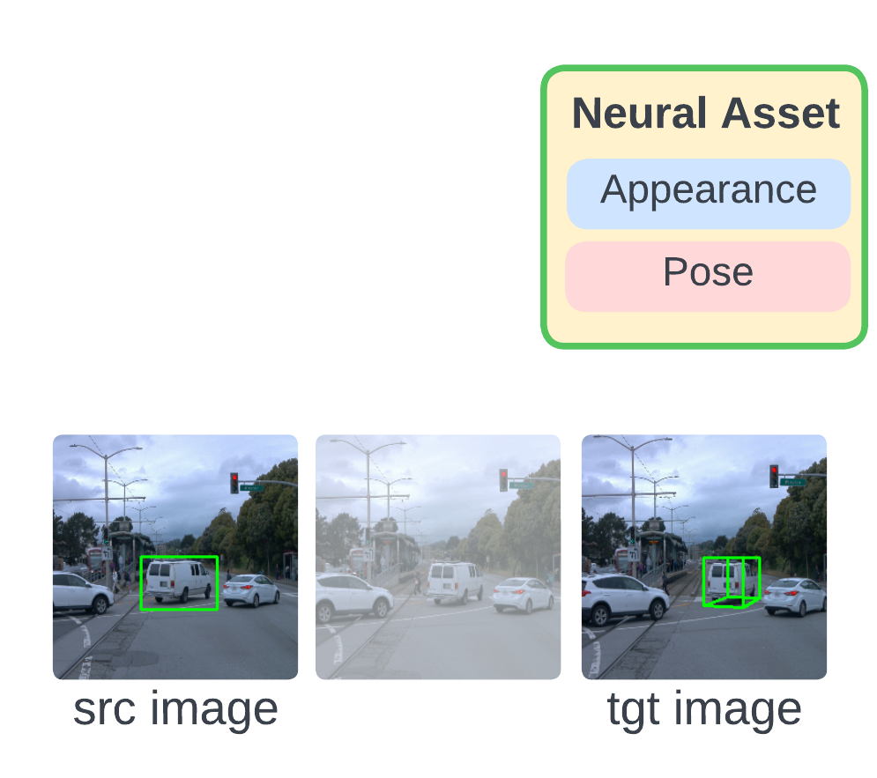
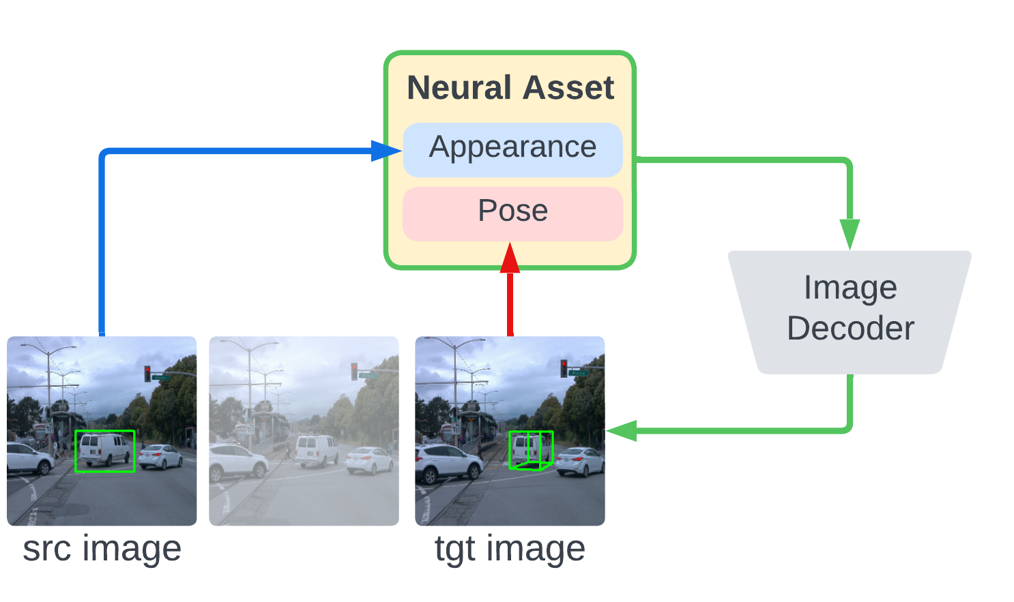
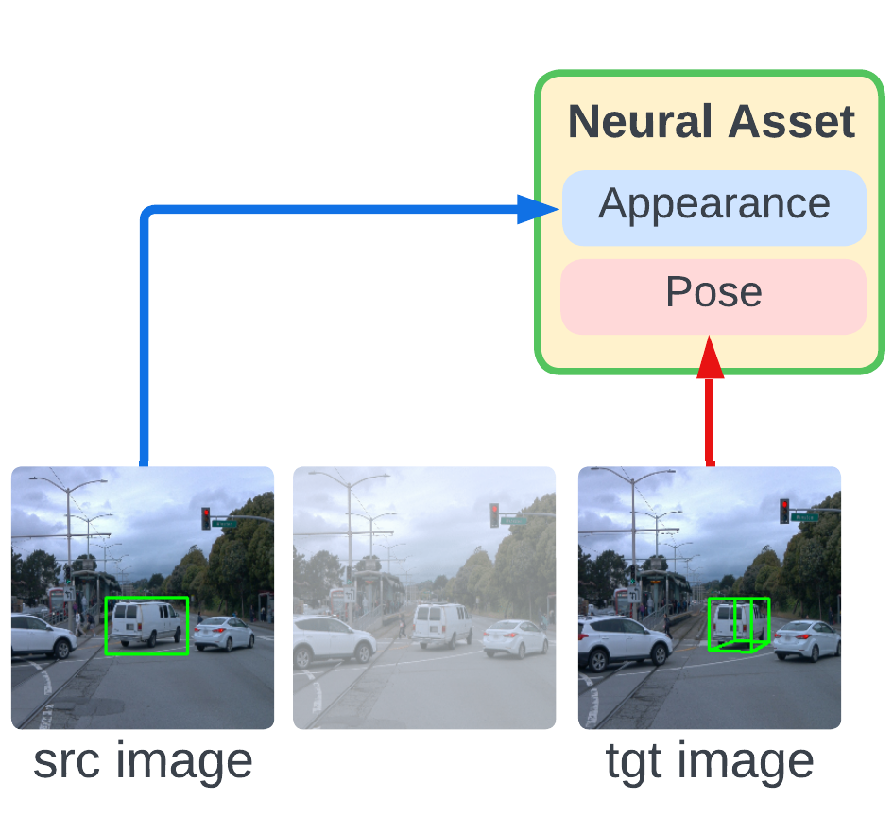
Neural Assets Learning
How to disentangle appearance and pose?
High-level idea: encode them from different video frames
Appearance token is pose-invariant
Notes:
At a high-level, given a video, we randomly sample 2 frames from it, called source and target images
Then, we encode the object appearance token from the source image, and the object pose token from the target image
Finally, we run a decoder to reconstruct the target image from the encoded appearance and pose tokens. The reconstruction loss serves as the training signal for the entire pipeline
When encoding the source appearance token, the model does not know which target image we will use. So in order to reconstruct the object under any target pose, the model has to learn object appearance under a canonical pose, similar to a 3D asset in CG
On the other hand, to minimize the reconstruction loss, the decoder has to render all the visual effects of objects such as shadows and occlusions. It cannot just do copy pasting but has to understand the object-background interaction as we will see in the experiments

Slide 13
Neural Assets Architecture
Appearance: RoIAlign with 2D boxes
Pose: MLP over 3D bbox coords
BG: independent background modeling
Decoder: an image diffusion model
+ rel. camera pose
He, Kaiming, et al. "Mask r-cnn." ICCV. 2017.
Notes:
Concretely, we first extract image feature maps with an encoder, and use RoIAlign to extract appearance tokens. For pose tokens, we take the corner coordinates of object 3D bounding boxes, and pass it to an MLP.
The decoder can be any image diffusion model, where we stack the Neural Assets of all objects to a sequence, and condition the diffusion model on it
Notably, here we have an additional background token input. Its appearance token is from the entire image where we mask out objects to prevent foreground information leak. Its pose token is the relative camera transformation between source and target images. This helps the model differentiate global camera motion and local object movement

Slide 14
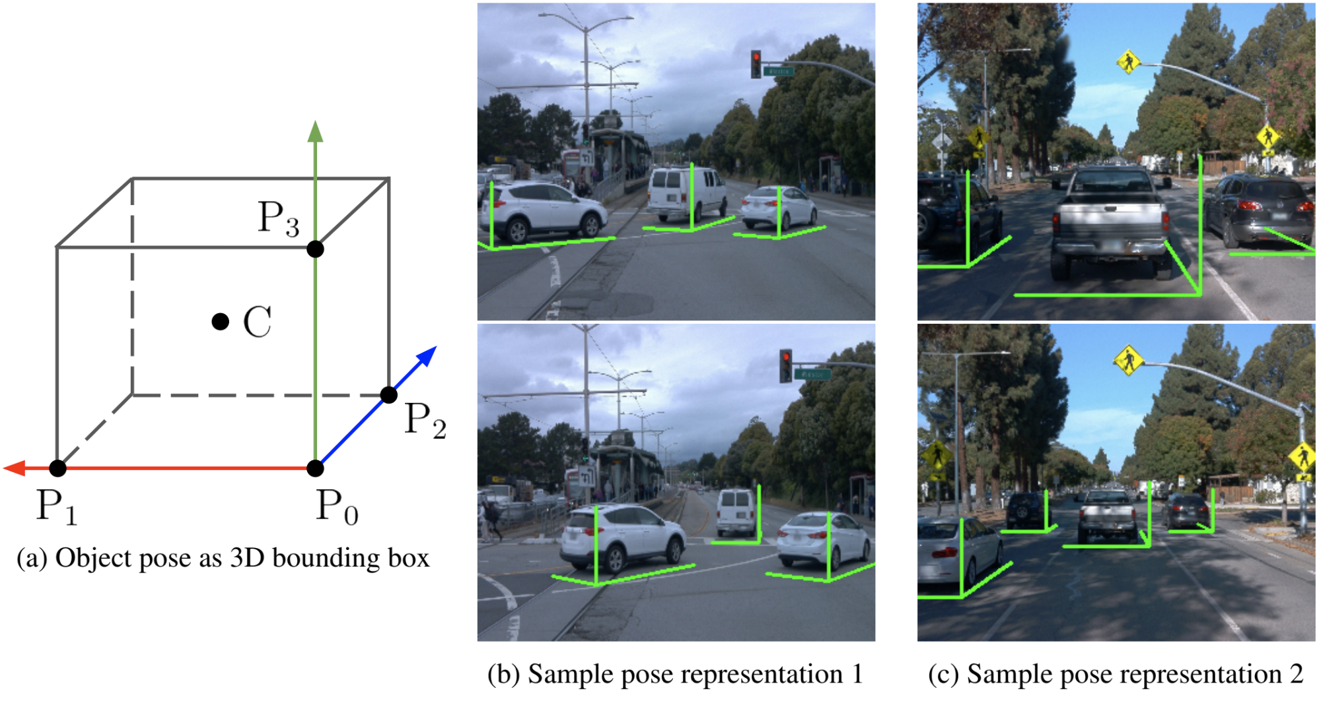
Neural Assets: 3D Pose Representation
One option: (center, size, quat), common in 3D object detection
Ours: concat 4 corners (2D projection + depth) – local coordinate system

Slide 15
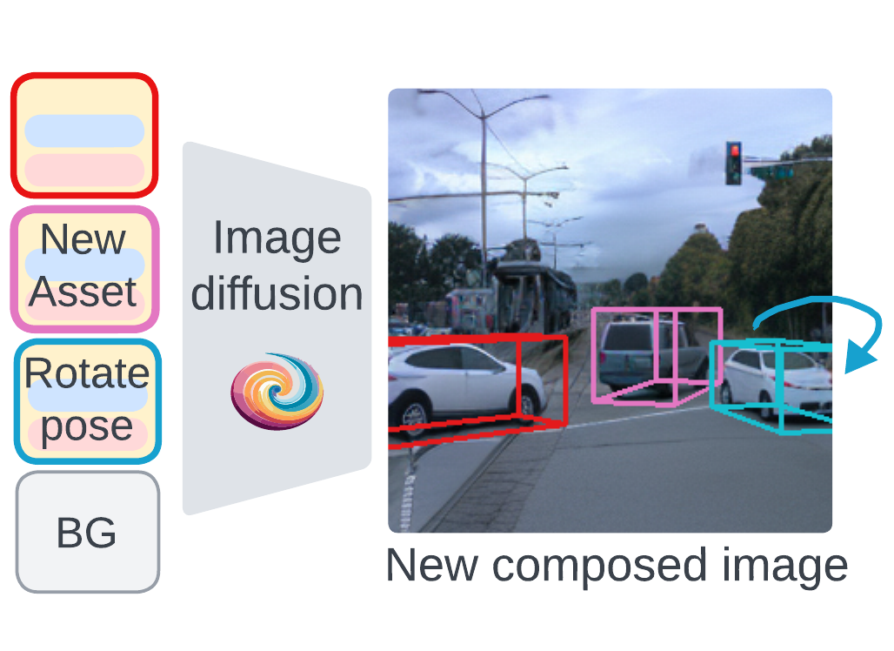
Test-time Controllability
Neural Assets as a unified interface
Pose control: transform 3D boxes
Compositional generation: replace assets
Encode
Edit
Notes:
After the model is trained, it serves as a unified interface for controllable generation
Given an image, we first encode each object to a Neural Asset representation. Then, to modify their pose tokens, we can simply change their 3D bounding boxes. In addition, if we replace the appearance token between images, we achieve object transfer across scenes. We can do the same thing to replace the background of images

Slide 16
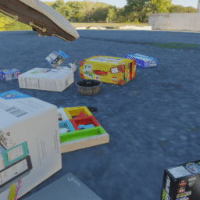
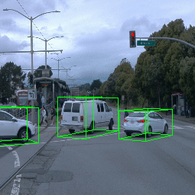
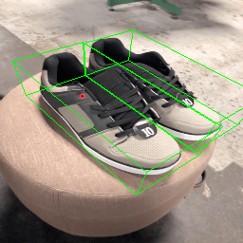
Experiments
Datasets:
Synthetic: OBJect, MOVi-E
Real-world: Waymo Open, Objectron
OBJect
MOVi-E
Waymo Open
Objectron
Michel, Oscar, et al. "Object 3DIT: Language-guided 3d-aware image editing." NeurIPS. 2023.
Greff, Klaus, et al. "Kubric: A scalable dataset generator." CVPR. 2022.
Sun, Pei, et al. "Scalability in perception for autonomous driving: Waymo open dataset." CVPR. 2020.
Ahmadyan, Adel, et al. "Objectron: A large scale dataset of object-centric videos in the wild with pose annotations." CVPR. 2021.
Notes:
Now let’s look at experiments. We test the 3D pose control ability on 4 datasets. Two of them are synthetic. OBJect is the one proposed by a baseline 3DIT, it contains synthetic paired images. MOVi-E is also simulated with Blender. It has both object interactions and camera movement
We also have two real-world datasets. Waymo Open is an outdoor self-driving dataset. Objectron is an indoor dataset which captures daily objects under 360 degree moving cameras

Slide 17
Experiments
Task: Given a source image + desired 3D pose changes, predict the target image
Metrics: measure reconstruction quality, PSNR, SSIM, LPIPS
Baselines:
3DIT: text-guided, trained on paired synthetic data
Chained: SAM + Zero-1-to-3 + Stable Diffusion Inpainting
Our implementation:
Image encoder: DINO
Image decoder: Stable Diffusion v2.1
Zhang, Richard, et al. "The unreasonable effectiveness of deep features as a perceptual metric." CVPR. 2018.
Michel, Oscar, et al. "Object 3DIT: Language-guided 3d-aware image editing." NeurIPS. 2023.
Kirillov, Alexander, et al. "Segment anything." ICCV. 2023.
Liu, Ruoshi, et al. "Zero-1-to-3: Zero-shot one image to 3d object." ICCV. 2023.
Rombach, Robin, et al. "High-resolution image synthesis with latent diffusion models." CVPR. 2022.
Caron, Mathilde, et al. "Emerging properties in self-supervised vision transformers." ICCV. 2021.
Notes:
The task is very intuitive: given a source image containing multiple objects and the 3D pose changes of these objects, we want the model to synthesize the target image after applying the pose changes
We measure the difference between predicted and ground-truth target image with reconstruction-based metrics, such as PSNR, SSIM, and LPIPS
For baselines, we take 3DIT which is trained on synthetic paired data, and uses text to control objects, such as move it left by 10 pixels, or rotate clockwise by 30 degree. Since it can only control one object per forward pass, we apply it autoregressively to edit all objects. We also design a baseline that chains multiple strong models. It first runs SAM to segment the target object out, then apply Zero-123 to rotate it, and finally use SD Inpainting model to put it back to the target location
For our model, we use DINO as the image encoder, and SD 2.1 as the image decoder. Interestingly, we find SD 2.1 to perform much better than SD v1

Slide 18
Quantitative Results
OBJect dataset has 3 separate subsets
Our model achieves the best performance in all settings
Notes:
We show the quantitative results using bar charts. The OBJect dataset has three separate settings about translating, rotating, and removing objects
As you can see, our model achieves the best results in all metrics on all datasets

Slide 19
Ablation Study
DINO extracts better pose-invariant features
Fine-tuning is surprisingly important
Modeling background + camera helps
Distinguish global camera motion vs local object motion
Paired training facilitates appearance-pose disentanglement

Slide 20
Qualitative Results: MOVi-E
Chained: copy-paste the objects, no adaptation e.g. shadows
3DIT: cannot locate the correct object (which box to move?)
Sequential editing leads to error accumulation
Notes:
Now we provide more qualitative comparison. Here is an example on MOVi-E. The Chained baseline is able to rotate the object thanks to the powerful Zero-123 model, but it simply pastes the object to the target location without adapting to the environment.
3DIT is even worse. It has two issues, first, it’s controlled with text, but when an image has multiple objects of the same class, it cannot locate the correct object. In addition, since we have to apply it sequentially to edit all object, the error accumulation leads to big drop in image quality

Slide 21
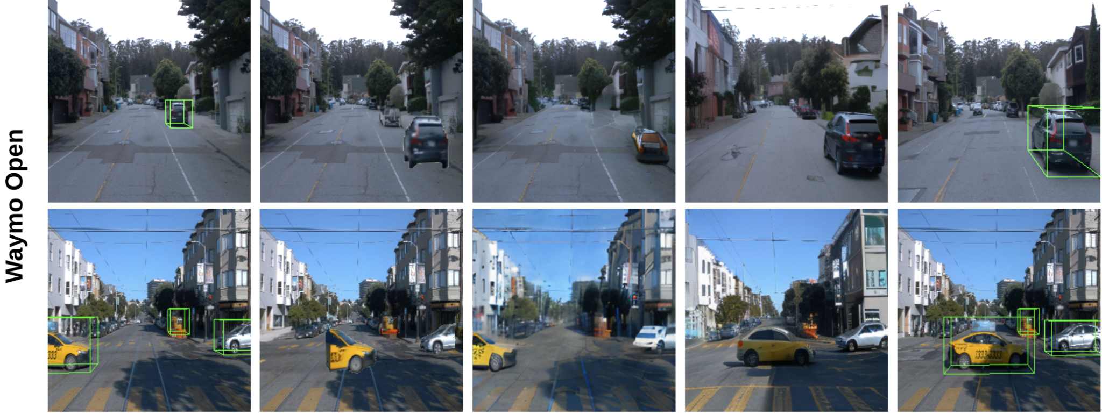
Qualitative Results: Waymo Open
Our model hallucinates objects with plausible appearance
Notes:
Here is an example on Waymo Open. the car in the first example is very small, and is partially out of view in the second example. Chained is not able to add details to it and just copy pastes the low-quality and incomplete cars. In contrast, our model does reasonable hallucination to generate cars of high quality. It also renders the shadows pretty well in the second example

Slide 22
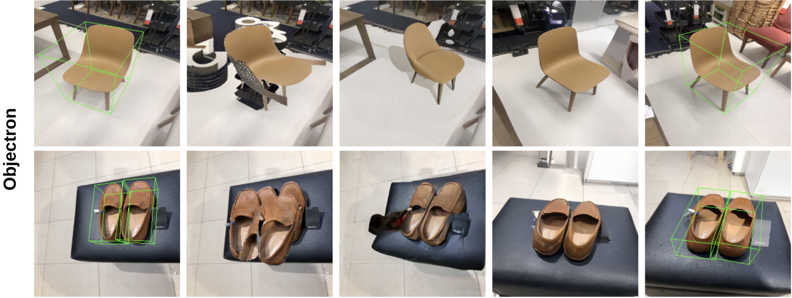
Qualitative Results: Objectron
We can also model camera movement and background changes
Notes:
Finally we show a comparison on Objectron. In this dataset objects are always static, and only the camera moves around. None of the baselines is able to render the background correctly after camera transformation
Thanks to the global background and camera encoding, our model can model camera movement, and synthesize a reasonable background at the novel view

Slide 23
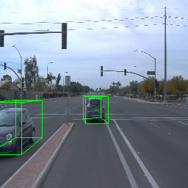
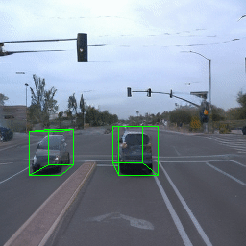
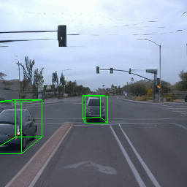
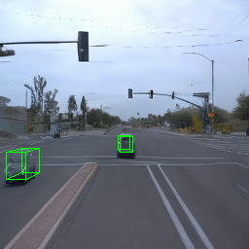
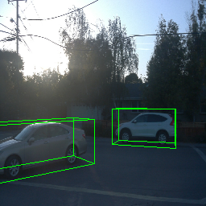
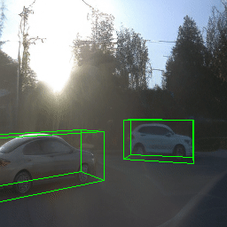
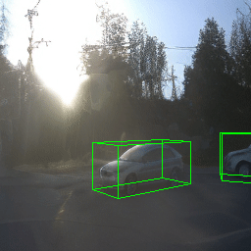
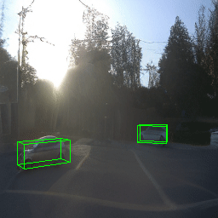
Controllable Scene Generation
Source Image
Translate
Rotate
Rescale
Heavy occlusion
Out-of-view car
O.O.D. lighting
Video results:
neural-assets.github.io
Notes:
Now, we show more control results of Neural Assets. On Waymo Open, we can handle heavily occluded cars. You can see these two cars have complicated occlusion relationship when we translate, rotate, and rescale them.
We can seamlessly generate cars moving in and out of view
In addition, our model is robust to unseen lighting conditions and backgrounds

Slide 24
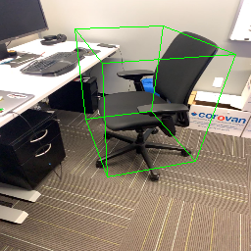
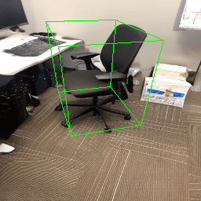
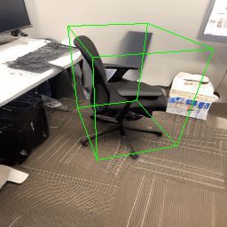
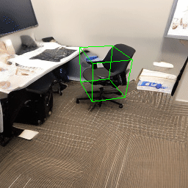
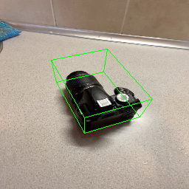
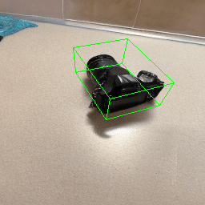
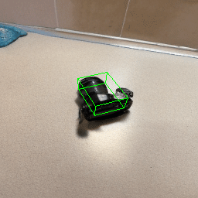
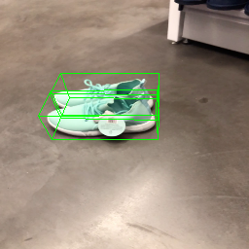
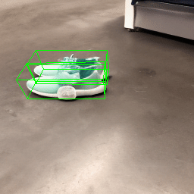
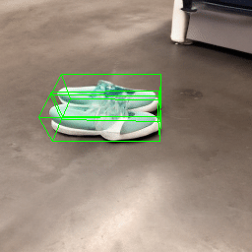
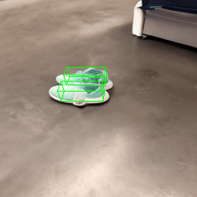
Controllable Scene Generation
Source Image
Translate
Rotate
Rescale
Object and camera motion are sometimes entangled (e.g. Translate)
Objectron dataset only has camera motion!
Video results:
neural-assets.github.io
Notes:
Here are results on Objectron. One issue here is that in the translation case, the object and camera motion are entangled. As I mentioned, this is because Objectron only has camera movement, and the objects are always static. Surprisingly, we can still disentangle them in the rotation case. We are not sure why this happens. One hypothesis I have is that the model doesn’t learn entangled object and camera poses. Instead, it’s trying to keep the relative distance between the foreground object and background elements. This is why when you translate the objects the desks and walls are also moving. But when you only rotate it, since the distance is unchanged, the object becomes disentangled from the background

Slide 25
Compositional Generation
Simply drop / replace / append Neural Assets across scenes
Notes:
Besides changing the 3D pose of objects, representing each object with individual tokens also allows flexible compositional generation. We can remove an object by dropping its token from model input, or remove everything else by only keeping its token. If we replace tokens from another image, we can transfer objects across scenes to compose a new image

Slide 26
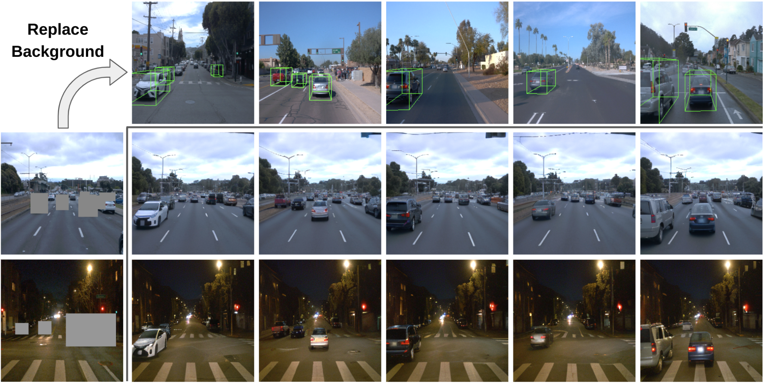
Global Background Replacement
Car lights are turned on!
Notes:
Finally, since we learn a background token to model the global scenes, we can also replace the background between images. Here we show an interesting example. We take a background from night time, and compose it with cars recorded in day time. In the generated image, the cars have their lights turned on. You can also see the specular highlight on the back of front cars, which is because of the light of the ego vehicle. This proves that our model is not doing simple copy-pasting. It really learns to adapt objects to their new locations with all necessary visual effects

Slide 27
Failure Cases / Limitations
Symmetry ambiguity
Sometimes, cars are “sticky” to lanes (see right example):
Source image
Rotation
… and generally can’t do things far outside of training distribution: Flip car upside down, lift it into the air, etc.
Notes:
Of course, our model has some limitations. One major failure case is the symmetry ambiguity. It cannot really perform a full 360 degree rotation of cylinder-like objects such as cups
Also, sometimes it learns very strong prior of the world. Like cars also stick to lanes and won’t go to the sidewalks. This rule is actually maybe a good thing to learn
Finally, it cannot generate things that are too different from the training distribution, such as flipping the car upside down or lift it into the air

Slide 28
Future Works
This work only handles rigid object transformation + camera movement
An ideal “Neural Assets” should do more:
Deformation, e.g., human
Articulation, e.g., open scissors
Structural decomposition, e.g., cut a tomato
This is because we use 3D bbox as the pose representation
Our framework should easily fit other 3D pose representation
Notes:
To me, the most exciting future direction of this work is extending it to larger-scale datasets and more scenarios. In this paper we only handle the most common situation in real world, that is, rigid object transformation and camera motion. But an ideal Neural Assets should do more, including the deformation of objects like humans; rigid object articulations which will be very important for robotics; and structural decomposition like cutting a tomato to two pieces.
This limitation is because we use 3D bbox as the pose representation which can only handle rigid transformation. But we believe our appearance-pose disentanglement learning framework should easily fit other 3D pose representation

Slide 29
Thank You!
Check out our project page for video results:
https://neural-assets.github.io/
Notes:
Thanks for listening. Please check out our project page for more results. I will take any questions now

