Slide 1
Mind the Time: Temporally-Controlled
Multi-Event Video Generation
Ziyi Wu, Aliaksandr Siarohin, Willi Menapace, Ivan Skorokhodov,
Yuwei Fang, Varnith Chordia, Igor Gilitschenski, Sergey Tulyakov
CVPR 2025
Project page: https://mint-video.github.io/
Notes:
Today I’ll present Mind the Time or MinT, a text-to-video generator that supports temporall-controlled multi-event video generation. This work is done during my internship at Snap research

Slide 2
Motivation
Existing text-to-video (T2V) models only take in one text prompt
The generated video usually contains only a single event
There might be scene cuts, but we cannot control its timing
Prompt: A stylish woman walks down a Tokyo street…
Prompt: A movie trailer of a space man…
Videos taken from OpenAI Sora: https://openai.com/index/sora/
Notes:
To begin with, what is multi-event video generation? How does it differ from common text-to-video generation? Well, a general T2V model often takes in only one text prompt, and the generated video usually contains only a single event
For example, in this super famous sora lady video, it’s 1-min long, but the content is just a lady walking, which is very boring
Sometimes, the video might contain scene cuts that describe multiple scenes, but again you cannot control when do these scene cuts happen. All you can do is just fine-tuning your text prompt and try different random seeds, hoping to get what you want in the model output

Slide 3
Task: Multi-Event Video Generation
Goal: generate a video containing sequential events
Wait, what if we just concatenate all events and run SOTA video models?
They often fail!
Notes:
Therefore, the goal of our task is to enable the generation of sequential events in current T2V video generators
But wait, you may wonder that current video models seem so good, maybe we can easily adapt them to do this task? What if we just concatenate the text description of all the events in one super long prompt and run existing models
The answer is no, all SOTA models will fail in this case

Slide 4
Task: Multi-Event Video Generation
SOTA video models ignore some events, or merge multiple events together
Prompt: A man raises his arms up, then lowers them down, then extends to his left, and finally to his right
CogVideoX-5B
Mochi 1
OpenAI Sora (storyboard)
Kling 1.5
Gen3-Alpha
CogVideoX: https://huggingface.co/spaces/THUDM/CogVideoX-5B-Space
Mochi 1: https://www.genmo.ai/
Gen3-Alpha: https://runwayml.com/
Kling 1.5: https://klingai.com/
Notes:
Here I’m showing one example, the text prompt is like doing morning exercise. We want the man to first raises his both arms, then lowers them down, then extends to his left, and finally extends to his right. Notice that we want to move both arms always in the same direction
We tested two SOTA open-source models, CogVideoX and Mochi, and three SOTA commercial models, Kling, Gen3 from Runway, and Sora from OpenAI
CogVideoX has large motion, but it misses the later two events; Mochi has almost static motion, maybe because the text prompt is out of training distribution; Kling does the best, it does up, down, left, but then it’s not moving both arms to right, but on both sides. Gen3 is also bad. For Sora, it releases its API after our work, and it has a so-called storyboard function that claims to do exactly the same task multi-event generation, but I test it and TBH I don’t what it is doing
Overall we tested many prompts, and all SOTA models either ignore some events, and merge multiple events together

Slide 5
MinT: Multi-Event + Time Control
Our model, MinT, generates sequential events, and can control their time range
Prompt:
[0.0 → 2.3s]: A man raises his arms up
[2.3 → 4.5s]: lowers them down
[4.5 → 6.8s]: extends to his left
[6.8 → 9.1s]: extends to his right
Notes:
In this paper, we present MinT, a text-guided model that supports clear multi-event generation. In addition, we can control the precise time range of each event, when do they start and when do they end. This is never possible in prior models
In this presentation, I will use color border to indicate the desired time range of each event so that you can verify their alignment easily

Slide 6
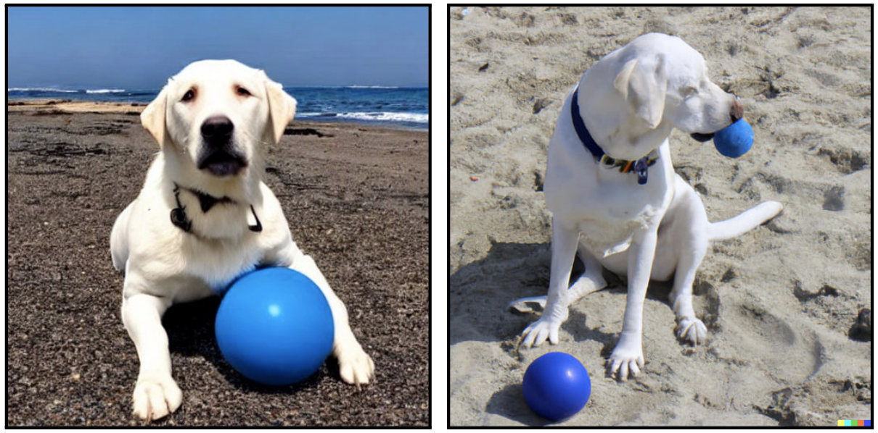
Why Do Existing Models Fail?
Text-guided models struggle with intricate spatial prompts
Prompt: A dog puts its right arm above a blue ball
Stable Diffusion
DALLE-2
Avrahami, Omri, et al. "Spatext: Spatio-textual representation for controllable image generation." CVPR. 2023.
Lian, Long, et al. "Llm-grounded video diffusion models." ICLR. 2024.
Notes:
Before diving into our method, let’s think about why existing models all fail. While time-control is a very new topic in generative models, people have been studying spatial control for a long time. People realize that existing models are bad at understanding complicated spatial relationship. For example, a dog puts its arm above a ball, the generated images contain the correct objects but with the wrong spatial layout

Slide 7
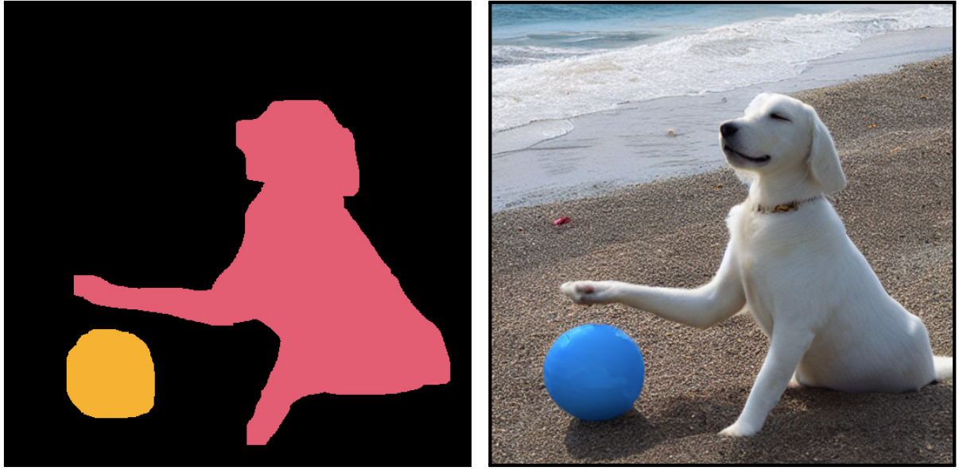
Why Do Existing Models Fail?
Text-guided models struggle with intricate spatial prompts
Grounding objects to spatial locations (e.g. mask, bbox) can greatly improve this
Prompt: A dog puts its right arm above a blue ball
Stable Diffusion
+
Stable Diffusion
DALLE-2
Object Mask
Avrahami, Omri, et al. "Spatext: Spatio-textual representation for controllable image generation." CVPR. 2023.
Lian, Long, et al. "Llm-grounded video diffusion models." ICLR. 2024.
Notes:
To solve this, later work propose to explicitly ground objects to a spatial location in the image. For example, by associating them with bounding boxes or segmentation masks, the task becomes much easier and the model generates the correct structure

Slide 8
Why Do Existing Models Fail?
Similarly, a multi-event prompt has complicated temporal structure
Models need to reason the time span of each event
Notes:
Similarly, a multi-event text prompt has a very complicated temporal structure. The model needs to first plan the time range of each event so that their total length fits an entire video, and then fill in the right content to each event. This involves complex reasoning and we suspect that it’s beyond the capacity of current video generators

Slide 9
Why Do Existing Models Fail?
Similarly, a multi-event prompt has complicated temporal structure
Models need to reason the time span of each event
We address it with explicit temporal grounding of events
Associate each event with a time range
0.0s
A man raises his arms up
He lowers them down
He extends to his left
He extends to his right
Temporal grounding
2.3s
A man raises his arms up, then lowers them down, then extends to his left, and finally to his right
4.5s
6.8s
9.1s
Notes:
Inspired by how people handle spatial prompts, we propose to provide explicit temporal grounding of events as model input, by associating each event with its start and end time. Previously, we have a super long text prompt mixing multiple events. Now after temporal grounding, they are bind to a time range in the temporal dimension, so the model can focus on one event at a time, making multi-event generation much easier

Slide 10
Method: MinT
Model Input:
Video taken from "Panda-70m: Captioning 70m videos with multiple cross-modality teachers." CVPR. 2024.
Notes:
Concretely, let’s say we have this video as a training data

Slide 11
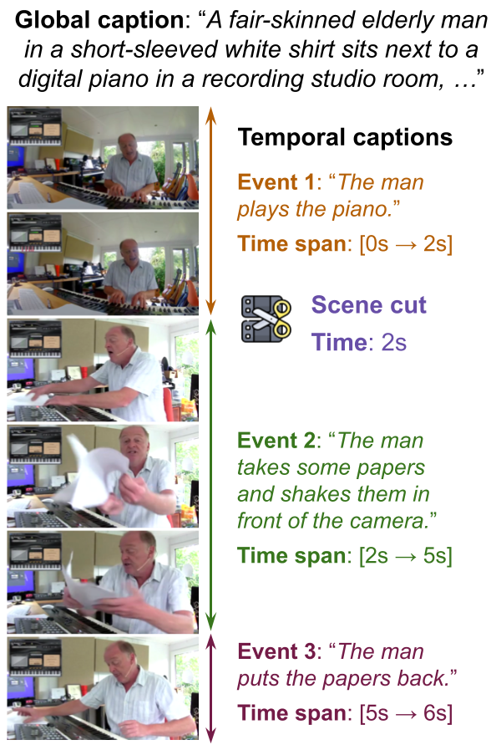
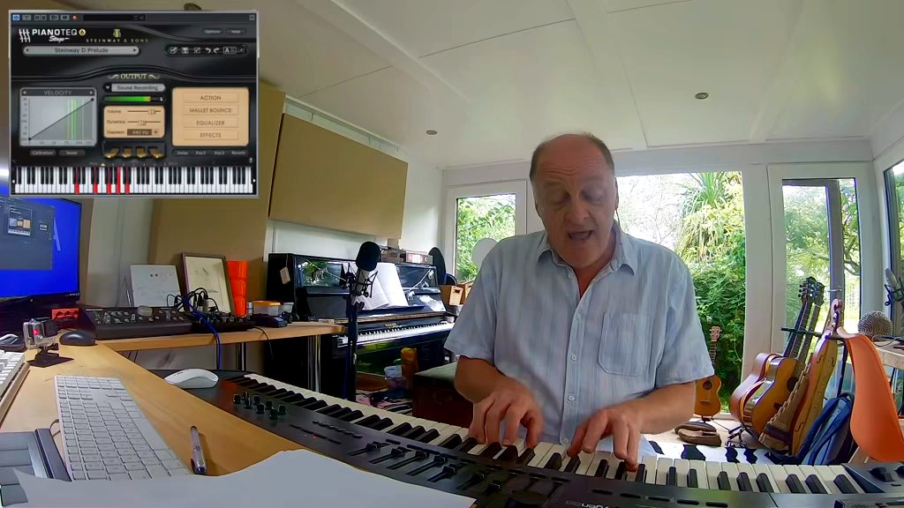
Method: MinT
Model Input:
A global caption: overall scene
Video taken from "Panda-70m: Captioning 70m videos with multiple cross-modality teachers." CVPR. 2024.
Notes:
We first provide a global caption that describes the overall scene such as background, in a recording studio room, and the attributes of characters like the dressing of this person. The global caption will stay unchanged throughout the video

Slide 12
Method: MinT
Model Input:
A global caption: overall scene
Several temporal captions: event + time
Video taken from "Panda-70m: Captioning 70m videos with multiple cross-modality teachers." CVPR. 2024.
Notes:
Then, we have several temporal captions, each consisting of a text description and its start and end time

Slide 13
Method: MinT
Model Input:
A global caption: overall scene
Several temporal captions: event + time
(Optional) Scene cuts
Video taken from "Panda-70m: Captioning 70m videos with multiple cross-modality teachers." CVPR. 2024.
Notes:
In addition, we have an optional scene cut label. As you can see, there is a scene transition aka cut at 2s. We can train our model on such annotation, and we will be able to generate such effects at inference time. We will skip it for now and focus on temporal captions first

Slide 14
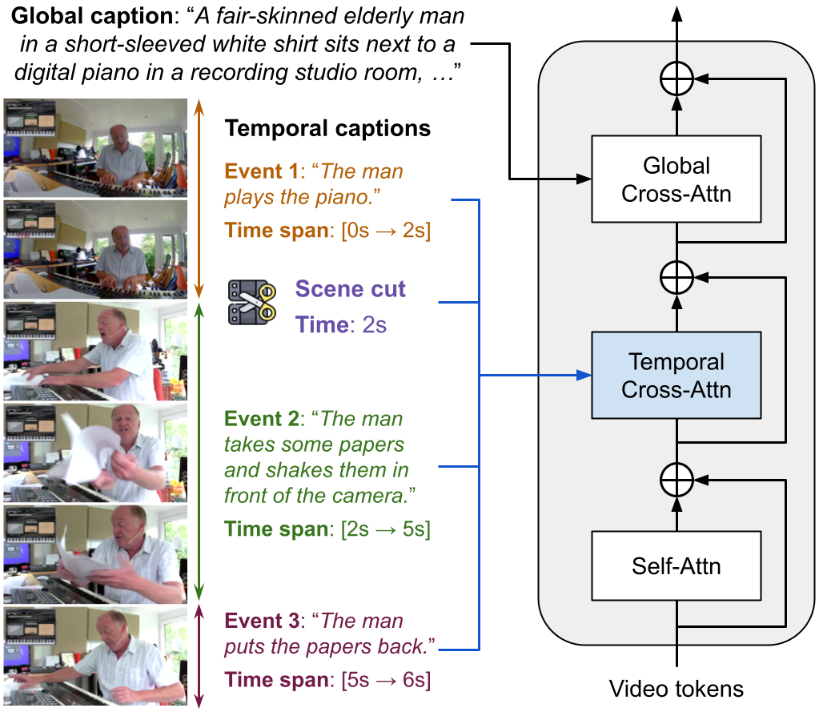
Method: MinT
Fine-tune a pre-trained Video DiT
Add a new Temporal Cross-Attn layer
Concat all temporal inputs
Peebles, William, and Saining Xie. "Scalable diffusion models with transformers." ICCV. 2023.
Notes:
The next question is, how to process global caption and temporal captions? In this paper, we fine-tune a large-scale pre-trained T2V diffusion model, which is implemented with diffusion transformer, DiT. The basic DiT block often contains a self-attn layer over all video tokens, followed by a cross-attn layer fusing video tokens and text embeddings of the text prompts. Now, we still use the original cross-attn for the global caption, but insert a new Temporal cross-attn to condition on temporal captions and scene cuts by concating everything together

Slide 15
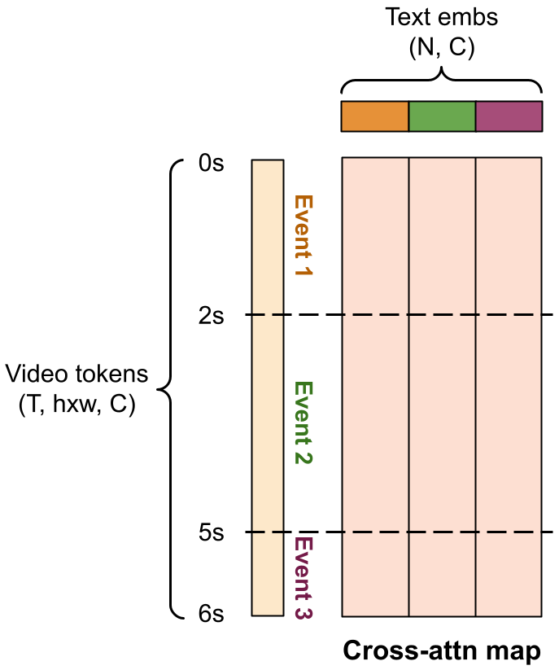
Temporal Cross-Attn
Key
Cross-attn between video tokens and text embeddings
Challenge: how to encode event time information here?
How should the attn map look like?
Query
Notes:
What does that mean? Let’s take a closer look at the temporal cross-attn layer. Suppose we are generating a 6s video that contains 3 events. The Query video tokens have a time dimension T, and we ignore the spatial dimension h and w because we only care about time of events here. For each event, it has a text prompt, so with three events, we concat their text embedding together and get smth like this which is the Key in cross-attn
We know that the core in cross-attn is the QK attention map, that determines which video tokens will look at which text embeddings. So the challenge here is, how can we encode the time of events here? How can we tell the model, this trunk of video tokens belong to event 2, so it should focus on the text embedding of event 2?
Let’s first think about what will an ideal attn map look like

Slide 16
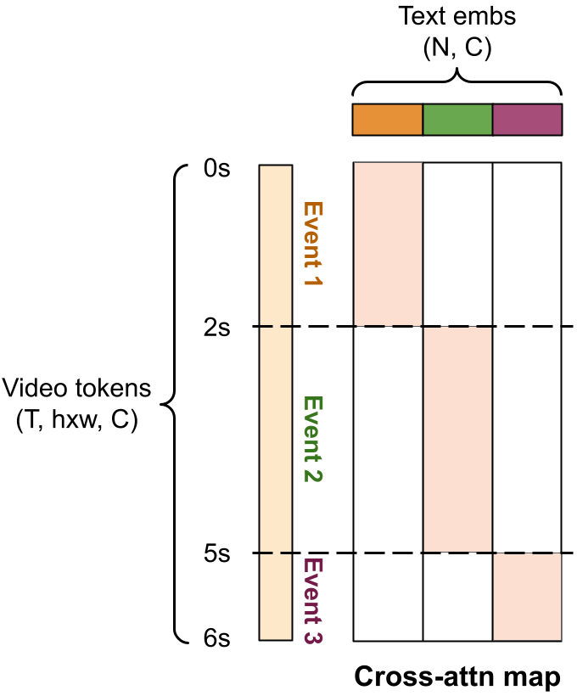
Temporal Cross-Attn
Can we do hard-masking?
Frames only attend to the current event
Introduce abrupt changes at event boundaries
Notes:
Maybe the most straightforward way is hard-masking. That is, we force video tokens to only attend to current event, and all zero to other events
However, intuitively, for frames close to an event boundary, it is beneficial to receive information from both events to synthesize a smooth transition. Our ablation also shows that hard attn masking often leads to abrupt changes at event boundaries

Slide 17
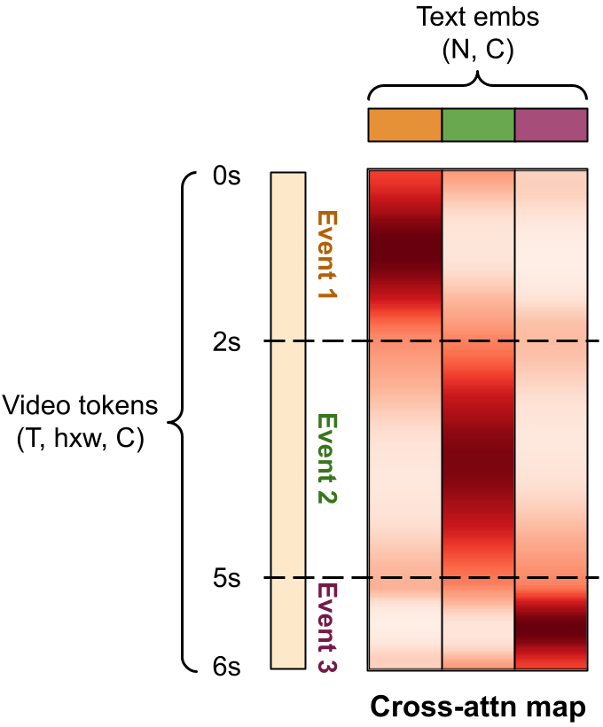
Temporal Cross-Attn
We use Rotary Positional Encoding (RoPE) as a soft mask
Peaks at center frame of an event
Smooth transitions between adjacent events
Su, Jianlin, et al. "Roformer: Enhanced transformer with rotary position embedding." Neurocomputing. 2024.
Notes:
Instead, we propose to adopt a widely used positional encoding technique, RoPE, as a soft mask to guide the attn map. With our special modifications, our cross-attn map looks like this:
- An event has the highest attn weight with the middle frame of the event; and
- We have a smooth transition of the attention weight at the boundary of events – you can see that the weight is the same at these points, so the model also learns a smooth transition between events

Slide 18
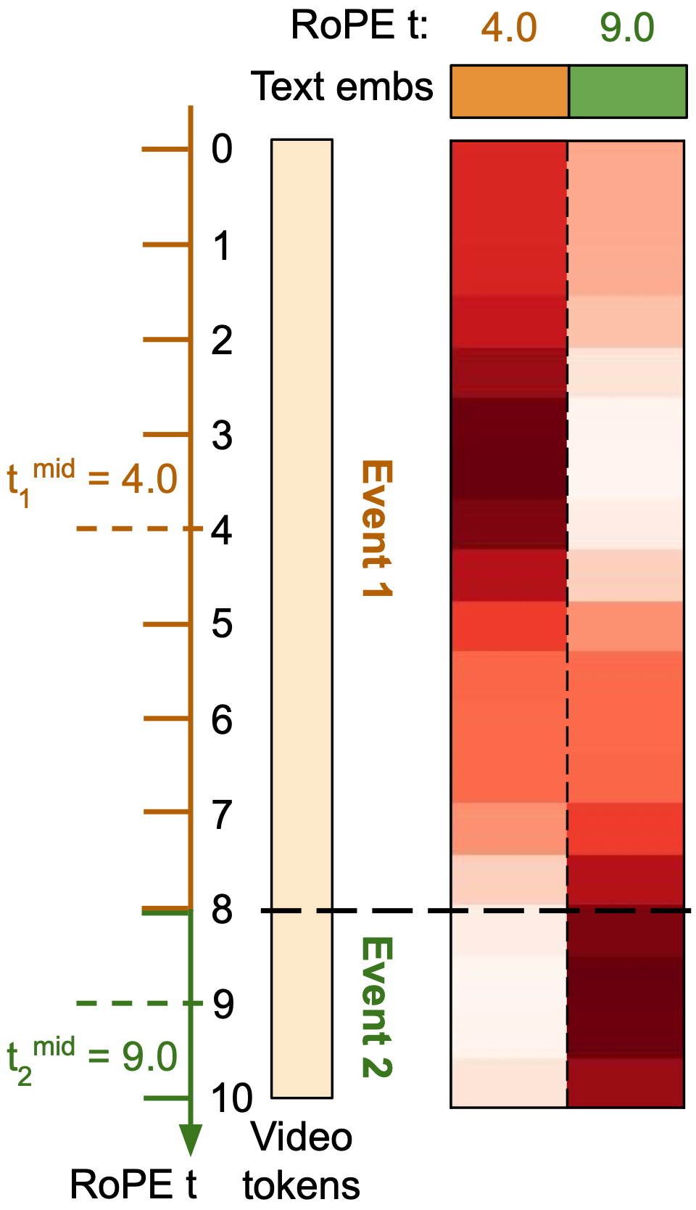
Vanilla RoPE
RoPE encodes each token with an index
Tokens with close index attend more to each other
Su, Jianlin, et al. "Roformer: Enhanced transformer with rotary position embedding." Neurocomputing. 2024.
Notes:
So how do we achieve this? Let’s look at a simplified case of 2 events, and only 20 frames. At a high level, vanilla RoPE bind each token with an index, so tokens with close index are biased to attend more to each other

Slide 19
Vanilla RoPE
RoPE encodes each token with an index
Tokens with close index attend more to each other
Encode video tokens with time
Su, Jianlin, et al. "Roformer: Enhanced transformer with rotary position embedding." Neurocomputing. 2024.
Notes:
Intuitively, we can encode each video token with its time in the video, such as 0, 1, 2, 3, 4, 5 bala bala bala

Slide 20
Vanilla RoPE
RoPE encodes each token with an index
Tokens with close index attend more to each other
Encode video tokens with time
Encode text embeddings with event middle time
Su, Jianlin, et al. "Roformer: Enhanced transformer with rotary position embedding." Neurocomputing. 2024.
Notes:
Then, for event text embeddings, we encode them with the middle time of each event

Slide 21
Vanilla RoPE
RoPE encodes each token with an index
Tokens with close index attend more to each other
Encode video tokens with time
Encode text embeddings with event middle time
Su, Jianlin, et al. "Roformer: Enhanced transformer with rotary position embedding." Neurocomputing. 2024.
Notes:
In this case, the mid-time of event 1 is 4, and the mid-time of event 2 is 9

Slide 22
Vanilla RoPE
RoPE encodes each token with an index
Tokens with close index attend more to each other
Encode video tokens with time
Encode text embeddings with event middle time
Looks good? No…
Notes:
And this is the attention map we get, under vanilla RoPE. Looks OK right? Actually no. What’s wrong here?

Slide 23
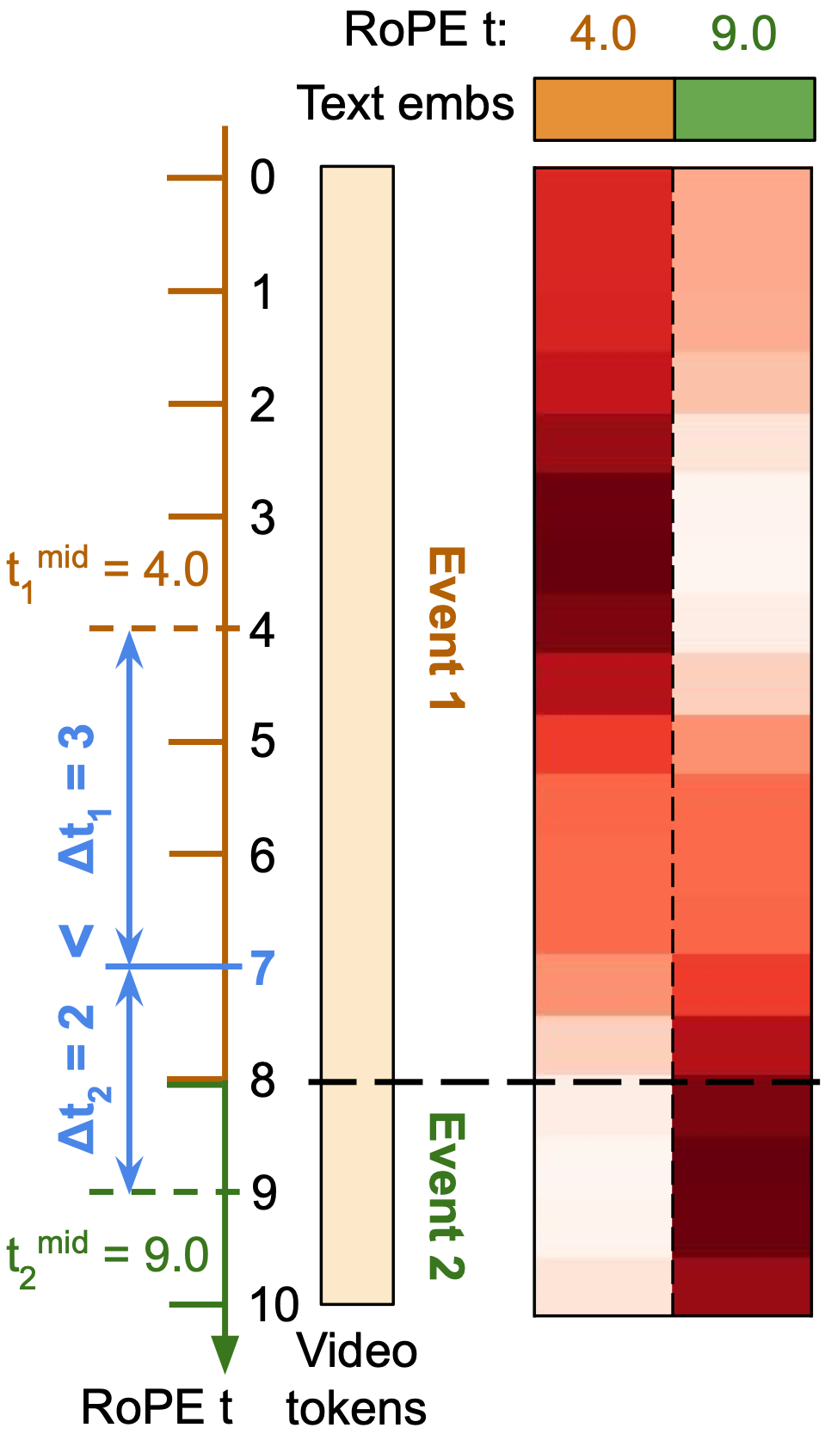
Vanilla RoPE
What’s wrong here?
Frame 7 belongs to Event 1
But it is closer to the midpoint of Event 2
It attends more to the wrong event!
Notes:
If we look closer, at a specific frame at t=7, this frame belongs to event 1, but when we count the distance, it’s actually closer to the midpoint of event 2. Right? t-mid-1 is 4 and t-mid-2 is 9, so the distance of frame 7 to event 1 is 3, which is larger than its distance to event 2 which is 2
As a result, frame 7 is encouraged to attend more to event 2 shown by the higher attention weight, which is wrong

Slide 24
Vanilla RoPE
Why does this happen?
Events have different durations
Notes:
Why does this happen? This is because events have different lengths. Thus, their midpoints’ distances to the event boundary are also different. Like here, 4 to 8 the distance is 4, while 9 to 8 the distance is only 1

Slide 25
Rescaled RoPE (ReRoPE)
A simple solution:
Rescale all events to have the same duration
Notes:
How can we tackle this? We propose a simple modification to vanilla RoPE, called Rescaled RoPE or ReRoPE. If the issue happens when events have different durations, then we just rescale all events to have the same duration

Slide 26
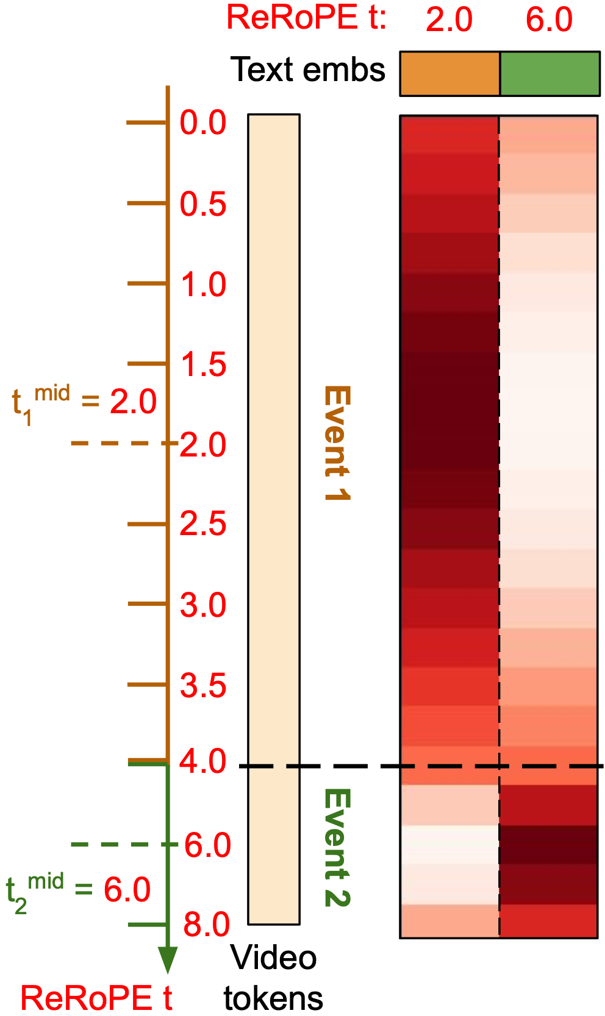
Rescaled RoPE (ReRoPE)
A simple solution:
Rescale all events to have the same duration
Recompute timestamps as RoPE index
Rescale
Notes:
What does that mean? Let’s say we make all events have the same duration of 4s. Then, we re-compute the ReRoPE index. As you can see, this is the old RoPE index, just the time of each frame, from 0 to 10s. For event 1, it goes from 8s to 4s, so every index is divided by 2. For event 2, it goes from 2s to 4s, so every index is multiplied by 2

Slide 27
Rescaled RoPE (ReRoPE)
A simple solution:
Rescale all events to have the same duration
Recompute timestamps as RoPE index
Notes:
Now, the middle time of event 1 becomes 2.0, and the middle time of event 2 becomes 6.0, which are used to encode the event text embeddings

Slide 28
Rescaled RoPE (ReRoPE)
A simple solution:
Rescale all events to have the same duration
Recompute timestamps as RoPE index
Now we have correct attention transitions!
Notes:
And now we have the correct attention weight transitions

Slide 29
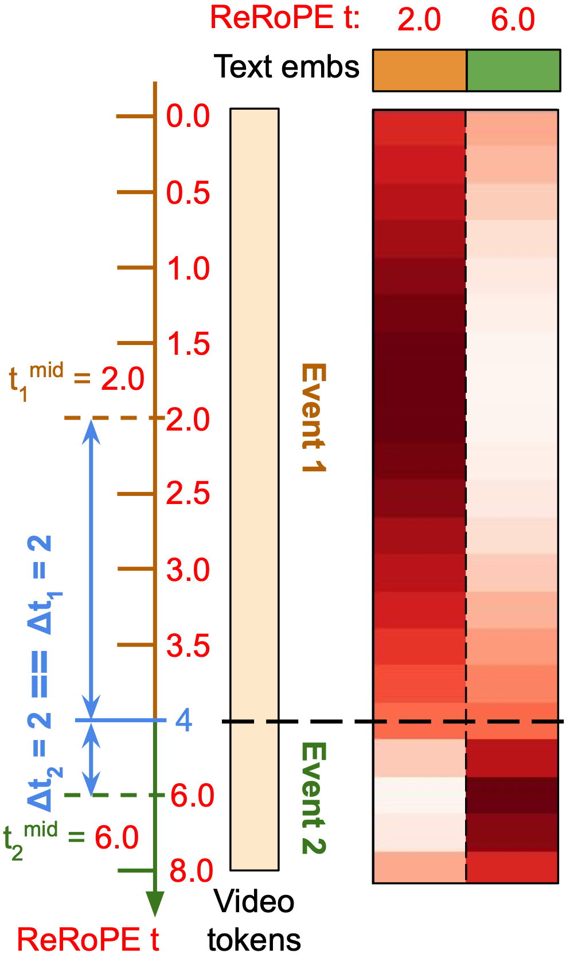
Rescaled RoPE (ReRoPE)
A simple solution:
Rescale all events to have the same duration
Recompute timestamps as RoPE index
Now we have correct attention transitions!
Notes:
As you can see, the event boundary has t=4, whose distance to both events are both 2, leading to the same attention weight

Slide 30
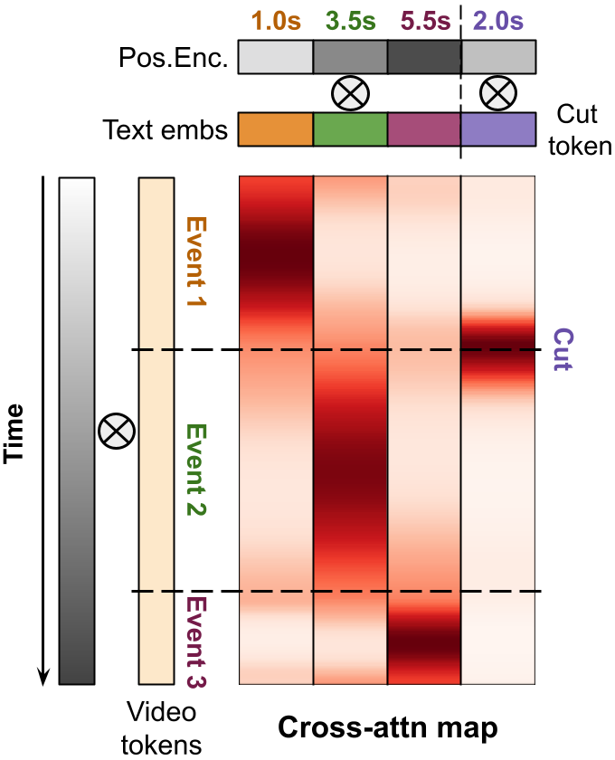
Rescaled RoPE (ReRoPE)
ReRoPE
Notes:
Now let’s look the entire pipeline again, we have these temporal captions, we input them to the temporal cross-attn layer, which uses ReRoPE to obtain the desired cross-attn map
Looks great, but what about the scene cut label?

Slide 31
Scene Cut Conditioning
Pro-edited, long videos often contain scene cuts
Prior works discard them / split to short clips
This loses valuable information!
We keep all cuts, and condition our model on them
Again with ReRoPE time encoding
Notes:
To the best of our knowledge, our work is the first that controls the generation of scene cuts in a video. Professionally edited long videos such as movies often contain frequent cuts, prior works often remove these videos, or split them into shorter clips based on cuts. However, this reduces the amount of training data, and makes the model unable to learn such valuable information from professional video editor
We thus decide to keep all the cuts, and explicitly condition our model on them, so that we can control its generation at test time
How? Again with ReRoPE positional encoding

Slide 32
Scene Cut Conditioning
Notes:
OK, so this is the temporal cross-attn without scene cut, we use the middle time of event to do RoPE

Slide 33
Scene Cut Conditioning
Notes:
Now given a scene cut and its time t=2, we treat it as a special temporal caption, whose start and end time are the same, are both 2s. And we use a learnable token as its text embedding. Then, we can just apply ReRoPE on it

Slide 34
Scene Cut Conditioning
Attention peaks at scene cut time!
t=2
Notes:
The resulting cross-attn map looks like this – the cut token attends the most to video tokens at t=2, telling the model where it happens

Slide 35
Scene Cut Conditioning
This enables us to control shot transition in generated videos
Notes:
Scene cut conditioning allows us to control shot transition in generated videos, such as a sudden change in camera pose

Slide 36
Scene Cut Conditioning
This enables us to control shot transition in generated videos
Prompt: A man is using his phone → lifts his head → lowers his head
No Cut
After First Event
After All Events
Notes:
In this example, the prompt is a man uses a phone, then lifts his head, and then lowers again. When not inputting any cut, it’s a smooth video, the camera is static. When input a cut after the first event, it takes a sudden change. When input cuts after each event, the camera changes every time

Slide 37
Scene Cut Conditioning
This enables us to control shot transition in generated videos
Prompt: A woman is typing on keyboard → scrollbar → keyboard → holds her headphones
No Cut
After First Event
After All Events
Notes:
This example is more clear. When not inputting any cut, it’s again a smooth video. When having one cut it has one change, and when having cuts after all events, the camera changes every time. But notice how the character, the laptop, and everything in the background remain the same. Overall, MinT is the first video model with this level of controllability

Slide 38
Experiments
Training data:
We need text captions + timestamps
Existing datasets are small
Manually label ~200k videos with temporal captions
Detect scene cuts in videos
Evaluation data:
A HoldOut set from our training data
StoryBench: similar format
Krishna, Ranjay, et al. “ActivityNet-Captions.” ICCV. 2017.
Soucek, Tomás, and Jakub Lokoc. "TransNet v2." ACM MM. 2024.
Chen, Tsai-Shien, et al. "Panda-70M." CVPR. 2024.
Bugliarello, Emanuele, et al. "StoryBench." NeurIPS. 2023.
Notes:
OK. Now let’s look at experiments. For training data, we need videos with text captions and timestamps. Surprisingly, existing datasets are all not suitable – they are either too small to fine-tune a large video diffusion model, or the visual quality is very bad, or the labeling of events are not fine-grained enough. Therefore, we manually label ~200k videos with temporal captions, and run a pre-trained scene cut detector to annotate all cuts in the video. We then fine-tune the entire model for ~10k iterations on 256 A100 GPUs, which takes ~a week
For evaluation, we have a holdout validation set from our training data (~2k), and a dataset published by Google called StoryBench (~3k), which has the same temporal captions as our format

Slide 39
Comparison with SOTA Models
Prompt: A man is typing on the laptop → touches his headphones → closes the laptop → stands up
CogVideoX-5B
Mochi 1
MinT (Ours)
Kling 1.5
Gen3-Alpha
Notes:
We compare our model with SOTA open-source and commercial models
MinT generates the correct video with the man typing on the laptop, touches his headphone, closes the laptop, and stands up
In contrast, none of these SOTA models can generate all events

Slide 40
Comparison with SOTA Models
More on our project page:
https://mint-video.github.io/
Prompt: A woman is tapping on her phone → takes a selfie → lowers the phone and taps → adjusts her hair
CogVideoX-5B
Mochi 1
MinT (Ours)
Kling 1.5
Gen3-Alpha
Notes:
Here, MinT generates the woman first tapping on her phone, then takes a selfie, then lowers the phone and type again, and finally adjusts her hair
Again, none of SOTA models can generate all the events

Slide 41
Event Timing Control
We can control the start and end time of events
Prompt: A man is using his phone → lifts his head → lowers his head
-1.0s
-0.5s
0.0s
+0.5s
+1.0s
Prompt: A woman is holding her arms → laughs to the camera → puts her hand at the waist
-1.0s
-0.5s
0.0s
+0.5s
+1.0s
Notes:
Now let’s look at the time control ability of MinT. We can specify the start and end time of each event. Here, in each row, we offset the events by a different number of seconds, basically making them happens earlier or later. And in the result, you can see the smooth progress of events over time. In addition, we roughly keep the appearance of the subject and background the same. This capacity is very useful in content creation, when people want to adjust the temporal dynamics of videos

Slide 42
Motion-Enhanced Video Generation
Writing temporal captions might be tedious for regular users…
LLMs can do it for you!
Generate videos with enhanced motion
Notes:
For pro content creators, the extra controllability of MinT is great. But for regular user, one concern you may have is, previously you only need one text prompt to generate a video, but now you need to write all the temporal captions and their time range, which is kinda tedious
Don’t worry! We show that LLMs can help you with that. Given a short prompt, LLMs can extend it to the global caption and temporal captions we want, leading to videos with enhanced motion

Slide 43
Motion-Enhanced Video Generation
Short caption: a cat drinking water
Notes:
For example, we have this caption: a cat drinking water. If you just run our base T2V model, it generates a video with repeated motion, which is very boring

Slide 44
Motion-Enhanced Video Generation
Short caption: a cat drinking water
Extended:
A cat walks to a bowl →
laps at water with its tongue →
lifts its head and looks around
Notes:
With an LLM, it extends it to multiple actions, and the generated video looks much more interesting

Slide 45
Motion-Enhanced Video Generation
Short caption: a bear climbing a tree
Notes:
Here is another example. With a short caption: a bear climbing a tree, the generated video is boring

Slide 46
Motion-Enhanced Video Generation
Short caption: a bear climbing a tree
Extended:
A bear walks to a tree →
stands and places its paw on the tree →
climbs the tree → pauses to rest
Notes:
An LLM extends it to four events, resulting in a much more dynamic video

Slide 47
Motion-Enhanced Video Generation
Quantitative results on VBench
Take the Dynamic Degree prompt list
Prompt enhancement greatly improves the generated video dynamics
Huang, Ziqi, et al. "Vbench: Comprehensive benchmark suite for video generative models." CVPR. 2024.

Slide 48
Results on OOD Prompts
Our fine-tuning videos are mostly human-centric
It can still generate novel concepts!
Notes:
Another concern you may have is, MinT is fine-tuned mostly on daily human videos. Will it lose the creativity to imagine novel concepts?
We show that it can also generate multi-event videos with novel concepts such as warriors with swords, animals like cat, and spaceship

Slide 49
Failure Cases
MinT inherits all limitations of base video models
Human hands, complex physics
Multi-object concept binding
Object association between captions
Prompt: the dark skinned man eats pizza, the man in blue drinks from green bottle
Global caption: a woman wearing a red device…
Temporal caption: she adjusts the device on her eyes
Notes:
As the first attempt in time-controlled video generation, MinT has several limitations. For example, it’s fine-tuned from a base T2V model, so it inherits all its limitations such as unable to handle human hands or model complex physics. This should be solved with a better base model
MinT also sometimes have issue with multi-object concept binding, like when there are multiple persons in the video, it confuses their attributes. This is an issue with spatial binding, and can be solved when we also do spatial grounding like providing object bounding box to the model
Finally, MinT sometimes struggles with object association between global and temporal captions. In this example, the global caption says “a woman wearing a red device”, and the temporal caption says “she adjusts the device on her eyes”. We know that they mean the same thing, but the model gets confused and generates a new red device. To solve this, we may need a specific layer to do information exchange between global and temporal captions, and of course, more training data

Slide 50
Future Directions
A movie consists of multiple shots, each shot is usually <10s
MinT can “direct” a shot, but cannot do longer
Potential solution:
MinT + video personalization = intra-shot + inter-shot consistency!
Lin, Han, et al. “VideoDirectorGPT: Consistent multi-scene video generation via llm-guided planning." COLM. 2024.
Henschel, Roberto, et al. "Streamingt2v: Consistent, dynamic, and extendable long video generation from text." arXiv. 2024.
Notes:
I’m very excited about this paper as it opens up many future directions. If we think about a movie, it consists of many shots, and each shot is usually shorter than 10s. Existing video models, as well as MinT, can generate a 10s video, but cannot do longer
Yet, this sounds very enough for most of the cases. Then in order to generate a movie or long video, we can combine MinT with video personalization methods that maintain the appearance of subjects between videos. This way, we can get both intra- and inter-shot subject consistency, and control the time of plots. To me this is a very interesting application to look at

Slide 51
Check out our project page for more results:
https://mint-video.github.io/
Thank You!
Notes:
OK that’s all for the presentation. We have more video results on our project page. Thanks for listening. I’ll take any questions

