Slide 1
IF-Defense: 3D Adversarial Point Cloud Defense via Implicit Function based Restoration
Ziyi Wu¹*, Yueqi Duan²*, He Wang², Qingnan Fan², Leo Guibas²
¹Tsinghua University ²Stanford University
2020.12.15

Slide 2
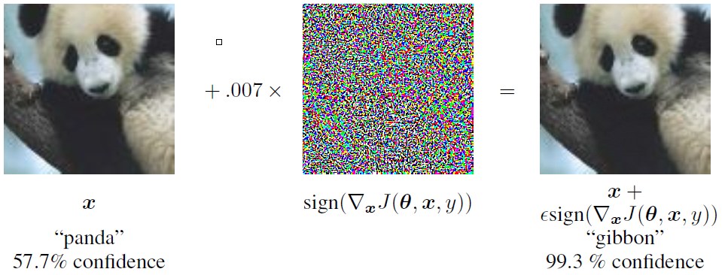
Adversarial Machine Learning (Adv ML)
What?
Adv example: fool the victim model while being visually similar to clean data
Why? (ECCV’20 Adv Workshop)
Security: defend against an adversary
Robustness: test the worst-case robustness of ML systems
Interpretability: towards human-level abilities
How?
Two settings: white-/black-box attack
White-box: gradient ascent
Black-box: query+search
[1] Carlini, Nicholas, et al. "On evaluating adversarial robustness." arXiv preprint arXiv:1902.06705 (2019).
[2] Goodfellow, Ian J., Jonathon Shlens, and Christian Szegedy. "Explaining and harnessing adversarial examples." ICLR 2015.

Slide 3
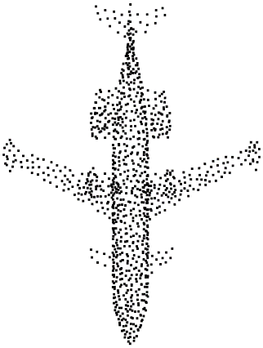
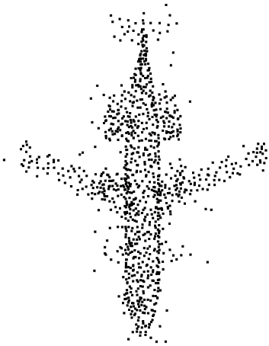
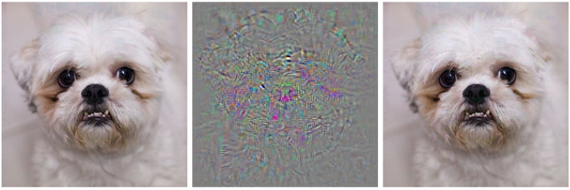
Adv ML in 3D Point Clouds
Why?
Safety-critical applications, e.g. self-driving cars
Occlusions, noises, sparsity in raw point clouds
3D and 2D attacks are different!
2D attacks can only change pixel values
3D attacks can perturb point coordinates, add or drop some points
Point clouds are unstructured and unordered
[1] Goodfellow, Ian J., Jonathon Shlens, and Christian Szegedy. "Explaining and harnessing adversarial examples." ICLR 2015.
[2] Xiang, Chong, Charles R. Qi, and Bo Li. "Generating 3d adversarial point clouds." CVPR 2019.

Slide 4
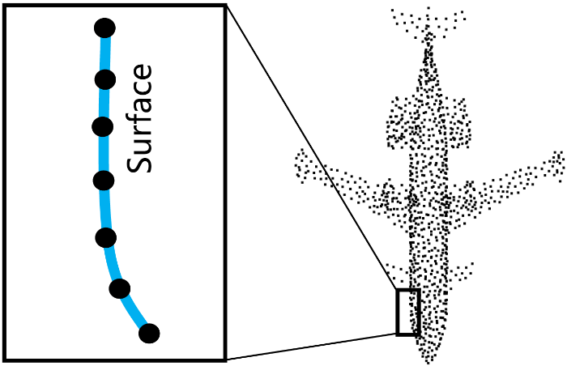
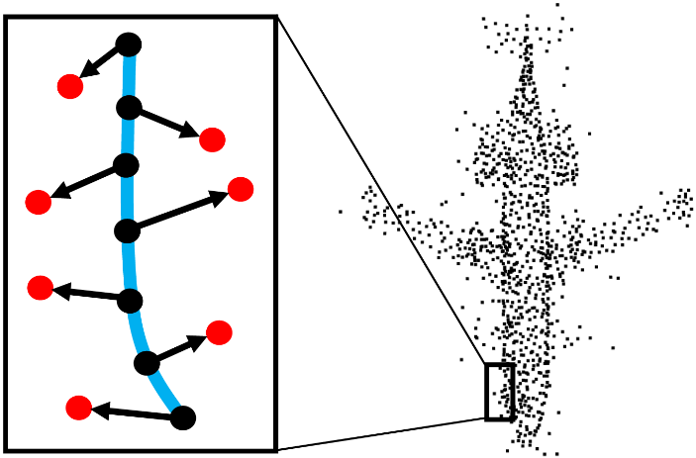
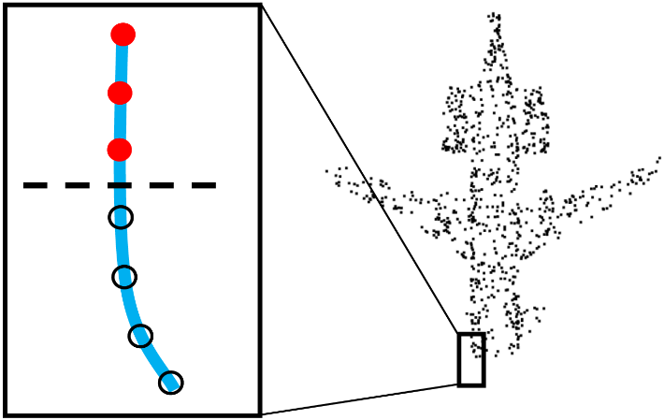
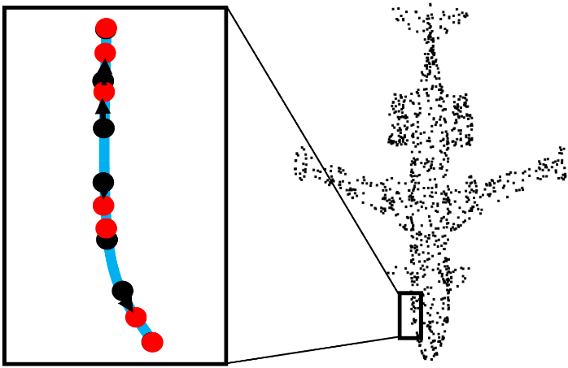
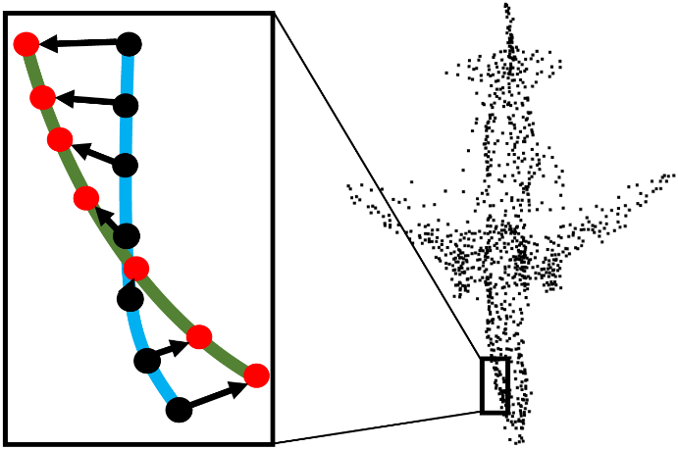
Different Attack Effects
clean
Point perturbation
Out-of-surface perturbation
On-surface perturbation
Surface distortion
Local part removal
Geometric Deformation
(a) out-of-surf. pert.
(c) Part Removal
(b) on-surf. pert.
(d) Geo. Deformation

Slide 5
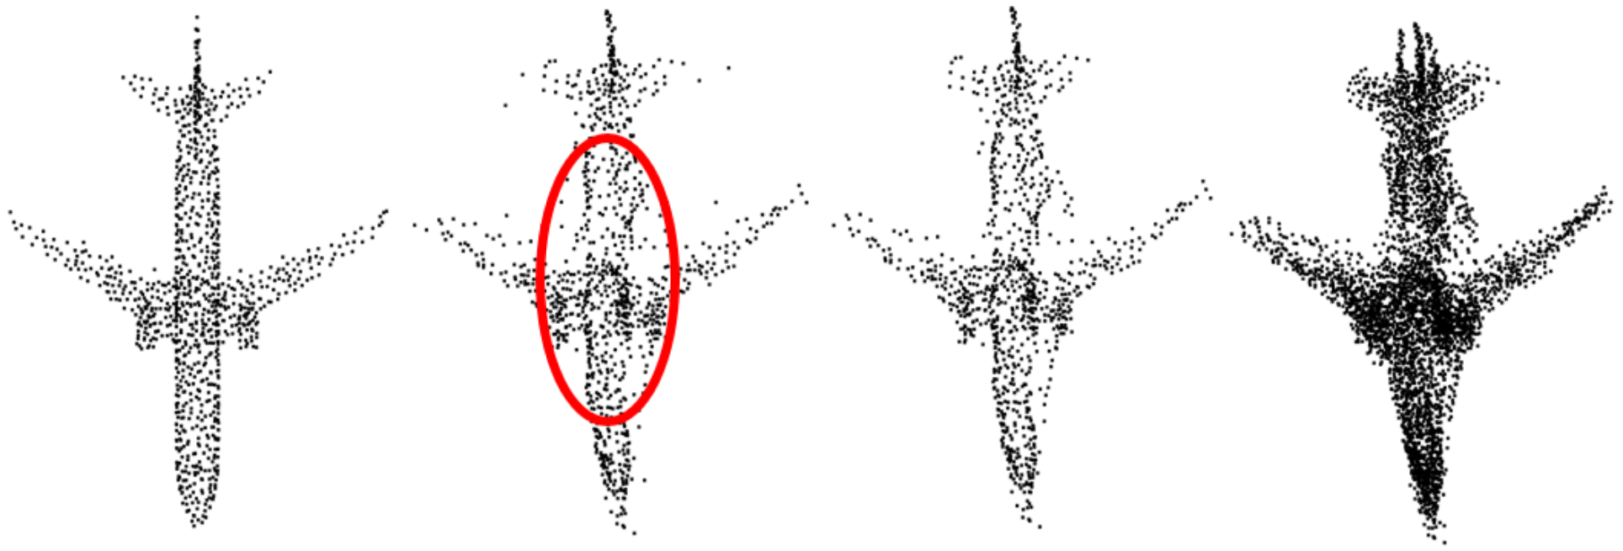
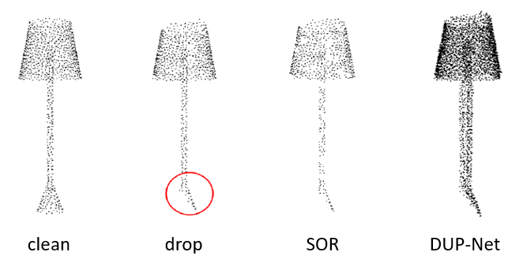
Existing Defenses
SOR (Statistical Outlier Removal): identify outliers via $k$NN distance
DUP-Net (SOR+PU-Net, previous SOTA)
Can perform outlier removal to solve out-of-surface perturbation
Cannot recover on-surface perturbation
Do not consider surface distortion!
clean
adv
SOR
DUP-Net
clean
adv
SOR
DUP-Net
[1] Zhou, Hang, et al. "DUP-Net: Denoiser and upsampler network for 3D adversarial point clouds defense." ICCV 2019.

Slide 6
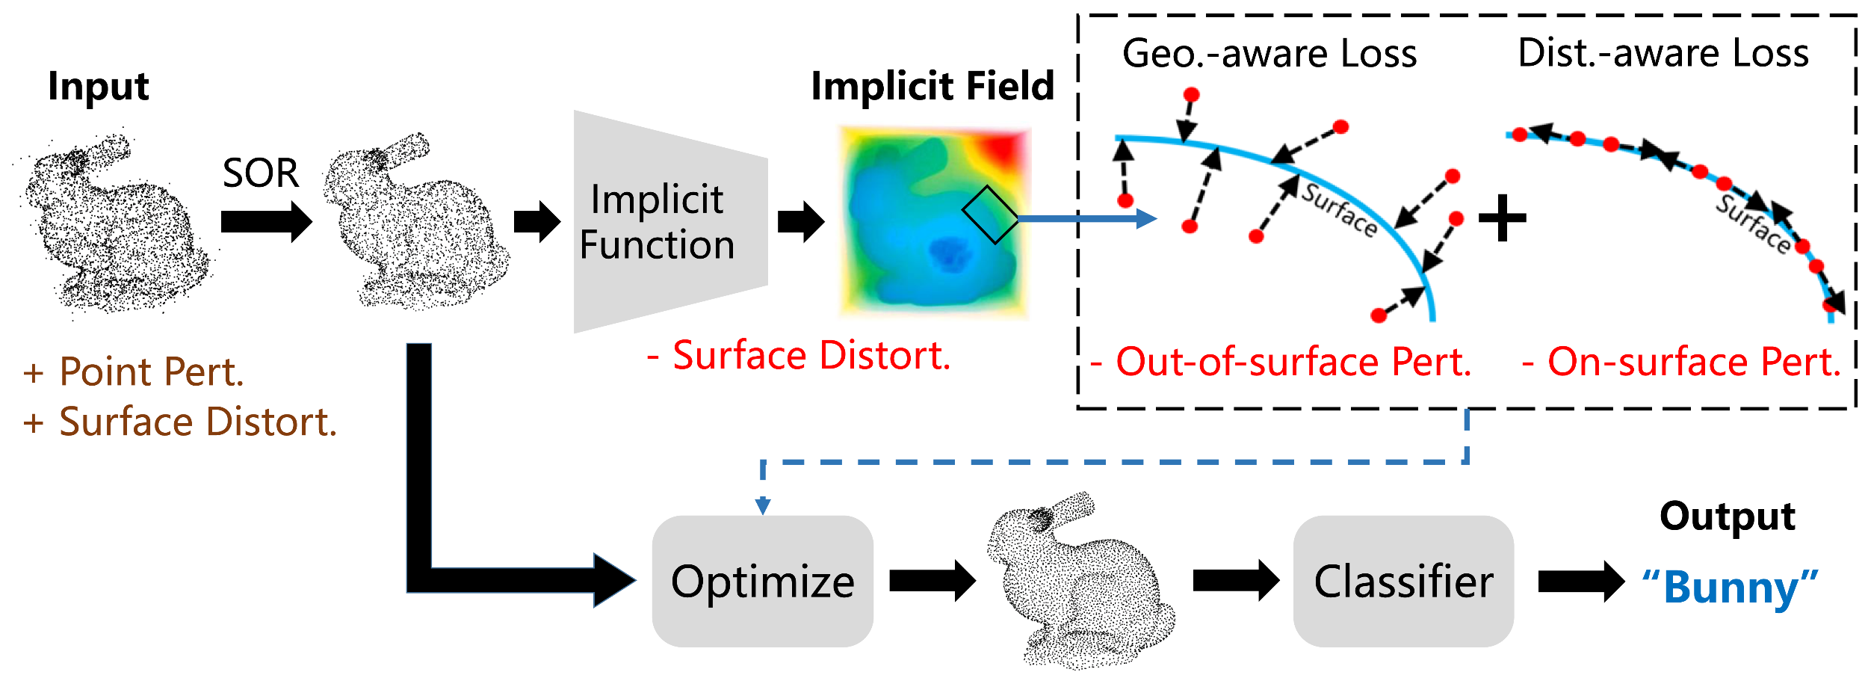
IF-Defense: Implicit Function based Restoration
Two key steps of our defense:
Surface recovery: recover the natural shape, via an implicit function network
Point cloud restoration: re-generate points from implicit fields of shapes, via an optimization-based process

Slide 7
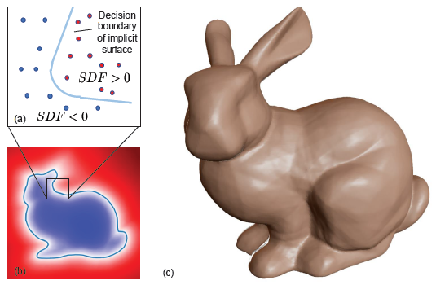
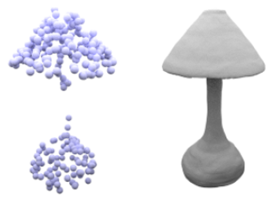
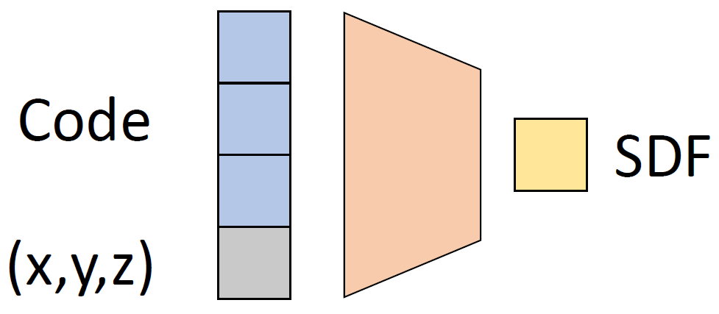
Surface Recovery
Implicit function (IF) network: trained on clean shapes in the reconstruction task
Encode shape priors: natural shape completion & recovery
Input the adv point cloud to an IF, get an implicit representation of the natural shape
DeepSDF
Occupancy Network
[1] Park, Jeong Joon, et al. "Deepsdf: Learning continuous signed distance functions for shape representation." CVPR 2019.
[2] Mescheder, Lars, et al. "Occupancy networks: Learning 3d reconstruction in function space." CVPR 2019.

Slide 8
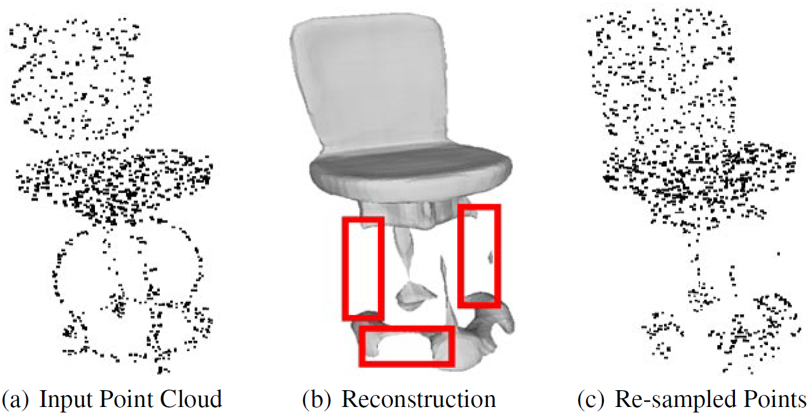
Point Cloud Restoration
How to re-generate a point cloud from the implicit representation?
An intuitive way: re-mesh & re-sample
Errors in the implicit field degrade the defense performance!
[1] Park, Jeong Joon, et al. "Deepsdf: Learning continuous signed distance functions for shape representation." CVPR 2019.
[2] Duan, Yueqi, et al. "Curriculum DeepSDF." ECCV 2020.

Slide 9
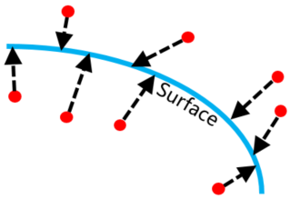
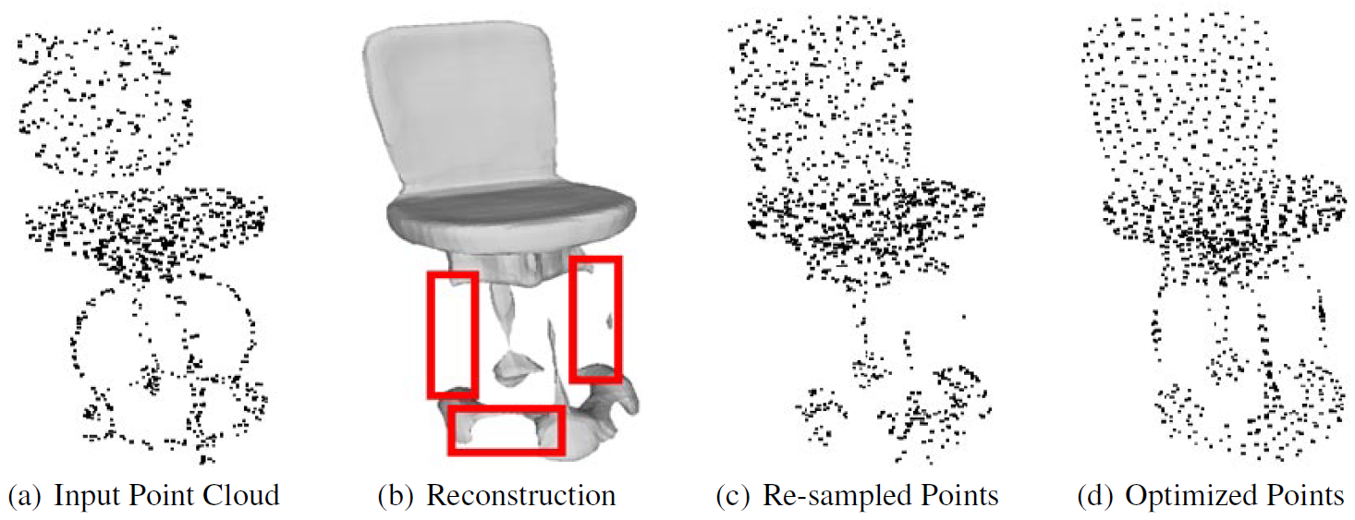
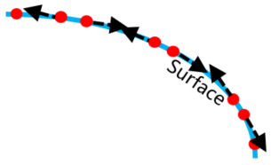
Optimization-based Restoration
0.5
Input points lying on missing parts, can compensate the errors in implicit field!
Initialize from input points, optimize their coordinates according to:
Geometry-aware loss: capture the surface
Distribution-aware loss: uniform distribution
Geo-aware loss
$$ℒ_{S}=\sum_{i}{ℒ_{ce}(ONet\left(x_{i}, z\right),0.5)}$$
Dist-aware loss
$$ℒ_{D}=\sum_{i}{\sum_{j∈kNN(x_{i})}{−||x_{i}−x_{j}||⋅e^{−α||x_{i}−x_{j}||}}}$$

Slide 10
Experiments
ModelNet40 classification task
Victim models: PointNet, PointNet++, DGCNN, PointConv and RS-CNN
Implicit function network: ONet and ConvONet
Attacks evaluated:
Point perturbation – CVPR’19
Point adding – CVPR’19
kNN attack – AAAI’20
Point dropping – ICCV’19
LG-GAN – CVPR’20
AdvPC – ECCV’20
Defenses evaluated:
SOR
DUP-Net (previous SOTA)
SOR+PointNet AutoEncoder (SOR-AE)
Re-meshing based IF-Defense w/ ONet (Mesh)
Optimization based IF-Defense w/ ONet or ConvONet (Opt or Conv-Opt)
Out-of-surface perturbation
On-surface perturbation
Local part removal
Geometric deformation
[1] Peng, Songyou, et al. "Convolutional occupancy networks." ECCV 2020.

Slide 11
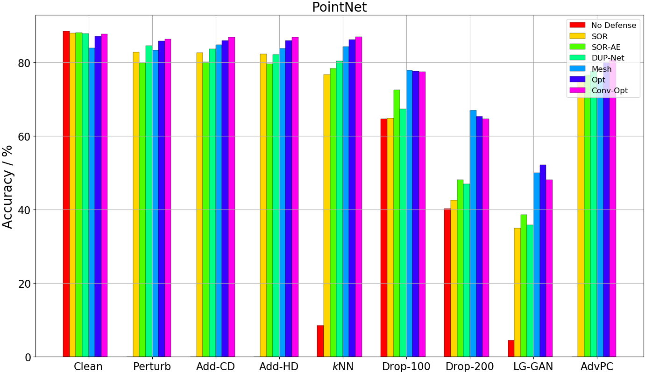
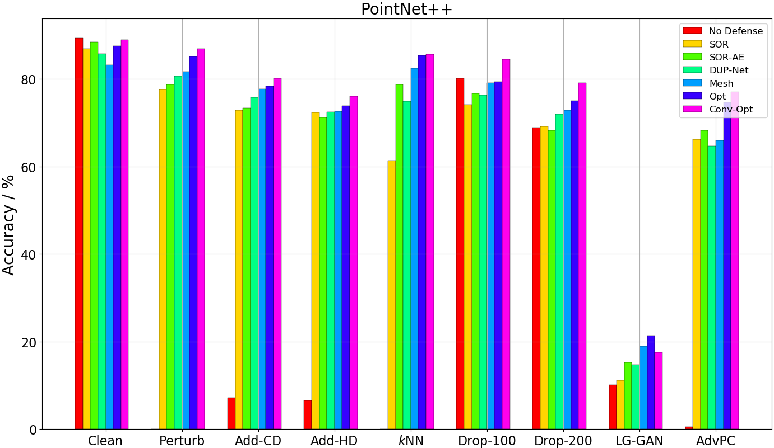
Experimental Results
3.17%
8.77%
Opt consistently outperforms Mesh, while Conv-Opt achieves new SOTA
Small improvement on perturb and adding attack
Significant increase on $k$NN, dropping, LG-GAN, AdvPC
6.64%
6.89%
7.09%
18.88%
13.54%
6.19%

Slide 12
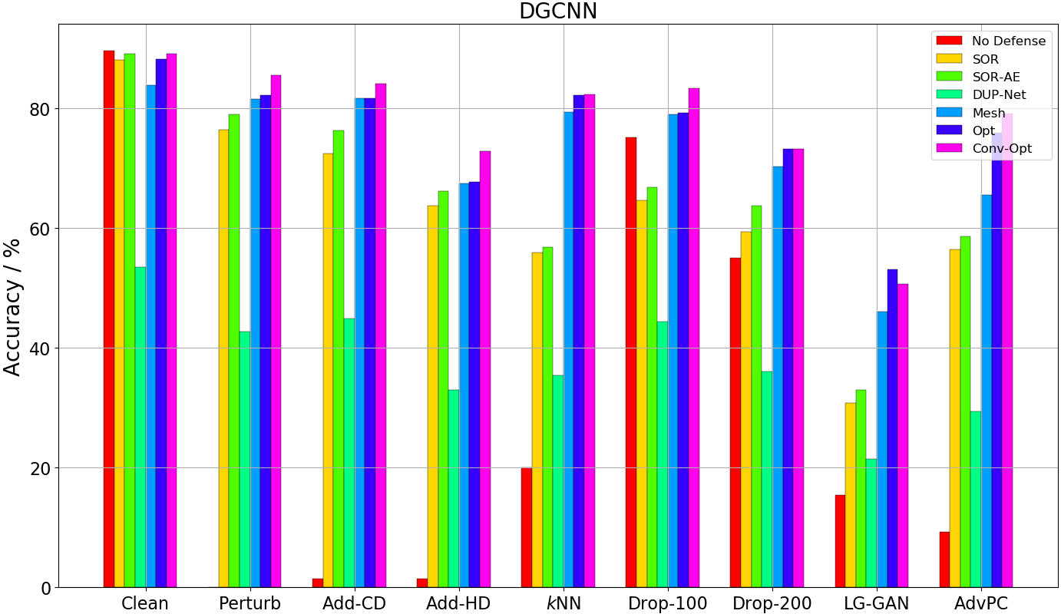
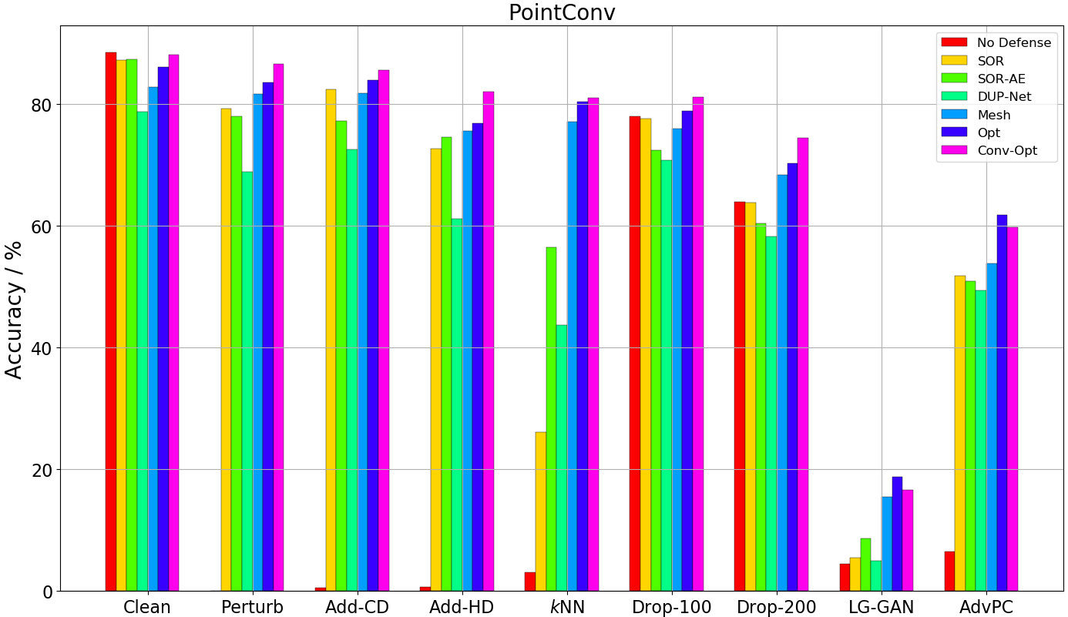
Experimental Results
20.47%
10.02%
Opt consistently outperforms Mesh, while Conv-Opt achieves new SOTA
DUP-Net performs poorly, since it distorts local point distribution
25.55%
24.58%
9.60%
10.73%
20.12%
10.14%

Slide 13
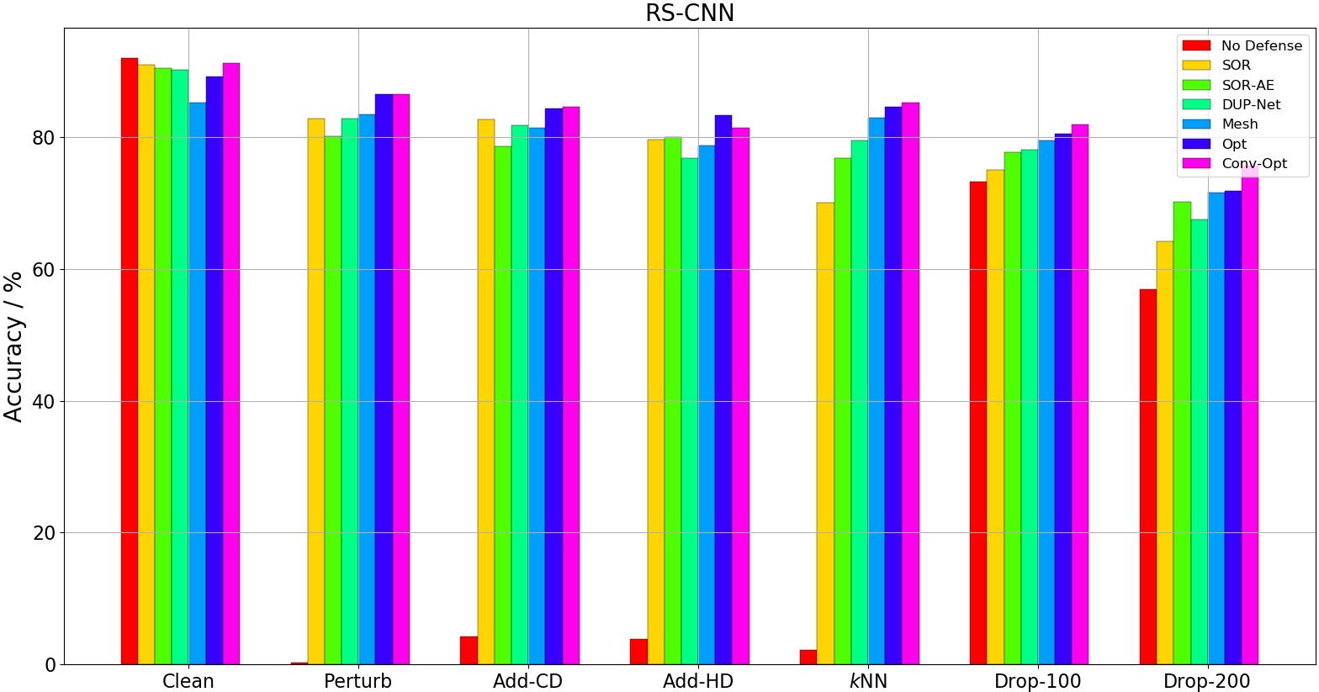
Experimental Results
IF-Defense still achieves the highest accuracy against all the attacks
Interestingly, DUP-Net performs fairly well here
RS-CNN inputs the distance between points, thus modeling the point distribution
5.79%
5.42%

Slide 14
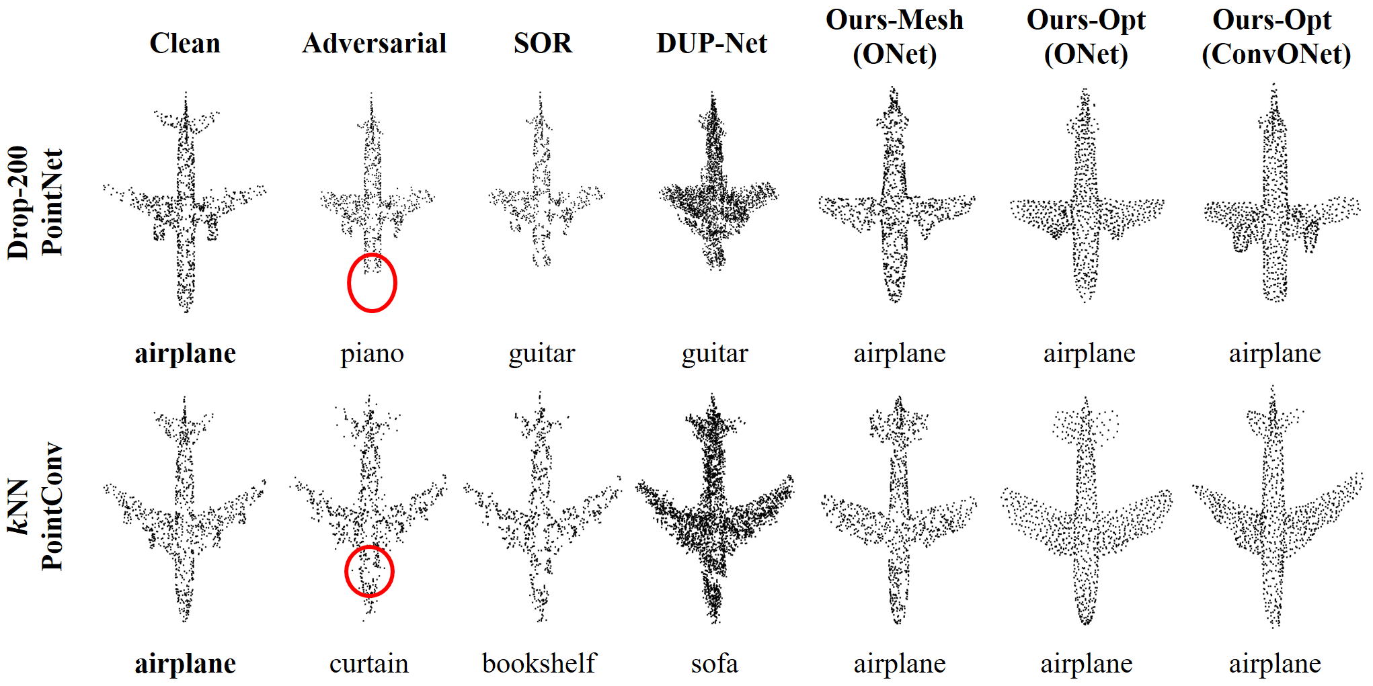
Qualitative Results

Slide 15
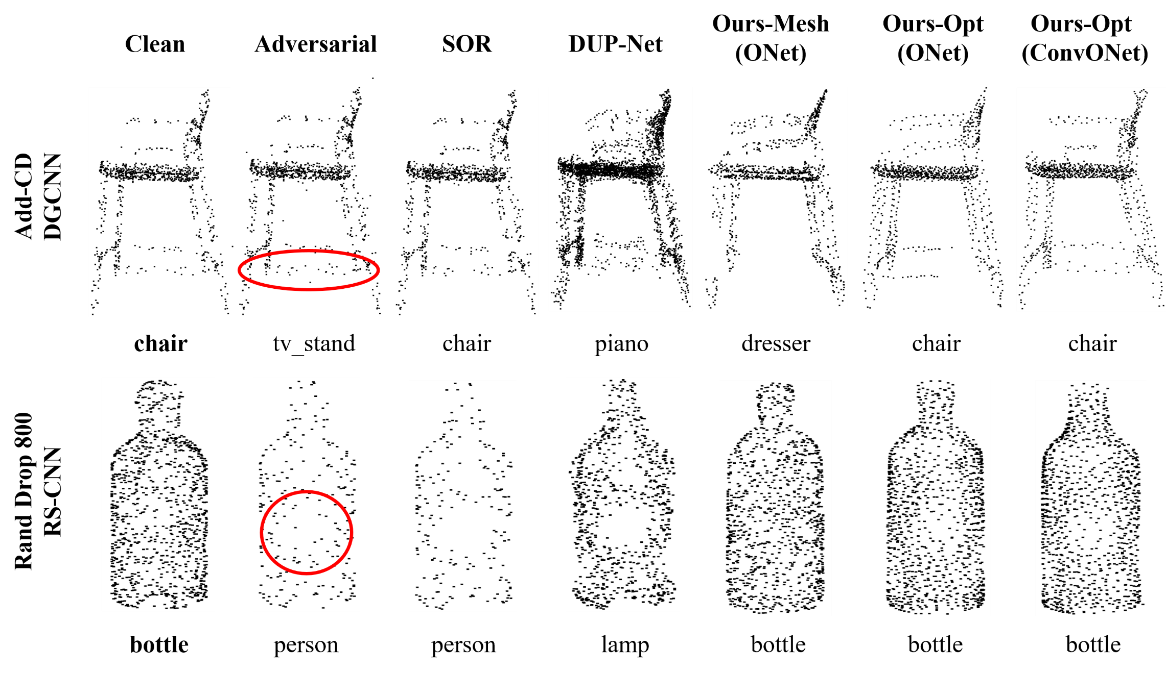
Qualitative Results

Slide 16
Rethinking: Why Implicit Function?
We need shape priors to recover surface distortion – the reconstruction models
Explicit representations:
Point cloud: cannot control point distribution
Voxel/Mesh: errors in reconstruction results
Implicit representations:
Can leverage inputs to compensate reconstruction errors
Can optimize towards desired point distribution
The point cloud restoration process is non-differentiable

Slide 17
More Experiments
Inference Time
Adaptive Attack
White-box attack targeting on IF-Defense
The optimization process is non-differentiable, so attack the implicit field
Accuracy still higher than 50%
The encoder-decoder structure
$$ℒ_{2}=−\sum_{i}{ℒ_{ce}(ONet\left(\hat{x_{i}}, z\right),0.5)}$$
$$ℒ_{1}=−||z−\hat{z}||_{2}^{2}$$
$k$NN attack: ~80%

Slide 18
Summary
Comprehensive study of the effects of existing 3D adv attacks
Propose a general defense framework IF-Defense to tackle all attack effects
Introduce an optimization based method for point cloud restoration
Achieve new SOTA defense performance against all the attacks on five typical point cloud networks
Paper submitted to CVPR’21

Slide 19
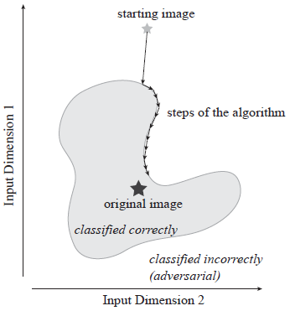
Future Works
Try more point cloud networks, e.g. submanifold-/sparse-convolution
Explore black-box attack in 3D point cloud (on going)
2D black-box attacks rely on exhaustive search
3D attacks have more choices
No clear point correspondence
Find salient points/semantic parts to reduce search space?
[1] Brendel, Wieland, Jonas Rauber, and Matthias Bethge. "Decision-based adversarial attacks: Reliable attacks against black-box machine learning models." ICLR 2018.

Slide 20
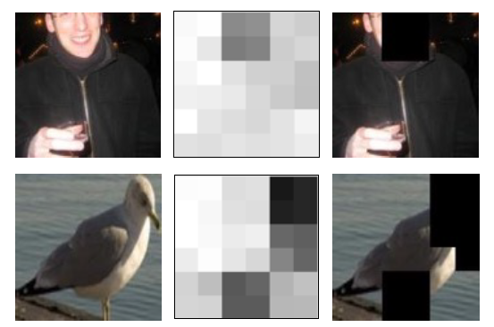
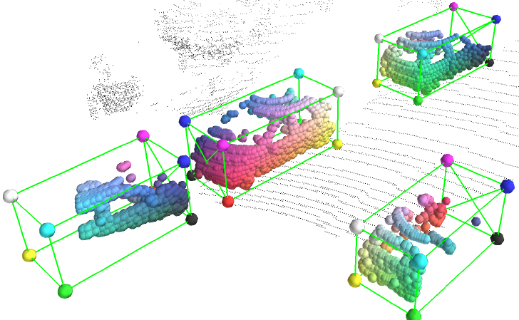
Future Works
Extend to more tasks, e.g. 3D object detection, scene segmentation
Similar work in 2D detection: A-Fast-RCNN (CVPR’17)
Improve detector robustness using adv examples
Generate occlusion masks to make objects harder to detect
However, the resulting images look unnatural, may harm the model
Occlusions/noises in 3D LiDAR point clouds are common and natural
[1] Wang, Xiaolong, Abhinav Shrivastava, and Abhinav Gupta. "A-fast-rcnn: Hard positive generation via adversary for object detection." CVPR 2017.

