Slide 1
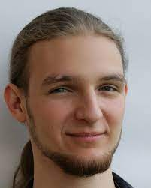
SlotFormer: Unsupervised Visual Dynamics Simulation with Object-Centric Models
ICLR 2023 https://slotformer.github.io/
Ziyi Wu
Nikita Dvornik
Klaus Greff
Thomas Kipf*
Animesh Garg*
(* equal supervision)
Notes:
Hello everyone, this is Ziyi Wu from the University of Toronto and affiliated with the Vector Institute. Today I’ll present our work SlotFormer, which is accepted by ICLR 2023. This is a joint work with collaborators from Samsung research and google research

Slide 2
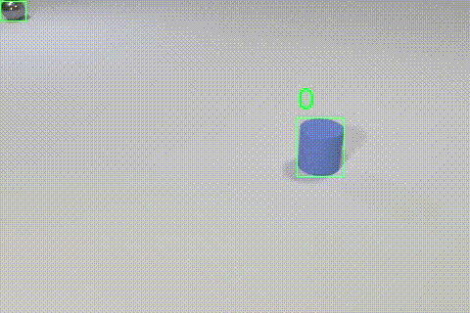
Visual Dynamics Learning
Learning scene dynamics from raw visual data
Unsupervised dynamics learning
Improve downstream supervised tasks
Video credit:
Chen, Zhenfang, et al. "Grounding Physical Concepts of Objects and Events Through Dynamic Visual Reasoning." ICLR. 2021.
Ding, Mingyu, et al. "Dynamic visual reasoning by learning differentiable physics models from video and language." NeurIPS. 2021.
Notes:
This paper tackles the problem of visual dynamics learning, which aims at predicting the future of a scene given a few initial observations. The ability to learn complex multi-object scene dynamics from raw visual inputs is a key component of intelligent systems. It requires the ability to identify individual objects, like the detection bounding boxes here, capture their properties such as appearance and positions, as well as to model their spatio-temporal interactions, such as the collision events
Therefore, unsupervised dynamics learning has been a challenging problem in both computer vision and robotics. Having a faithful dynamics model enables us to predict the future. More importantly, when combined with downstream task models, it allows to transfer the unsupervisedly learned knowledge to improve these supervised tasks, such as visual reasoning and model-based control. For example, in this this VQA task, we are given a few observation frames, and asked about whether the collision event will happen in the future. Equipped with an accurate dynamics model, we can simulate the future rollout of the scene, and easily predict the correct answer

Slide 3
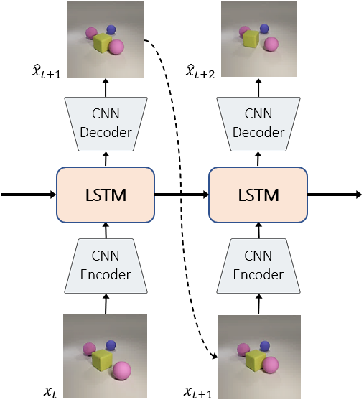
Visual Dynamics Learning
Video prediction: dynamics modeling in pixel space
LSTM over global feature map
Degeneration
GT
PredRNN
GT
PredRNN
Wang, Yunbo, et al. "Predrnn: Recurrent neural networks for predictive learning using spatiotemporal lstms." NeurIPS. 2017.
Notes:
One intuitive approach to visual dynamics learning is to frame it as a video prediction problem in the pixel space. This family of works usually apply recurrent modules such as LSTM over dense image feature maps to predict the next frame, and train the model with a MSE reconstruction loss. However, these models ignore the difference between foreground objects and background environment, as they directly process the entire feature map. It often leads to degeneration over longer horizon. For example, if we unroll PredRNN, a famous video prediction method, from the initial 2 frames, you can see that after several steps, the blue sphere becomes blurry, and the yellow sphere disappears completely. In another example shown here, the green sphere disappear, and the other shapes are blurry as well

Slide 4
Visual Dynamics Learning
Object-centric representations
Represent objects and background with separate features (slots)
Model interactions over slots
Video credit:
Kipf, Thomas, et al. "Conditional Object-Centric Learning from Video." ICLR. 2022.
Notes:
Recently, some approaches leverage object-centric representations to model scene dynamics. The key idea is to decompose the scene into individual foreground objects and background environment, and represent them each with a 1D feature vector, which we call slots. Then, they learn the interactions over slots to model the dynamics

Slide 5
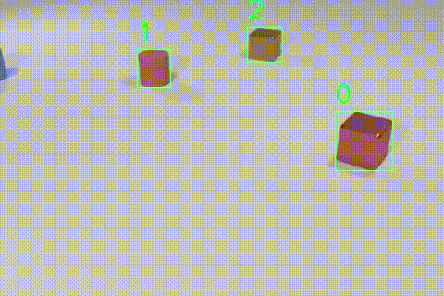
Visual Dynamics Learning
Object-centric representations
Recent trend in computer vision: learning from data
One feature map + task-specific head
Human perception is different!
Discrete concepts, e.g. objects, events
Reason over abstractions of the world
SlotFormer: a fully unsupervised object-centric dynamics model
Video credit:
Chen, Zhenfang, et al. "Grounding Physical Concepts of Objects and Events Through Dynamic Visual Reasoning." ICLR. 2021.
Spelke, Elizabeth S., and Katherine D. Kinzler. "Core knowledge." Developmental science 10.1 (2007): 89-96.
Notes:
So, why do we need OC rep? Well indeed, it seems that recent trend in CV is to learn everything with less inductive bias purely from data, such as vision transformers. They embed everything to a single feature map, and apply task-specific heads to predict desired outputs
However, humans perceive the world in a completely different way. Given visual inputs, we first convert them into discrete concepts such as objects and events, and then reason over these abstractions of the world. Such hierarchical processing mechanism plays an important role in human reasoning. For example given this video, we will first identify individual objects like the bounding boxes here, and interpret their movement using discrete events, such as collision, entering and leaving the scene. Then, we can easily build upon these intermediate rep for high-level reasoning tasks
Inspired by this, in this work, we propose SlotFormer, a fully unsupervised dynamics model built upon object-centric representations. We show that it can not only generate videos of high quality, but also simulate accurate object dynamics which are helpful for downstream supervised tasks

Slide 6
Prior Works
Apply models in the state space of objects
Require GT physical properties
Unrealistic for unsupervised visual dynamics learning
Battaglia, Peter, et al. "Interaction networks for learning about objects, relations and physics." NeurIPS. 2016.
Notes:
Now, let’s review some prior works in object-centric dynamics learning. Some earlier methods directly apply deep models in the state space of objects. However, they require ground-truth physical properties such as position and velocity for training, which is unrealistic for unsupervised visual dynamics learning, because we want to learn from unlabeled raw videos

Slide 7
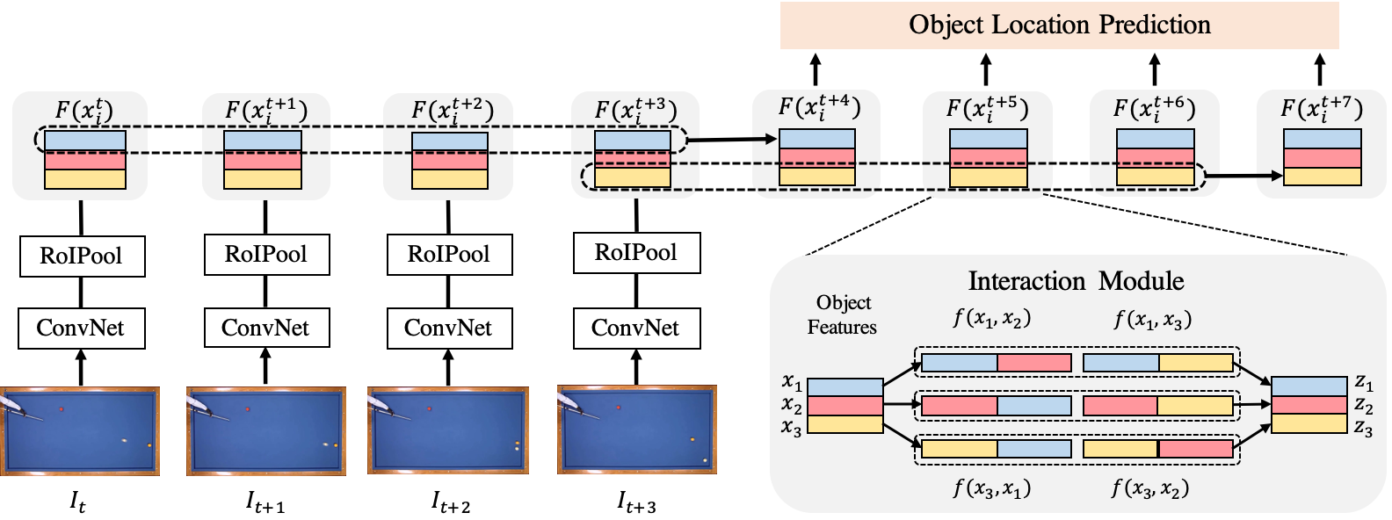
Prior Works
Apply interaction modules over object features from pre-trained detectors
Require supervision to initialize object representations
Qi, Haozhi, et al. "Learning Long-term Visual Dynamics with Region Proposal Interaction Networks." ICLR. 2021.
Notes:
Instead of explicitly learning object states, some works apply powerful interaction modules to infer object dynamics from vision features. However, the OC features usually come from ground-truth annotations or pre-trained detectors. This still requires supervision to initialize object representations. And we know that the generalizability of object detectors is still an open problem itself

Slide 8
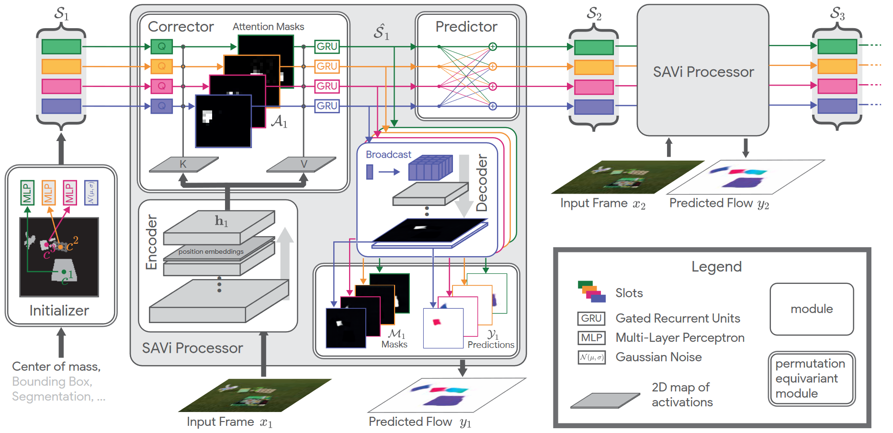
Prior Works
Unsupervised object discovery from videos
Kipf, Thomas, et al. "Conditional Object-Centric Learning from Video." ICLR. 2022.
Notes:
Since our goal is to learn object dynamics without any supervision, we need a way to identify objects from videos without using labels. Recently, several works have extended Slot Attention to unsupervised object discovery from videos. Basically, these methods can be viewed as recurrent encoder-decoder models with a structured latent state composed of K object slots. For each timestep, they first apply CNN encoder to extract frame feature maps. These visual features are then used to update slots via Slot Attention, which encourages each slot to bind to one object in the scene. To train the model, they decode each slot separately to RGB images and alpha masks, which are then combined to reconstruct the input. The entire network is trained using unsupervised reconstruction loss. For time 0, slots are initialized from learnable latent codes. While slots at later timesteps are initialized by applying a Predictor on previous slots. This ensures the temporal consistency of slots

Slide 9
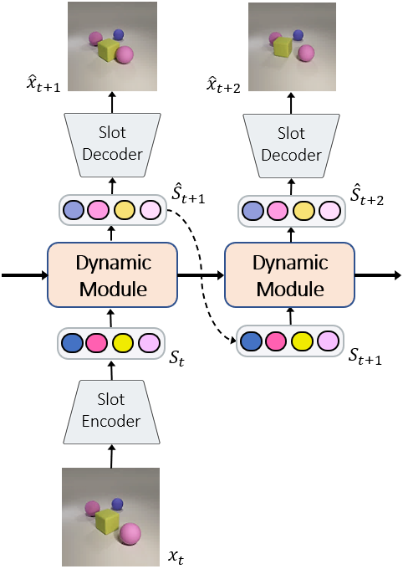
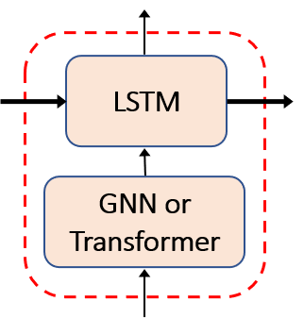
Prior Works
Unsupervised object-centric dynamics model
Object discovery from videos
Dynamics learning over object slots
Drawbacks
Strong priors
Separate modeling of spatial and temporal dynamics
LSTM + GNN/Transformer
Single-step recurrent time window
Zoran, Daniel, et al. "PARTS: Unsupervised segmentation with slots, attention and independence maximization." ICCV. 2021.
Notes:
Vanilla video slot attention models do not explicitly learn scene dynamics. Therefore, recent works study building dynamics module over learned video slots, which are most relevant to our paper. They first segment objects from videos, as you can see here, by extracting a set of slots from input frames. Then, it learns a dynamic module over slots. The dynamic module often consists of a GNN or a Transformer to model the spatial interactions between objects, such as collisions, followed by an LSTM learning the temporal dynamics
However, these methods have 2 main drawbacks. First, the dynamic module is often designed for a specific OC model, imposing strong assumptions on the slots. For example, some methods manually decompose slot features to appearance, position, velocity and depth. The position and velocity is used to model collisions and the depth is used to model occlusions. Such domain-specific priors restrict the model’s scalability to more complex scenes
Second, they still model object interactions and temporal dynamics with 2 separate modules. As a result, the LSTM only sees a single-step time window. The lack of context information often leads to inconsistent rollout over long horizon

Slide 10
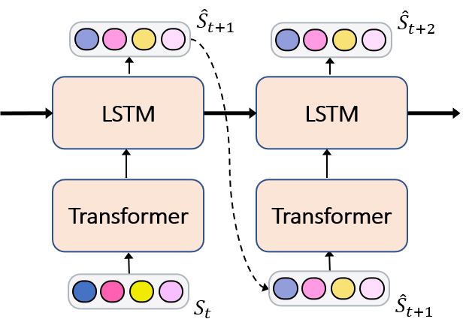
SlotFormer
Motivation: Transformer is good at relationship reasoning
Prior works: single-step object interactions
Our work: multi-step temporal dynamics
Input: $T$ slots $\{S_{1}, S_{2},…, S_{T}\}$. Predict: next slot $S_{T+1}$
Larger context window → consistent object dynamics
Ding, David, et al. "Attention over learned object embeddings enables complex visual reasoning." NeurIPS. 2021.
Yan, Wilson, et al. "Videogpt: Video generation using vq-vae and transformers." arXiv preprint arXiv:2104.10157 (2021).
Notes:
Inspired by the great success of Transformers in seq modeling and relationship reasoning, the motivation of this work is, can we discard LSTM and learn everything purely with a Transformer? In previous methods, they already use Transformers to model object interactions at a single timestep. So here, we aim to incorporate multi-step temporal dynamics as well
And the solution turns out to be quite straightforward. We input slots from T past frames, S1 to ST, and let the model predict slots at time T+1. Since Transformer is powerful enough to process unstructured features, we don’t need priors like slot decomposition. By conditioning on multiple timesteps, the Transformer jointly reasons about spatial-temporal relationship of the scene, leading to consistent object dynamics

Slide 11
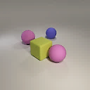
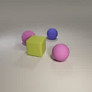
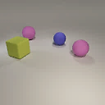
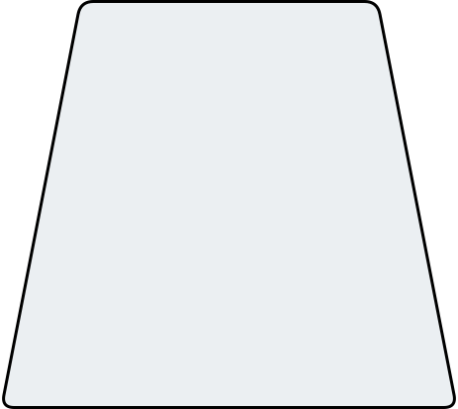
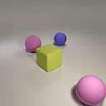
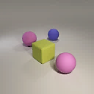
SlotFormer
Future
Rollout
Base slot model
Transformer
Autoreg. generation
Loss
$${\hat{x}}_{T+1}$$
$${\hat{x}}_{T+2}$$
$${\hat{x}}_{T+K}$$
Slot
Decoder
Slot
Decoder
…
Slot
Decoder
$${\hat{S}}_{T+1}$$
$${\hat{S}}_{T+2}$$
$${\hat{S}}_{T+K}$$
Transformer Encoder
Temporal Positional Encodings
Projection Layer
…
…
$$S_{1}$$
$$S_{T}$$
$${\hat{S}}_{T+1}$$
$${\hat{S}}_{T+K−1}$$
Slot
Encoder
Slot
Encoder
Burn-in
Frames
…
$$x_{1}$$
$$x_{T}$$
Notes:
Now, let’s look at the pipeline of SlotFormer. It consists of 4 parts, a base slot model that extracts object slots from videos. The Transformer module that performs visual dynamic reasoning. An autoregressive generation mechanism, and the unsupervised loss functions. Below we’ll look into them one-by-one in detail

Slide 12
SlotFormer
Base slot model
Video Slot Attention model: extract slots $S_{i}∈ℝ^{N×D}$ from input frame $x_{i}$
Slots are temporally-aligned
Pre-trained on target dataset
Transformer
Autoreg. generation
Loss
…
$$S_{1}$$
$$S_{T}$$
Slot
Encoder
Slot
Encoder
Burn-in
Frames
…
$$x_{1}$$
$$x_{T}$$
Kipf, Thomas, et al. "Conditional Object-Centric Learning from Video." ICLR. 2022.
Singh, Gautam, Yi-Fu Wu, and Sungjin Ahn. "Simple Unsupervised Object-Centric Learning for Complex and Naturalistic Videos." NeurIPS. 2022.
Notes:
First of all, we need to extract object slots from videos. Thanks to the powerful Transformer, we can build upon any OC models that is able to decompose videos into temporally consistent slots. Specifically, we employ models from the Slot-Attention family due to their strong performance in unsup obj discovery. Given T input frames, our OC model extracts a set of N slots from each frame. These slots are temporally-aligned, for example if at timestep 1, the yellow cube is represented by the 1st slot, then it will still be represented by the same slot position at later timesteps. This property can ease the learning of downstream task models such as VQA network
Before training the Transformer-based dynamics module, we will first pre-train the OC model on videos from the target dataset. This ensures the learned slots can accurately capture both foreground objects and background environment of the scene

Slide 13
SlotFormer
Base slot model
Transformer
Permutation equivariant P.E.
Spatio-temporal interaction
Autoreg. generation
Loss
$${\hat{S}}_{T+1}$$
Transformer Encoder
Temporal Positional Encodings
Projection Layer
…
$$S_{1}$$
$$S_{T}$$
Slot
Encoder
Slot
Encoder
Burn-in
Frames
…
$$x_{1}$$
$$x_{T}$$
Notes:
To build the dynamics module of SlotFormer, we stack multiple layers of the standard Transformer encoder. The slots are first linearly projected to the latent space, and added with a temporal positional encoding to indicate their input orders. For the positional encoding, a naïve solution is to use the sinusoidal one, which applies a different encoding to every slot regardless of its timestep. However, this will break the temporal consistency of slots, because the model may overfit to some specific combinations of object slots and their positions within one timestep. Instead, we only apply P.E. at the temporal level, such that the slots at the same timestep receive the same encoding. Our ablation study shows that despite having less parameters, temporal P.E. clearly improves the VQA performance
Now, we can utilize the Transformer to reason about the dynamics of the scene. We directly input slots from T timesteps to the model to performs joint spatio-temporal interactions. Then, we take the output tokens corresponding to the inputs at timestep T, and feed them to another linear layer to obtain the predicted slots at time T+1
In addition, we also add residual connections from input slot to predicted slot. As a result, the model is forced to learn to refine the slots using dynamics information, thus preserving their absolute order. Thanks to the residual connection and the temporal P.E., SlotFormer is able to preserve the temporal alignment of slots, and can be seamlessly integrated with downstream task models

Slide 14
SlotFormer
Base slot model
Transformer
Autoreg. Generation
Simulate error accumulation
Loss
$${\hat{S}}_{T+1}$$
$${\hat{S}}_{T+2}$$
$${\hat{S}}_{T+K}$$
Transformer Encoder
Temporal Positional Encodings
Projection Layer
…
…
$$S_{1}$$
$$S_{T}$$
$${\hat{S}}_{T+1}$$
$${\hat{S}}_{T+K−1}$$
Slot
Encoder
Slot
Encoder
Burn-in
Frames
…
$$x_{1}$$
$$x_{T}$$
Notes:
We can easily extend SlotFormer from single-step prediction to multi-step rollout. After obtaining slot T+1, we treat it as ground-truth, and use it along with Slot 2 to Slot T to predict Slot T+2. In this way, the Transformer can be applied autoregressively to generate any number of future frames
Such autoreg mechanism is not only used during testing, we also adopt it in training to simulate the error accumulation phenomenon, which is a common failure case in video prediction. Our ablation study shows that this improves the long-term accuracy of object dynamics drastically

Slide 15
SlotFormer
Future
Rollout
Base slot model
Transformer
Autoreg. generation
Loss
Slot recon.
Image recon.
$${\hat{x}}_{T+1}$$
$${\hat{x}}_{T+2}$$
$${\hat{x}}_{T+K}$$
Slot
Decoder
Slot
Decoder
…
Slot
Decoder
$${\hat{S}}_{T+1}$$
$${\hat{S}}_{T+2}$$
$${\hat{S}}_{T+K}$$
Transformer Encoder
Temporal Positional Encodings
Projection Layer
…
…
$$S_{1}$$
$$S_{T}$$
$${\hat{S}}_{T+1}$$
$${\hat{S}}_{T+K−1}$$
Slot
Encoder
Slot
Encoder
Burn-in
Frames
…
$$x_{1}$$
$$x_{T}$$
Notes:
Finally, let’s look at the loss function of our model. Since we have the entire videos during training, we can extract ground-truth slots from rollout frames, and compute the slot recon loss with the predicted slots. In addition, we freeze the pre-trained slot decoder, and use them to decode images from the predicted slots. These images are then used to compute image recon loss with ground-truth video frames
The entire network is trained end-to-end in a fully unsupervised manner

Slide 16
Experiments – Video Prediction
Goal: evaluate the visual quality and object dynamics
Datasets
OBJ3D: 3D scene
CLEVRER: much harder
Baselines
PredRNN: global image feature + LSTM
G-SWM: previous SOTA, which uses sophisticated priors
SAVi-dyn: SAVi + single-step Transformer-LSTM
VQFormer: Transformer over patch tokens (VQ-VAE)
Metrics
Visual quality: PSNR, SSIM, LPIPS (VGG perceptual distance)
Object dynamics: bbox AR, mask ARI, FG-mIoU
Lin, Zhixuan, et al. "Improving generative imagination in object-centric world models." ICML. 2020.
Yi, Kexin, et al. "CLEVRER: Collision Events for Video Representation and Reasoning." ICLR. 2019.
Van Den Oord, Aaron, and Oriol Vinyals. "Neural discrete representation learning." NeurIPS. 2017.
Notes:
OK now let’s move to the experiment part. We want to show that SlotFormer is a general-purpose dynamics model. So to begin with, we evaluate SlotFormer on the video prediction task on the visual quality of the generated videos and the simulated object dynamics
We experiment on two synthetic datasets. OBJ3D consists of object dynamics in 3D scenes, which is already the hardest dataset tested in previous papers. A sphere is launched from the front of the scene to collide with other objects. CLEVRER is a more challenging one. As you can see, the objects are smaller and there could be multiple objects entering the scene from arbitrary directions
We use 4 baselines. PredRNN is a traditional global image feature + LSTM method without the OC inductive bias. G-SWM is the previous SOTA OC dynamic model, which injects lots of hand-crafted priors in their framework. We design SAVi-dyn as SAVi plus a dynamics module, which is implemented as a single-step Transformer followed by an LSTM. Since our base model is also SAVi, by comparing SlotFormer and SAVi-dyn we can study whether Transformer is better than LSTM in dynamics modeling. Finally, to verify the effectiveness of slot representation, we design VQFormer, which uses the same spatio-temporal Transformer, but the inputs are patch tokens produced by VQ-VAE instead of object slots
For evaluation metrics, we measure the videos’ visual quality with PSNR, SSIM and LPIPS. PSNR and SSIM are similar to MSE, and LPIPS is the famous perceptual distance. To measure the predicted object dynamics, we use bbox avg recall (AR) and mask ARI which is similar to mIoU, and FG-mIoU which only measures the IoU of fg objects. These object-level metrics reflect the accuracy of the predicted object positions at each timestep, thus measuring the predicted object trajectories

Slide 17
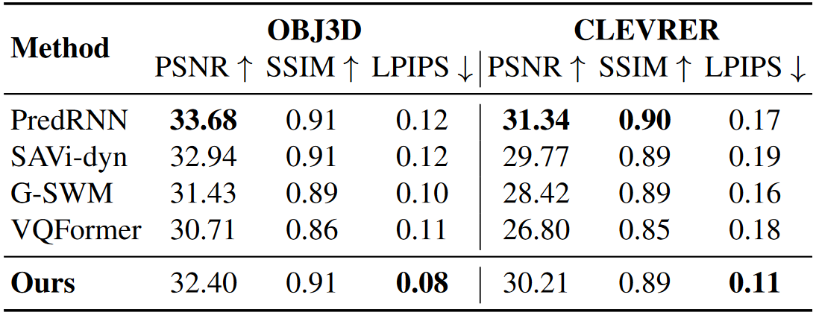
Visual Quality
PSNR and SSIM are inappropriate
SlotFormer achieves SOTA LPIPS
Zhang, Richard, et al. "The unreasonable effectiveness of deep features as a perceptual metric." CVPR. 2018.
Sara, Umme, Morium Akter, and Mohammad Shorif Uddin. "Image quality assessment through FSIM, SSIM, MSE and PSNR—a comparative study." Journal of Computer and Communications 7.3 (2019): 8-18.
Notes:
First let’s look at visual quality. It’s a common agreement that PSNR and SSIM don’t align with human perception well. As shown in this qualitative result, PredRNN produces blurry objects while SlotFormer is nearly perfect. But it still gets higher PSNR and SSIM than ours. In contrast, LPIPS captures consistent perceptual similarity with human. As you can see here, SlotFormer outperforms PredRNN by a sizeable margin, so we focus the comparison on LPIPS. For numerical results, we achieve SOTA LPIPS on both datasets and competitive PSNR and SSIM

Slide 18
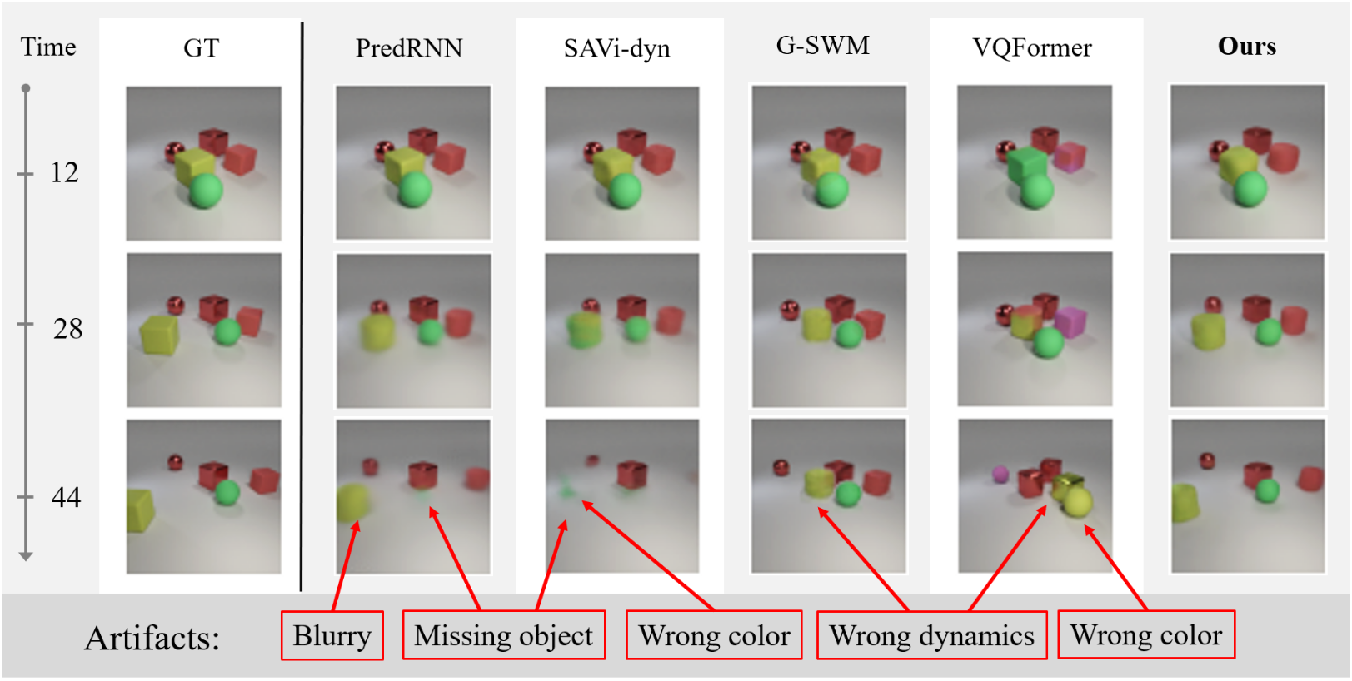
Object Dynamics
SOTA in bbox and mask → object trajectory
Notes:
Then let’s look at object dynamics. Since OBJ3D doesn’t have object-level annotations, PredRNN and VQFormer cannot generate such output, we don’t include them here. As shown in the table, SlotFormer achieves SOTA in all the metrics
Qualitatively, PredRNN still produces blurry objects due to lack of OC inductive bias. SAVi-dyn generates frames where the cylinder disappears because LSTM is not good at long-seq modeling. G-SWM also generates blurry objects in later frames. This is because its hand-crafted priors limit the model capacity. Finally, VQFormer generates sharp images because of its powerful VQ-VAE decoder. However, it fails to predict correct dynamics and object attributes. This shows that only a strong decoder to generate realistic images is not enough for learning accurate dynamics

Slide 19
Long-Term Consistency
Previous papers unroll <20 steps, we unroll >40 steps!
Better long-term results
Notes:
To gain more insights in why SlotFormer outperforms baselines, we plot the comparison of per-step metrics. Previous works only do short-term rollout for <20 steps, while we unroll for over 40 steps here. The first figure is LPIPS on OBJ3D dataset, where lower is better. The blue curve is SlotFormer. Although we’re worse than some baselines at the beginning, we achieve clear advancement at longer horizon. The right figure plots FG-mIoU on CLEVRER, where higher is better. You can see that SlotFormer is the best throughout the entire rollout length

Slide 20
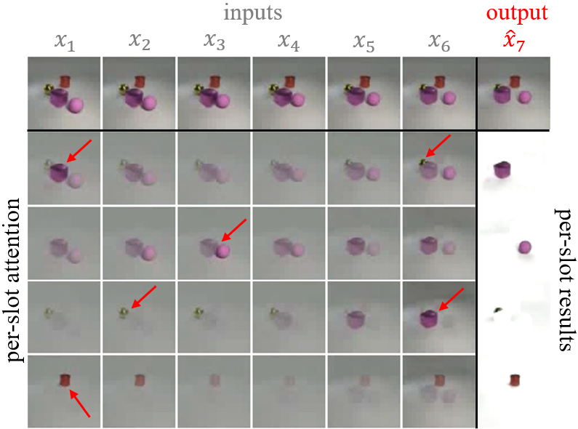
Self-Attention Maps Analysis
Spatio-temporal attention enables handling collisions, occlusions
Notes:
Finally, as a common practice in Transformer papers, we analyze its self-attn map. The first row are input and output video frames. The other rows are per-slot results. This column is the synthesized objects. The attention map indicates which region the model attends upon when predicting this object. In this example, the purple cube just collided with the purple sphere, and is about to hit the yellow sphere. When predicting the purple cube at next step, the model looks at the collision event and the yellow sphere it will hit. For the purple sphere, it only focus on the purple cube because it will never hit the yellow sphere. These two examples prove that the Transformer learns the correct interaction between objects.
For the yellow sphere, since it’s heavily occluded in x6, the model attends to earlier frames to get its appearance, and also the purple cube for the potential collision. Finally, the red cylinder just attends to itself because it’s not involved in the interactions.

Slide 21
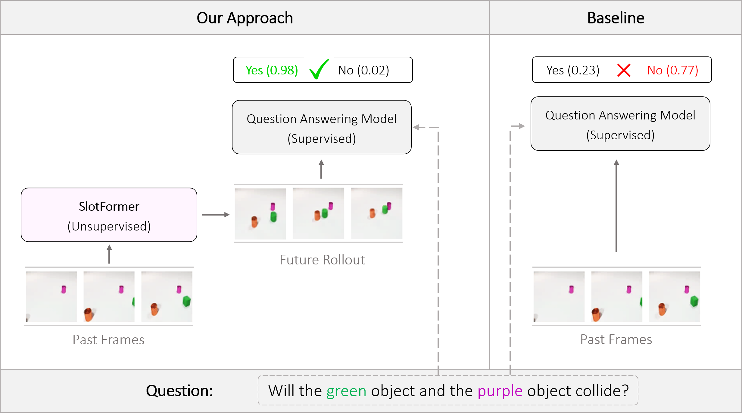
Experiments – Downstream Tasks
Goal: use the dynamics learned by SlotFormer to improve downstream tasks
Notes:
As a general-purpose dynamics model, SlotFormer can not only generate high quality videos, but also be combined with downstream task models to improve their performance
Here is an illustration of how it works. In this VQA task, the model observes a few frames, and is asked a question about a future event. Baseline methods simply extracts features from input frames to predict the answer. However, it produces the wrong result because it doesn’t explicitly reason about the future. In contrast, we unroll SlotFormer to simulate accurate future frames, which contain useful information for the correct answer. For example in this case, it successfully simulates the collision between the green and the purple cylinder. In this way, the unsupervised dynamics knowledge learned by SlotFormer can be transferred to improve downstream supervised task models

Slide 22
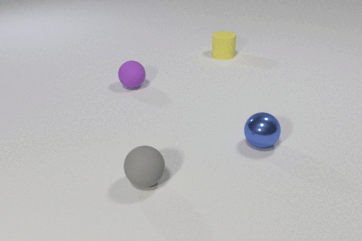
CLEVRER VQA
Descriptive: object properties
Explanatory: why it happens
Predictive: what will happen next
Counterfactual: what will happen if…?
Yi, Kexin, et al. "CLEVRER: Collision Events for Video Representation and Reasoning." ICLR. 2019.
Notes:
We evaluate our method on the CLEVRER VQA dataset. This dataset contains 4 types of questions. The descriptive and explanatory questions only ask about objects or events that occur during input frames. The predictive question requires the model to accurately simulate future events. So we focus our experiment on it, and compare the accuracy improvement brought by unrolling SlotFormer. The counterfactual question also involves dynamics simulation. However, it requires us to remove specific objects from the scene at the beginning. This is not compatible with our framework, as we don’t assume object-level annotations to identify the objects

Slide 23
CLEVRER VQA
Baselines
DCL: pre-trained detector + GNN-based dynamics module
VRDP: 3 variants of object detector + differentiable physics simulator
Aloe: unsupervised object slots + no dynamics module
Ours
Run Aloe on observed + unrolled future slots
Observed
Future (rollout)
Q: will the green cube and the purple cylinder collide next? A: yes!
Chen, Zhenfang, et al. "Grounding Physical Concepts of Objects and Events Through Dynamic Visual Reasoning." ICLR. 2021.
Ding, Mingyu, et al. "Dynamic visual reasoning by learning differentiable physics models from video and language." NeurIPS. 2021.
Ding, David, et al. "Attention over learned object embeddings enables complex visual reasoning." NeurIPS. 2021.
Notes:
We adopt three baselines to compare with. DCL employs a pre-trained object detector and a GNN-based dynamics module. VRDP tests 3 variants of object detectors, namely unsupervised object slots, pre-trained object detectors, and pre-trained detectors with additional object attribute supervision. VRDP runs differentiable physics engine over detected objects to simulate future dynamics, which exploits heavy priors about the environment. Finally, we choose Aloe as our base task model. Aloe also uses unsupervised object slots, and runs powerful Transformers over slots and texts for question answering. However, it does not have a dynamics module
Therefore, we equip Aloe with SlotFormer as the dynamics module. For predictive questions, we explicitly unroll SlotFormer, and feed both the observed and unrolled slots to the VQA model. For other questions, we just input observed slots to the model as the original Aloe

Slide 24
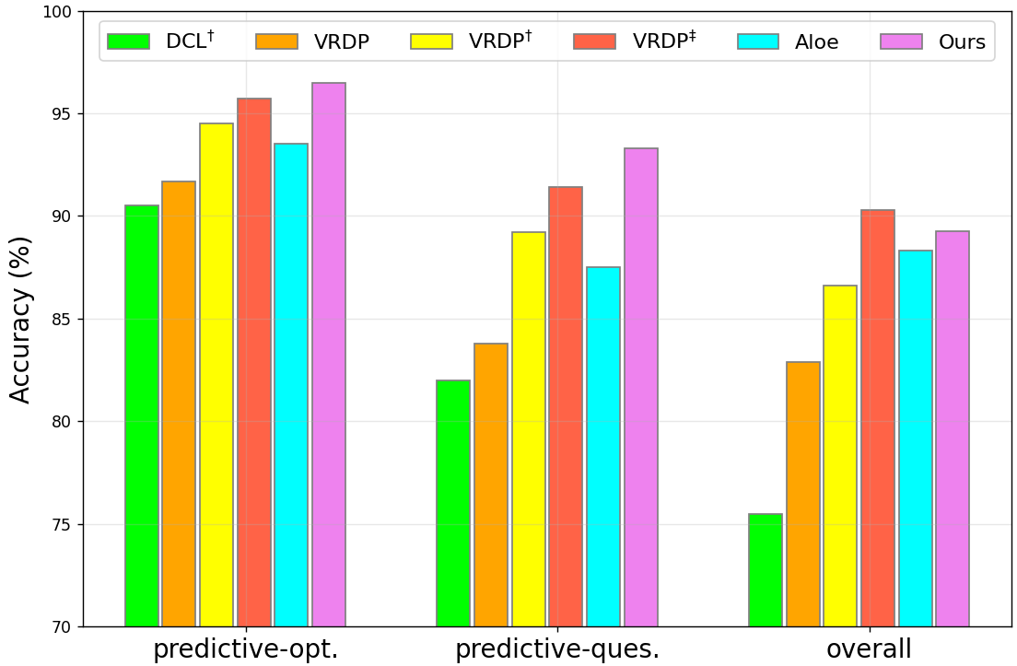
Quantitative Results
†: use pre-trained detectors. ‡: use object property labels. We are fully unsupervised!
Notes:
Here we show the quantitative results on predictive questions, and the overall average accuracy. opt and ques stand for per-option acc and per-question acc, which are two evaluation metrics. As an unsupervised dynamics model, our approach outperforms DCL and VRDP trained with object-level annotations in both settings of the predictive questions. Compared to Aloe which only reasons over input frames, the dynamics knowledge in SlotFormer successfully boosts its performance in predictive questions by 3.4 and 6 % in the per-opt and per-ques settings, respectively. Finally, for overall accuracy, we still outperform baselines with pre-trained detectors, and is competitive with VRDP which uses fine-grained object attributes labels

Slide 25
Qualitative Results
Observed
Future (not provided)
Q: will the green object and the
purple object collide next?
SlotFormer rollout
A: Yes
Observed
Future (not provided)
Q: will the blue cube and the
purple cube collide next?
SlotFormer rollout
A: Yes
Notes:
Here we show some qualitative results. In this example, SlotFormer successfully simulates 2 consecutive collisions, and helps the VQA model to predict the correct answer
In the second example, SlotFormer simulates the purple cylinder being bounced away after the first collision, and then collides with the distant blue cube, leading to the correct answer

Slide 26
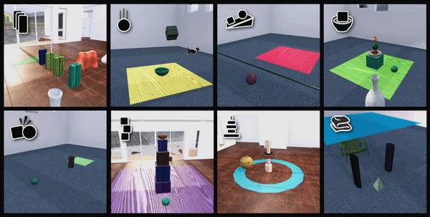
Physion VQA
Question: will 2 objects contact in the future?
Features
8 physical phenomena
Rigid-body collision
Falling, rolling, sliding
Soft-body deformation
Visually complex
Diverse objects
Distractors
Complicated background
We use STEVE to extract slots
Bear, Daniel, et al. "Physion: Evaluating Physical Prediction from Vision in Humans and Machines." NeurIPS Datasets and Benchmarks Track. 2021.
Singh, Gautam, Yi-Fu Wu, and Sungjin Ahn. "Simple Unsupervised Object-Centric Learning for Complex and Naturalistic Videos." NeurIPS. 2022.
Notes:
We also experiment on the Physion VQA dataset. The question in this dataset is very simply: will 2 objects in the scene contact in the future?
However, Physion is challenging due to two reasons. First, it has 8 different physical phenomena, which include rigid-body collision, object falling, rolling, sliding, and even soft-body deformation. Second, the videos are visually complex, as there are diverse objects instead of just some shape primitives. Also, there are distractors in the scene, and the background is usually texture-rich and very diverse instead of a single-color background. Together they pose great challenge to model training. To handle such complexity, we adopt STEVE, the SOTA video object-centric model to extract object slots

Slide 27
Physion VQA
Protocol
Given observed frames, rollout with the trained dynamics model
Apply a linear readout layer to predict whether objects (red and yellow) contact
Baselines
RPIN: GT object bbox + GNN-based dynamics module
pDEIT-lstm: global image feature (IN pre-trained DeiT) + LSTM
Observed
Future (rollout)
Q: will the red cube and the yellow floor contact? A: yes!
Qi, Haozhi, et al. "Learning Long-term Visual Dynamics with Region Proposal Interaction Networks." ICLR. 2020.
Touvron, Hugo, et al. "Training data-efficient image transformers & distillation through attention." ICML. 2021.
Notes:
The evaluation protocol of Physion is two step: given a few observed frames, we rollout our trained dynamics model to simulate the future. Then, we train a linear readout layer on the synthesized future to predict whether the two objects contact
We adopt 2 baselines. One is RPIN, which leverages GT object bbox and a GNN-based dynamics module for future prediction. The second one is pDEIT-LSTM. It first extracts global image features using IN pre-trained DEIT, then trains an LSTM to learn the dynamics over these image features. Compared to SlotFormer, these baselines all use additional information

Slide 28
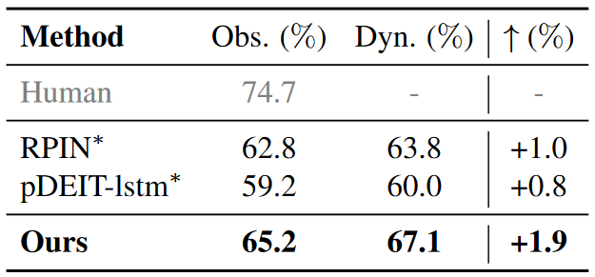
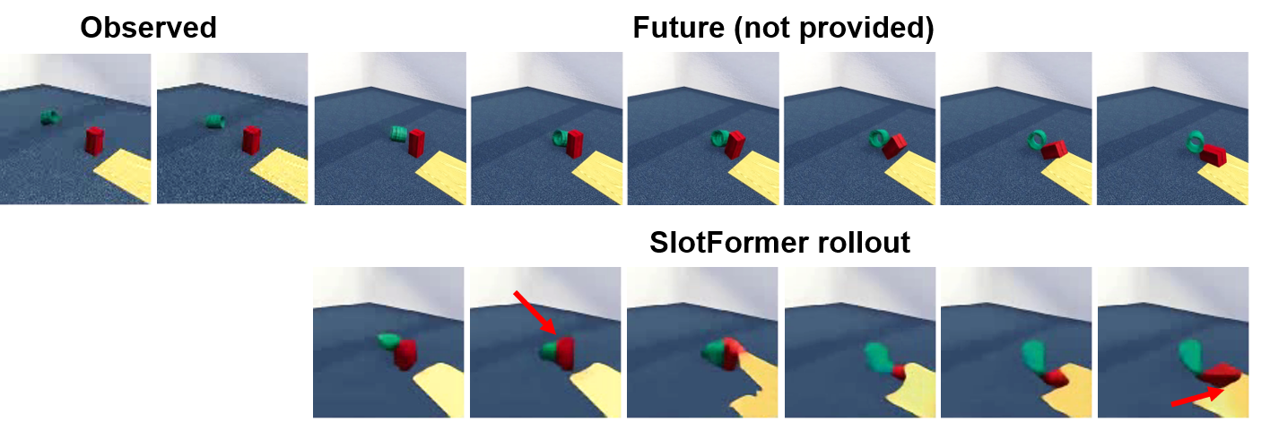
Physion VQA Results
SOTA accuracy and rollout improvement
Compatible with stronger object-centric models
Qualitative results:
Visually not good
Still captures the correct object motion
Notes:
Let’s look at the VQA results. Obs. is the accuracy on observed frames, Dyn. stands for the accuracy on observed plus rollout frames, and we calculate the improvement on the right. Quantitatively, SlotFormer achieves the best accuracy in both cases, and the rollout brings the biggest gain. This proves that SlotFormer is compatible with stronger object-centric models, and thus can handle visually complicated scenes
Qualitatively, the visual quality of generated videos are bad. We will explain the reason next. But overall, we are able to capture the correct object motion. Such as the collision of the two objects, and the falling down of the red cube

Slide 29
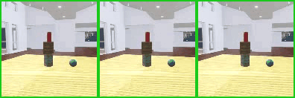
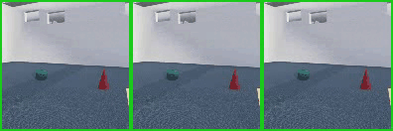
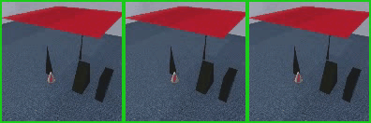
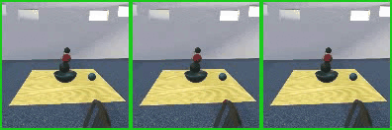
Qualitative Results
Why the generated videos look bad?
Compared to SAVi, STEVE’s slot decoder is not designed for pixel-space reconstruction
Even STEVE reconstructed videos are bad!
GT
Recon.
Rollout
GT
Recon.
Rollout
Notes:
So, why do the generated videos look so bad? This is because compared to SAVi, STEVE uses a Transformer-based slot decoder, which is not designed for pixel-space reconstruction. Here I show the videos reconstructed by STEVE by feeding in GT future slots to STEVE’s slot decoder. You can see that even the reconstructed videos are of low visual quality. Nevertheless, SlotFormer is still able to learn correct object motion in the latent slot space, and benefits downstream VQA task

Slide 30
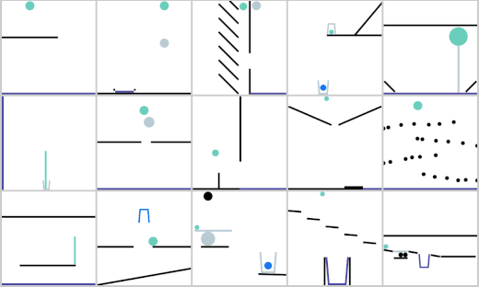
PHYRE Planning
Goal: place a red ball, so that the green ball touches the blue object after rollout
Bakhtin, Anton, et al. "Phyre: A new benchmark for physical reasoning." NeurIPS. 2019.
Notes:
Finally, we try our model on the PHYRE action planning dataset. The goal here is to determine the size of a red ball, and the location to place it, so that after scene evolution, the green ball will touch the blue object. The blue object can be anything, such as another ball, or a cup, or the floor. Note that, the model only has access to the initial frame, and it needs to simulate all the future frames based on it

Slide 31
PHYRE Planning
Protocol: model-based planning, rollout the scene for actions candidates, pick the best future
Baselines (all use GT object masks)
DQN: no rollout
Dec [Joint]: global image feature + LSTM
RPIN: object-centric feature + GNN-based dynamics module
Dyn-DQN: rollout + task-specific loss to inject dynamics information
Metrics: AUCCESS, AUC of the success_rate vs. num_try curve, higher is better
Girdhar, Rohit, et al. "Forward prediction for physical reasoning." arXiv preprint arXiv:2006.10734 (2020).
Qi, Haozhi, et al. "Learning Long-term Visual Dynamics with Region Proposal Interaction Networks." ICLR. 2020.
Ahmed, Eltayeb, et al. "Physical Reasoning Using Dynamics-Aware Models." arXiv preprint arXiv:2102.10336 (2021).
Notes:
Since it’s very hard to train a model to regress the size and position of the red ball, they are actually chose from a set of action candidates via ranking. The evaluation protocol resembles model-based planning. For each candidate action, we will rollout the scene, and train a task success classifier to predict whether it leads to a successful contact. Here are examples of 2 actions, on the left, after rollout, the task is not solved, so we won’t take it, while on the right, it leads to success, so we will choose this action
We compare SlotFormer with 4 baselines. Notably, all of them assume GT object masks. A naïve DQN model which predicts task success from the first frame without doing rollout. Dec [Joint] runs LSTM over global image features. RPIN is again object-centric feature plus a GNN-based dynamics module. Finally Dyn-DQN is DQN with rollout, and it designs some task-specific loss to inject dynamics information to the model
For the evaluation metric, PHYRE uses AUCCESS. You can think of it as the AUC of the success rate VS number of actions tried curve. Higher is better

Slide 32
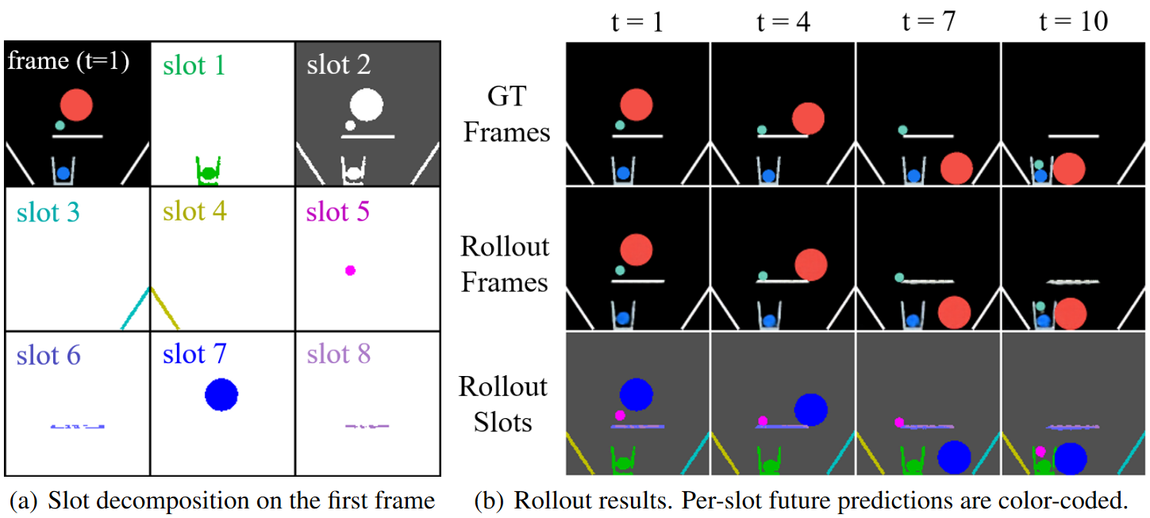
PHYRE Planning Results
As a fully unsupervised dynamics model, we achieve competitive results
SAVi learns reasonable scene decomposition
SlotFormer learns accurate object dynamics
* We reverse the background color for better object discovery results of SAVi
Notes:
Now let’s look at the results. Quantitatively, as a fully unsupervised dynamics model, SlotFormer achieves an AUCCESS score of 82, which is better than baselines that don’t do rollout or use global image features, and on par with more advanced baselines
Qualitatively, we show the per-slot scene decomposition, and the per-slot rollout, using color-coded masks. In general, SAVi learns reasonable scene decomposition into objects, and SlotFormer is able to reason their interactions for accurate future synthesis

Slide 33
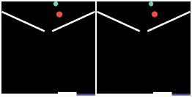
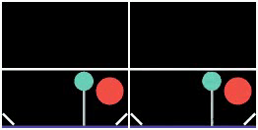
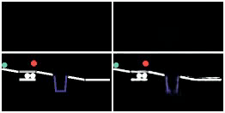
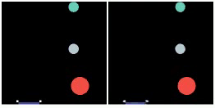
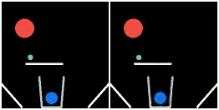
Qualitative Results
All results are conditioned only on the first frame
GT
Rollout
GT
Rollout
Notes:
Here we show more generated videos. Note that all results here are just conditioned on the first frame

Slide 34
Summary
SlotFormer: a general-purpose Transformer-based dynamics model
Build upon any video object-centric representations
Joint spatial-temporal reasoning
SOTA on object dynamics simulation
Improve downstream task performance
Future directions
Joint training of object slots and scene dynamics
Conditional generation, e.g. action-conditioned video prediction
Model uncertainty – stochastic video prediction
Check out our website for more results!
https://slotformer.github.io/
Notes:
In summary, we propose SlotFormer, a general-purpose Transformer-based dynamics model. It builds upon any underlying video OC rep, and performs joint spatio-temporal reasoning over object slots. Therefore, it’s able to generate future frames with high quality, and simulate accurate object dynamics. Experimental results show that we can transfer the learned unsupervised dynamics information to improve downstream supervised task models ``for free”
There are several future directions. Currently, we pre-train OC models to extract slots, and train the Transformer on it. One can explore joint training of the two steps, which may benefit each other. Second, all the tasks in this paper involve unconditional video prediction. We can also study conditional generation, such as action-conditioned generation. Finally, SlotFormer now works in a deterministic fashion. But uncertainty is an important aspect of real-world videos. So how to model multi-modality of the future is also an interesting direction
OK so that’s all for my talk. Thanks for listening. For more results, please check out our website. Thank you!

