Slide 1
LEOD: Label-Efficient Object Detection for Event Cameras CVPR 2024 Ziyi Wu, Mathias Gehrig, Qing Lyu, Xudong Liu, Igor Gilitschenski

Slide 2
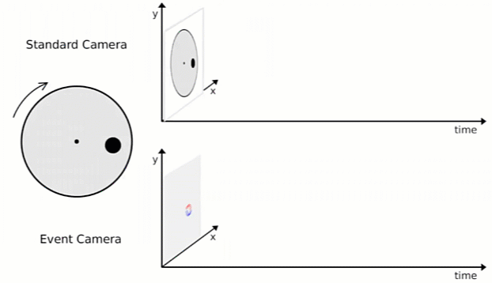
What are Event-based Cameras?
RGB Camera
Event Camera
Video credit: https://dioramslam.com/2021/10/08/event-cameras/
Notes:
So to begin with, what are event-based cameras? How is it different from conventional RGB cameras? Well, here we have a rotating disk with a black dot. If you put your RGB camera towards to this disk, it will record a video, which contains fixed rate image frames. On the other hand, if you use an event camera, you will get a continuous stream of spatio-temporal points. And we call these points events

Slide 3
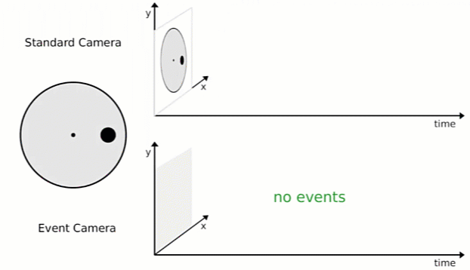
What are Event-based Cameras?
RGB Camera
RGB Camera
no events
Event Camera
Event Camera
Video credit: https://dioramslam.com/2021/10/08/event-cameras/
Notes:
Besides, if you don’t move the disk, RGB cameras still output static frames. However, you won’t get any events from the event camera

Slide 4
RGB Cameras vs. Event-based Cameras
Event camera: outputs asynchronous events, i.e., pixel intensity changes
RGB camera: outputs frames at fixed time interval
Figure credit: https://youtu.be/cFQRFRULCsA
Notes:
Concretely, a conventional RGB camera outputs frames at a fixed time interval. So at every delta t, you capture an image. This process is independent from the target objects. On the other hand, an event camera captures events async. Again in a delta time window, if at a spatial location (x, y), the intensity of that pixel changes over a threshold, then the camera outputs an event, which consist of 4 values, the timestamp t, the location (x, y), and the polarity p, indicating whether the pixel becomes brighter or darker

Slide 5
Advantages of Event-based Cameras
Low-energy consumption
Only records pixels with a change
Notes:
So what are the advantages of event-based cameras comparing to RGB cameras. Well first, it consumes less energy. Because we don’t need to record every pixel, but only the necessary pixels that have a value change

Slide 6
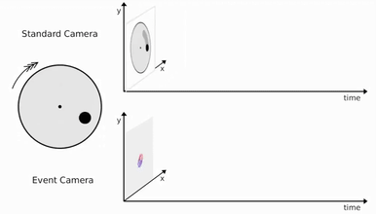
Advantages of Event-based Cameras
Low-energy consumption
High speed – no motion blur
RGB Camera
Event Camera
Video credit: https://dioramslam.com/2021/10/08/event-cameras/
Notes:
Second, event camera works with very high speed. Again with this disk, if you rotate it super fast, RGB cameras suffer from motion blur in each frame, while event cameras still capture continuous events with no noise. They are robust to the speed of the target object

Slide 7
Advantages of Event-based Cameras
Low-energy consumption
High speed – no motion blur
High dynamic range (HDR) – seeing in the dark/bright
RGB Camera
Event Camera
Video credit: https://dioramslam.com/2021/10/08/event-cameras/
Notes:
Finally, event cameras have a high dynamic range (HDR). They can see in the dark or bright environments. Here is a sidewalk captured by an RGB and an event camera at night. You can hardly see anything in RGB frames, while you still get useful signals in the events output

Slide 8
Research with Event-based Cameras
Commercialized in 2008
Lots of papers coming out from 2018
This paper studies event-based object detection
Speed is important in safety-critical scenarios, e.g., self-driving
Notes:
Event cameras are first commercialized in 2008. And from 2018, there are lots of research papers coming out applying it to many tasks, such as object recognition, detection, segmentation and so on

Slide 9
Related Works: Event-based Detection (EvDet)
Synchronous methods are current SOTA
Convert events within each time window to an “image”
Temporal information is important – recurrent modules
Perot, Etienne, et al. "Learning to detect objects with a 1 megapixel event camera." NeurIPS. 2020.
Li, Jianing, et al. "Asynchronous spatio-temporal memory network for continuous event-based object detection." TIP. 2022.
Gehrig, Mathias, and Davide Scaramuzza. "Recurrent vision transformers for object detection with event cameras." CVPR. 2023.

Slide 10
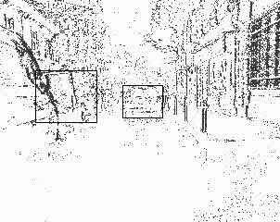
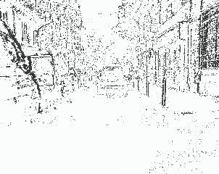
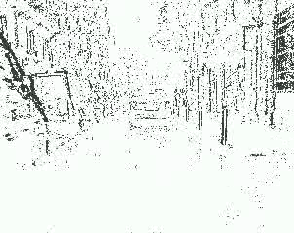
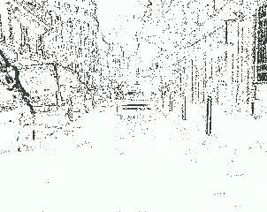
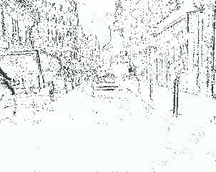
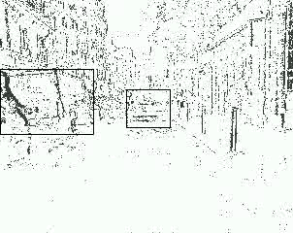
Task: Label-Efficient EvDet
Supervised methods are great, but it requires labels
Labeling ALL events (> 1000FPS) are costly!
Current datasets usually label at < 5Hz
Can we leverage unlabeled event data to improve performance?
Not used for training!
De Tournemire, Pierre, et al. "A large scale event-based detection dataset for automotive." arXiv preprint arXiv:2001.08499 (2020).

Slide 11
Related Work: Image Semi-supervised Detection
Setting: a small portion (5%) of images are labeled, while others are not
Common approach: online student-teacher learning
Xu, Mengde, et al. "End-to-end semi-supervised object detection with soft teacher." CVPR. 2021.

Slide 12
Related Work: Video Semi-supervised Detection
Event-based detection is closer to RGB video detection
Leverage temporal information to propagate labels
Yan, Pengxiang, et al. "Semi-supervised video salient object detection using pseudo-labels." ICCV. 2019.

Slide 13
Task: Label-Efficient EvDet
We propose two settings:
WSOD: all event streams are sparsely labeled (e.g. 1Hz)
SSOD: some are densely labeled (e.g. 10Hz), some are fully unlabeled
Current supervised EvDet actually belongs to WSOD
Weakly-supervised object detection (WSOD)
Semi-supervised object detection (SSOD)

Slide 14
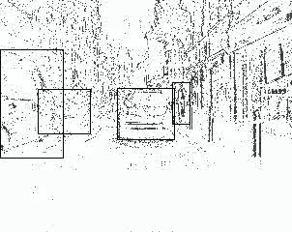
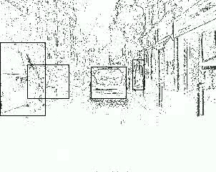
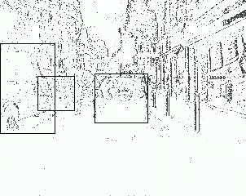
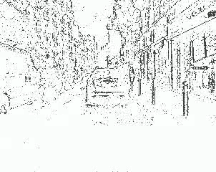
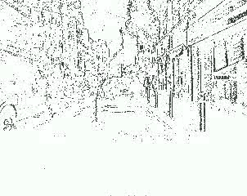
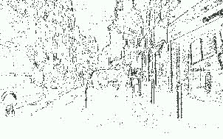
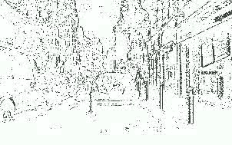
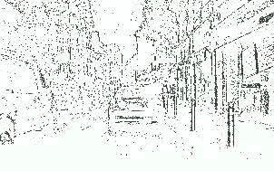
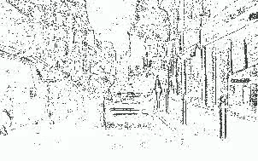
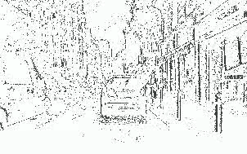
LEOD: Label-efficient Event-based Object Detection
LEOD: a unified self-training framework for both settings
Key: how to obtain reliable pseudo labels?
Event Stream with Limited Labels
Event Stream with Dense Labels
0
4
Pre-train
Detector
Re-train
Soft Anchor Assignment
3
1
2
TTA
Self-Label
Filter
Ensemble
Track
Unlabeled/Sparely-Labeled Event Stream
Pseudo-Labeled Event Stream

Slide 15
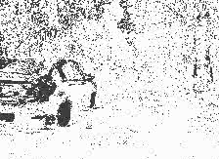
Towards Reliable Label Generation
Pre-trained detectors are weak, which miss lots of objects
We apply Test-Time Augmentation (TTA) to improve the recall
Horizontal flip
Time flip: robust to object motion
Forward
Backward

Slide 16
Towards Reliable Label Generation
We apply tracking to remove temporally inconsistent detections
Non-learnable, IoU-based inter-frame bbox linking (bi-directional)
However, it also causes false negatives
Bewley, Alex, et al. "Simple online and realtime tracking." ICIP. 2016.

Slide 17
Towards Reliable Label Generation
Finally, we remove predictions lower than a confidence threshold
However, we face a precision-recall trade-off
Empirically, a higher value is better. But this causes false negatives again!

Slide 18
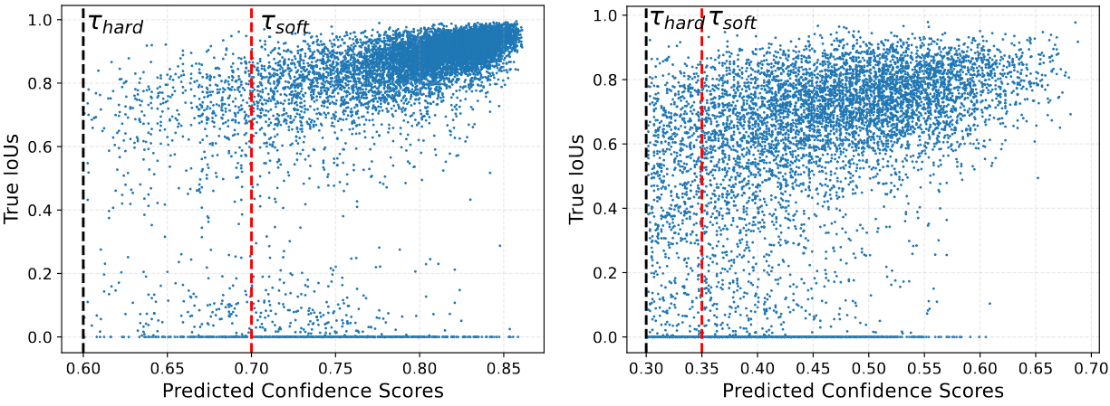
Robust Model Training
In detector training, people usually assign labels with a “margin”
E.g., GT with IoU > 0.5 are positive, < 0.4 are negative, others are ignored
Inspired by that, we design a soft anchor assignment strategy
Do not apply loss on removed-by-tracking or mid-confident boxes
Lin, Tsung-Yi, et al. "Focal loss for dense object detection." ICCV. 2017.

Slide 19
Experiments
Datasets: Gen1 & 1Mpx
Settings: WSOD & SSOD
Low-label: sub-sample 1%, 2%, 5%, 10% of the original labels
Full-label: all labels are provided (~10% on Gen1 and 50% on 1Mpx)
Model: RVT-S as our base model
Metrics: COCO-style mAP@[.5:.95]
Baselines:
Supervised Baseline: only trained on labeled data
Soft Teacher: adapted from the famous image-based method
Vanilla Self-Training: LEOD with naïve label filtering
Lin, Tsung-Yi, et al. "Microsoft coco: Common objects in context." ECCV. 2014.
Perot, Etienne, et al. "Learning to detect objects with a 1 megapixel event camera." NeurIPS. 2020.
De Tournemire, Pierre, et al. "A large scale event-based detection dataset for automotive." arXiv preprint arXiv:2001.08499 (2020).
Gehrig, Mathias, and Davide Scaramuzza. "Recurrent vision transformers for object detection with event cameras." CVPR. 2023.

Slide 20
Ablation Study
Setting: WSOD with RVT-S on both datasets
Each component improves mAP consistently
Gen1
1Mpx

Slide 21
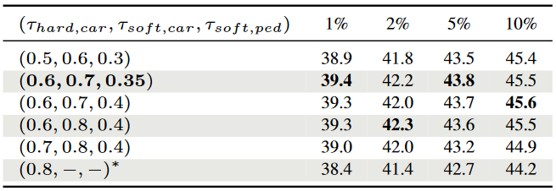
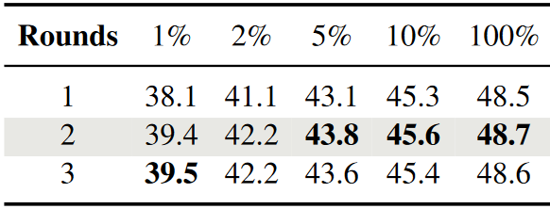
Ablation Study
Short Track Length
Setting: WSOD with RVT-S on Gen1
LEOD is robust to hyper-parameters
Confidence Thresholds
Self-training Rounds

Slide 22
Quantitative Results: Low-Label WSOD
LEOD outperforms baselines significantly
Soft Teacher does online self-training, thus missing temporal information
Cannot detect static objects & Too short to do tracking
Gen1 WSOD
1Mpx WSOD

Slide 23
Quantitative Results: Low-Label SSOD
LEOD is also the best on both datasets
SSOD results are much lower than WSOD (>5% on Gen1, >10% on 1Mpx)
We should prioritize the coverage of labels
Gen1 SSOD
1Mpx SSOD

Slide 24
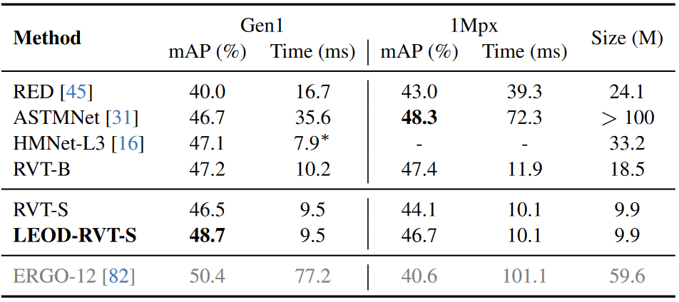
Quantitative Results: Full-Label
Even with 100% labels, LEOD still improves results
ERGO-12 uses large-scale pre-trained backbones + sophisticated training tricks

Slide 25
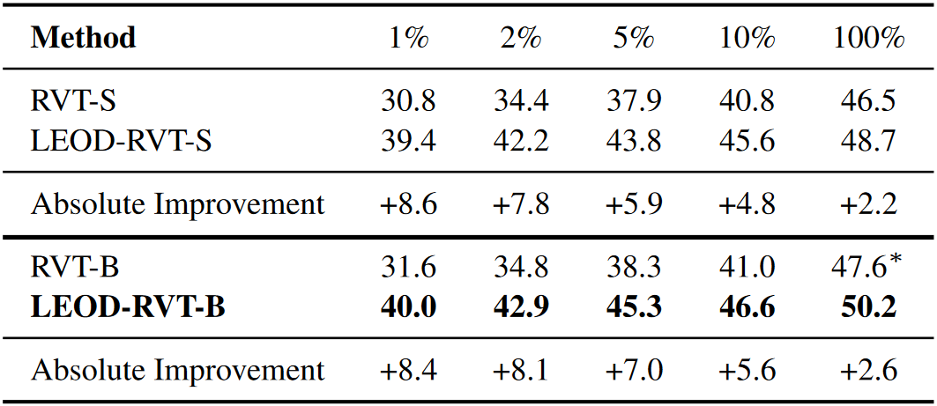
Quantitative Results: Scale Up the Detector
LEOD steadily scales to the larger RVT-B
The mAP improvement is even larger!

Slide 26
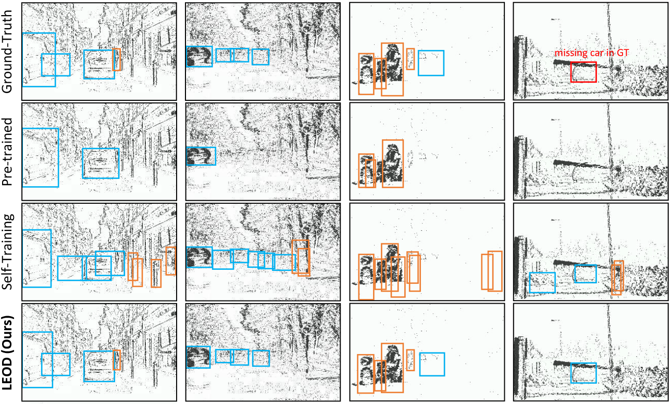
Qualitative Results

Slide 27
Conclusion
We introduce the task of label-efficient event-based object detection
LEOD is a unified self-training framework with reliable label filtering
Unlabeled events can significantly improve model performance
Future Works
Apply to asynchronous event-based detectors
Training on a mix of multiple datasets – follow the trend of VLMs

Slide 28
