Slide 1
BiDet: An Efficient Binarized Object Detector
Efficient inference: channel pruning, model quantization, etc.
Binary neural networks (BNNs), quantize weights and feature maps to $+1/−1$
Reduce the storage and computation by $32×$ and $64×$ respectively
Previous works focus on classification tasks
Near full-precision performance
We are the first to study BNNs for object detection
Object detectors are much “heavier”
Widely used on mobile devices
Binary Method | Top-1 Accuracy
2015 BNN | 42.2%
2016 XNOR-Net | 51.2%
2018 Bi-Real Net | 56.4%
2019 BBG | 59.4%
2019 CI-BCNN | 59.9%
2020 Real-to-Bin | 65.4%
FP-ResNet18 | 69.3%
Model | #Params(M) | MFLOPS
DenseNet161 | 28.68 | 7850
SSD300 | 26.30 | 31750
Faster R-CNN | 134.70 | 181120

Slide 2
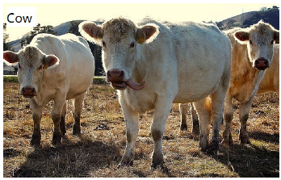
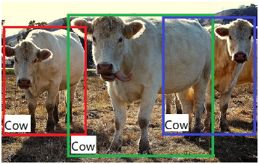
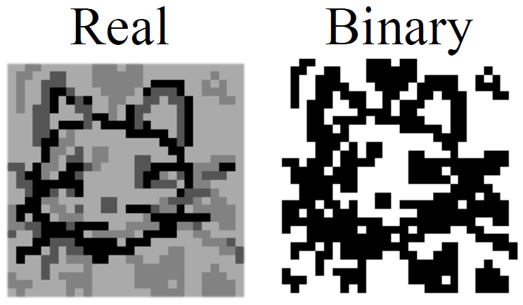
BNNs in Object Detection
Problems:
Simultaneously localize and classify
Requires pixel-level accuracy
BNNs binarize feature maps, harming representation capacity & resolution
Preliminary experiments: directly applying existing BNN methods degrades the performance significantly

Slide 3
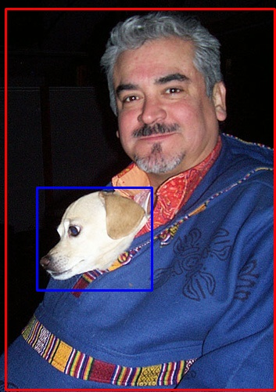
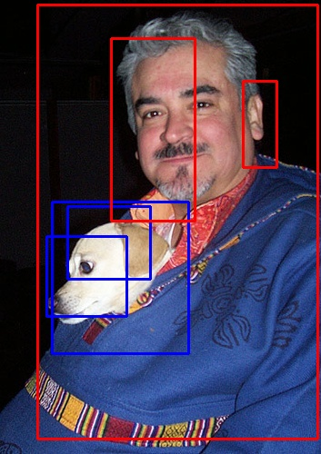
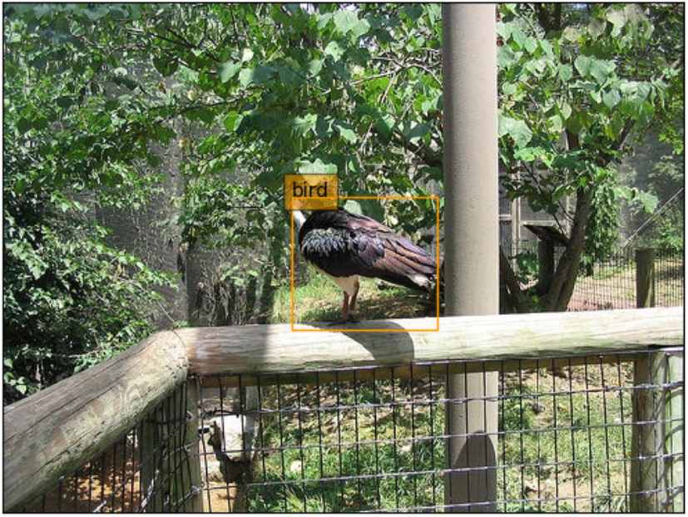
BNNs in Object Detection
False positives!
BNNs have limited representation capacity
There are redundancy in the intermediate feature maps
Limited power + redundancy = poor performance

Slide 4
Information Bottleneck (IB)
The IB principle
From information theory, originally used in data compression
Key effects: removing redundant, keeping important
Re-formulate object detection as a Markov Chain
$I(F;C, L)$ is simply the detection loss
$I(X;F)$ is similar to a regularization term

Slide 5
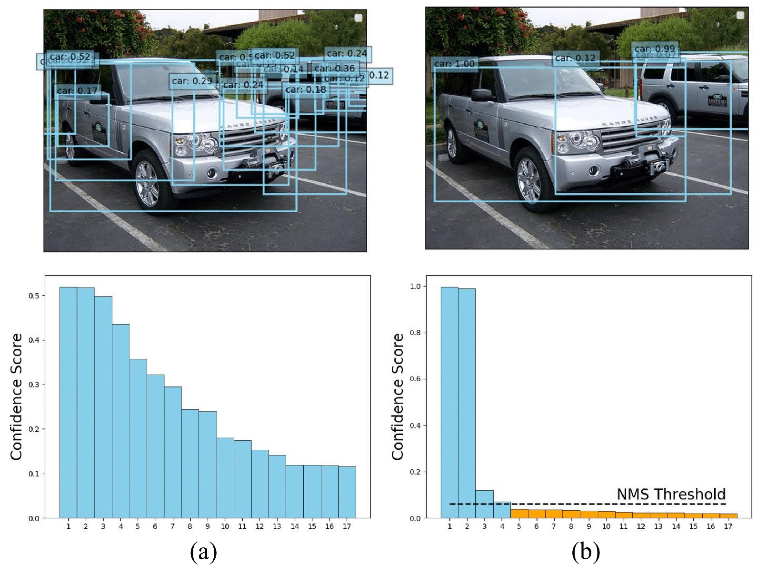
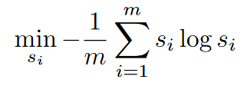
Sparse Object Priors (SOP)
IB is not enough, after all, it’s a theoretical method
The false positives:
Box prediction ambiguity
Enforce sparsity by entropy
Increase the contrast between scores
Low score boxes eliminated by NMS

Slide 6
Experiments
BiDet is a plug-and-play training strategy for binary detectors
IB, SOP
We incorporate it with existing BNNs methods
BNN, Xnor-Net, Bi-Real-Net
Adopt two detectors
SSD300 w/ VGG backbone, Faster R-CNN w/ ResNet-18 backbone
Test on two large scale datasets
Pascal VOC, Microsoft COCO

Slide 7
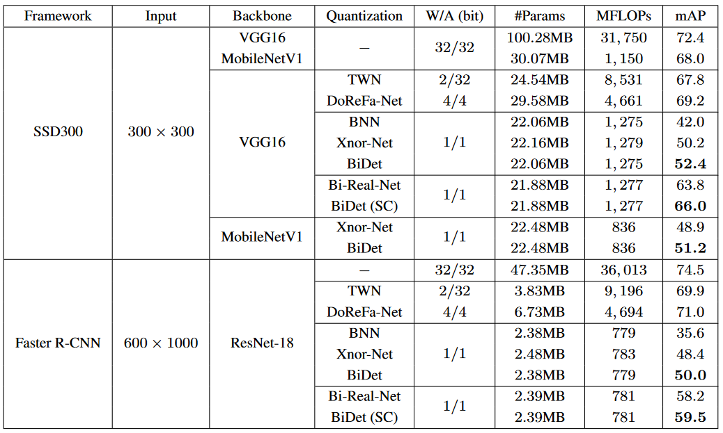
Pascal VOC
~5$×$
~25$×$
+2.2
+2.2
~20$×$
~46$×$
+1.6
+1.3

Slide 8
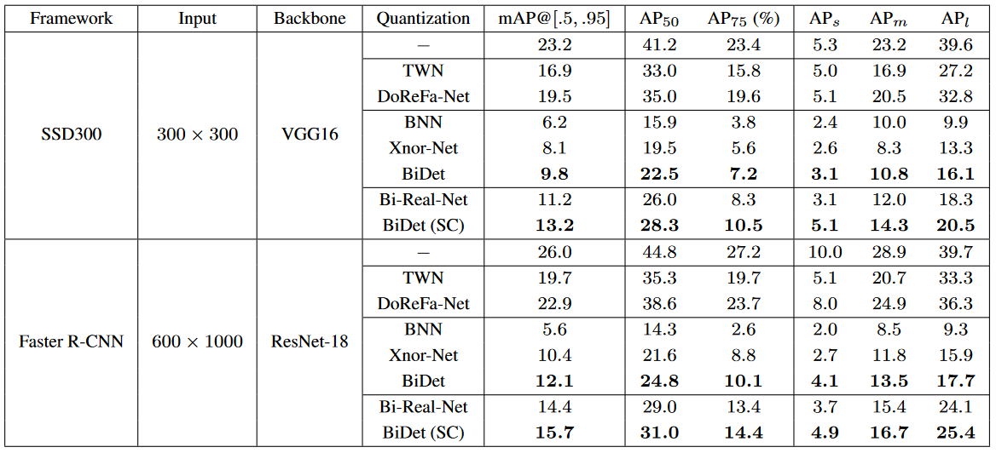
MS COCO
Consistently improve the AP
Performance gap is larger here
+1.7
+2.0
+1.7
+1.3

Slide 9
BiDet Visualizations

Slide 10
Summary
Apply BNNs to the object detection task
Employ the IB principle for redundancy removal
Leverage the SOP to eliminate the false positives
Reduce the model size and computation cost by more than 10$×$
Boost the performance compared to existing BNNs methods on two datasets
Paper accepted by CVPR’20

Slide 11
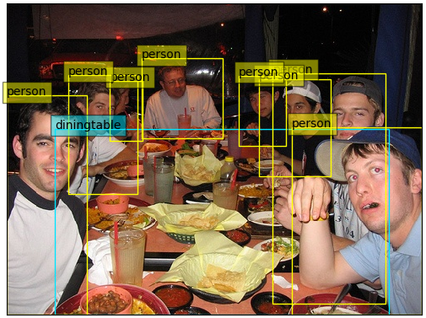
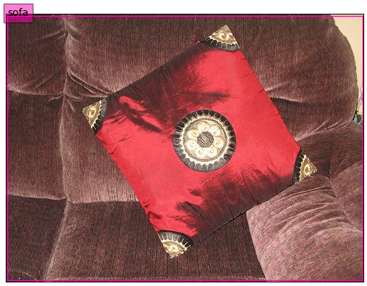
AutoBiDet
Improved version of BiDet, accepted by T-PAMI
Automatically adjust the IB trade-off ($β$) according to input
Measured by a GAN-like module

Slide 12
AutoBiDet
Class-aware SOP (C-SOP)
Different number of GT objects in an image
Weaker for dense class, stronger for sparse class
Extend the techniques in AutoBiDet to other efficient inference methods
Pruning, quantization, lightweight architecture design
Also improve their performance!

Slide 13
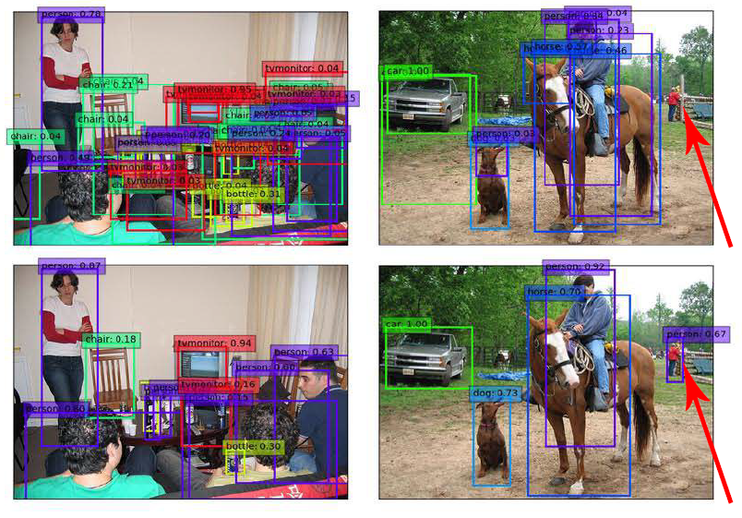
AutoBiDet Visualizations
Less false positives
Improve recall
Retain missed objects

